Slide 1
ADVANCEMENT TRACKING
Lake Minnetonka District 2018

Slide 2
How do your leaders, you & your scout keep track of your Scouts achievements?

Slide 3
HANDBOOKS

Slide 4
Charts

Slide 5
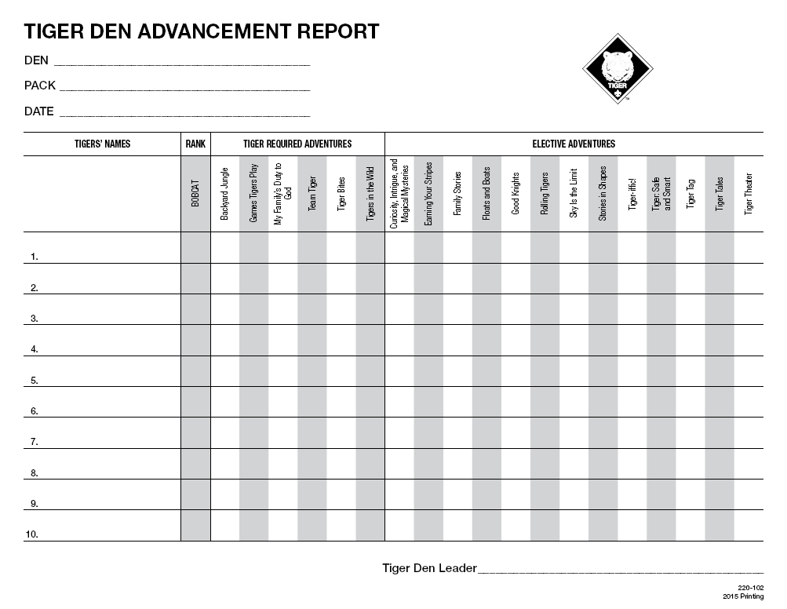
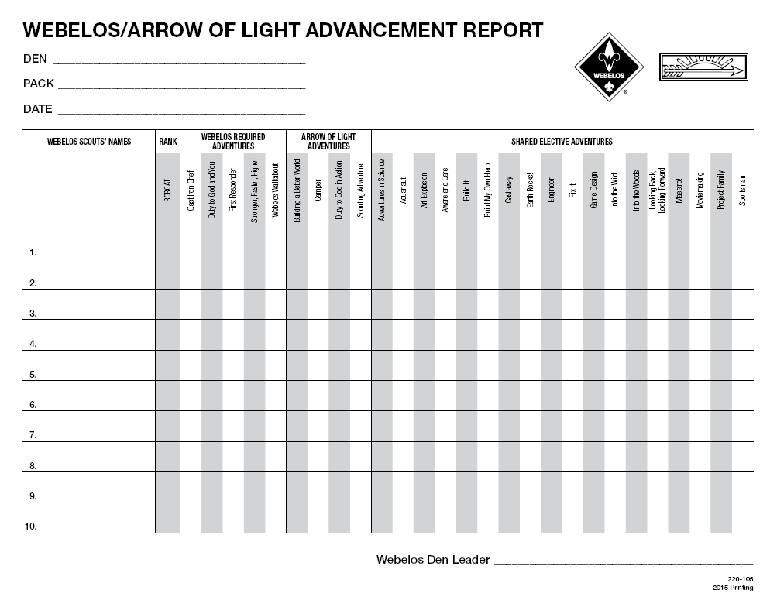
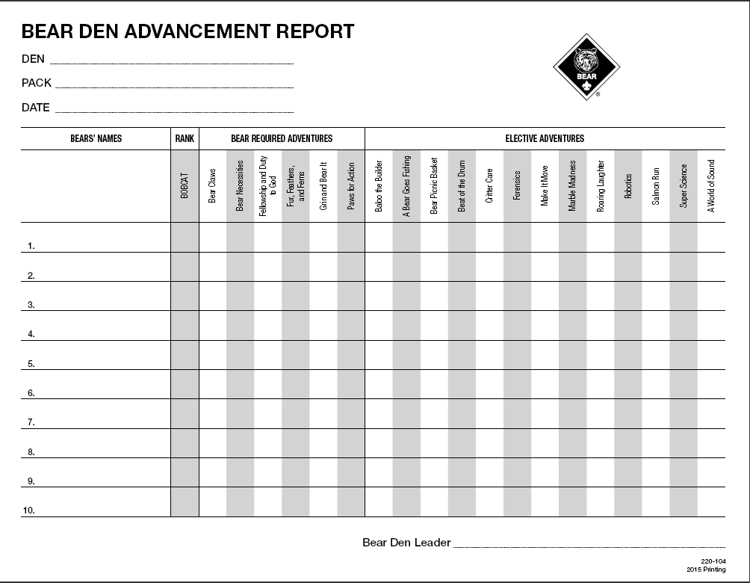
FORMS

Slide 6
Online Tracking Tools
ONLINE TRACKING TOOLS

Slide 7
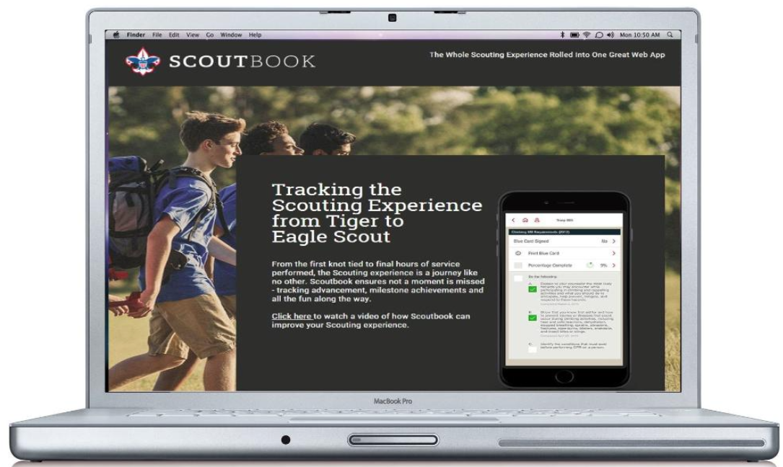
SCOUTBOOK: TRACK FROM LION TO EAGLE
Notes:
SCOUTBOOK is one of the best ways for our Leader and Parents to track the Scouts progress!
Many of the things you do at den meetings or activities, scout camp, or during the summer can count toward your rank achievements and electives.
Your leader, Parents and your scout can check them off as you go!
It will tell you exactly what he has earned and his progress towards his achievements!
See Den Activities & Home Work Assignments
Calendar Events
Message Fellow Scouts
Create purchase orders for your Advancement/Award Chair

Slide 9
www.scoutbook.com This is where I would go online live and demonstrate the following: Dashbboard, Advancement, Recording Requirements/Awards,Calendar Reports,
Notes:
SCOUTBOOK is one of the best ways for our Leader and Parents to track the Scouts progress!
Many of the things you do at den meetings or activities, scout camp, or during the summer can count toward your rank achievements and electives.
Your leader, Parents and your scout can check them off as you go!
It will tell you exactly what he has earned and his progress towards his achievements!
See Den Activities & Home Work Assignments
Calendar Events
Message Fellow Scouts
Create purchase orders for your Advancement/Award Chair

Slide 11
CALENDAR

Slide 12
BENEFITS OF SCOUTBOOK
Track Scout Achievement's
Assign Den Activities
Up Date Calendar
Message Leaders, Parents, & Fellow Scouts

Slide 13
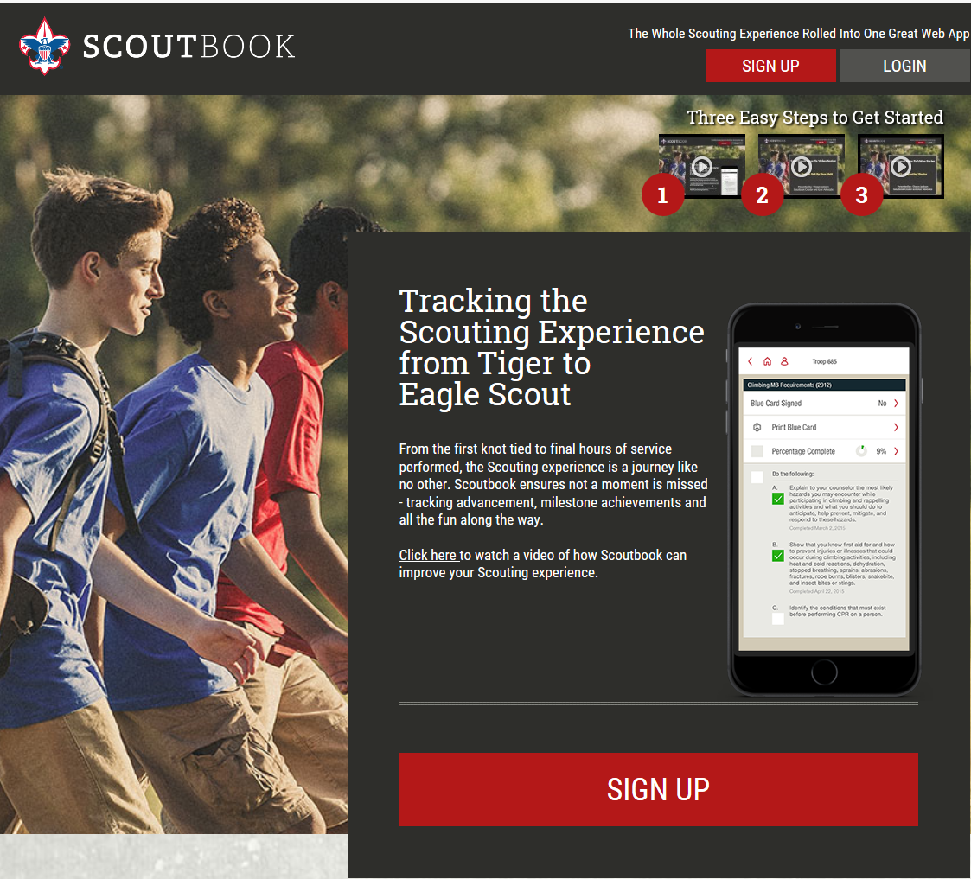
SIGN UP!!
https://www.scoutbook.com/

