Slide 2
Emily
Notes:
Introduction
“Hello, my name is_____.”
I’m here today to talk to you about exploring your world.

Slide 3
Emily
Notes:
Introduction
“Hallo! Ich heiBe.”
I’m here today to talk to you about exploring your world.

Slide 4
Notes:
So what exactly do we mean by “Your World?”...

Slide 5
Notes:
Are we talking about the planet?...

Slide 6
Notes:
Or maybe the people?...

Slide 7
Notes:
Or are we talking about your own world?

Slide 8
Notes:
Actually, we’re talking about ALL OF THE ABOVE. Because “Your World” is an increasingly interconnected and interdependent place.

Slide 9
Notes:
But what exactly do we mean by interconnected? Why is this so significant?

Slide 10
Notes:
Let’s consider a real world example. What do you see when you look at this hoodie?

Slide 11
Notes:
You were probably thinking that you saw a basic gray hoodie.
But in reality, this simple sweatshirt represents the coming together of various products and special skill sets from numerous countries and cultures.
Think about that.
If this basic hoodie represents interdependency between 5 countries, how many countries and cultures are represented in your whole outfit?

Slide 12
Notes:
But interconnectivity doesn’t just apply to consumer goods...

Slide 13
Notes:
...interconnectivity also impacts the job market. So much so that today, 1 in 5 U.S. jobs is tied to international trade, and countless other jobs require intercultural skills.
And that’s only going to increase in the coming years.
Take a look around the room.
How many of you will be working in a globally relevant job 10 to 15 years from now?

Slide 14
Notes:
Global Interconnectivity also pertains to your social life.
There are 40 million foreign-born residents in the U.S., and that number is rising every day.
Going forward, how many of your friends, colleagues, neighbors, etc. will be from another country or culture?

Slide 15
Notes:
But the main point is this: as our world becomes more and more interconnected each year, increasingly, interconnectivity is going to influence what we have to do to thrive in the 21st century.

Slide 16
Notes:
So, how do you prepare for an interconnected future?
Through intercultural learning, which is basically the process of learning how to interpret other cultures, and discovering the large role culture plays in shaping our word.

Slide 17
Notes:
In this interconnected world, one thing we all have in common is culture.
But culture is also what sets us apart.
So to help us understand culture, before we dive into talking about it, let’s take a second to close our eyes and open our minds...
[students close their eyes]

Slide 18
Notes:
Okay, now open your eyes and take a good look at the image in front of you.
What color are the zebra’s stripes?
[Students answer...]

Slide 19
Notes:
The answer? Neither!
One person could tell you they see white stripes on a black background, while another might see black stripes on a white background.
What determines how each individual responds is how they perceive the image - and everyone perceives differently.
THAT is what culture is all about.

Slide 20
Notes:
Now that we have a sense of what culture is and how it impacts us, let’s try to nail down an actual definition of the word. Surprisingly, finding a concise definition is not that easy...

Slide 21
Notes:
Ok, that’s a little better.
Culture is the collective programming of the mind which distinguishes the members of one human group from another, and is made up of...

Slide 22
Notes:
...Values, Behaviors, Beliefs and Attitudes.
These are the four main components of culture.
Now let’s think about some specific examples that fall within each of these categories.

Slide 23
Notes:
The food we choose to eat or not eat is an example of behavior.
In some cases, it’s also tied to our values or beliefs, such as the belief in Islam that pork is unclean and shouldn’t be eaten.
What are some other specific examples of values, behaviors, beliefs, and attitudes?

Slide 24
Notes:
The possibilities are almost endless, but here are some of the most popular examples.

Slide 25
Notes:
But do you see all of those things day to day?
When you meet new people, are you aware of the family roles they play, or the traditions they adhere to? Probably not.
Because culture is like an iceberg.
Without diving deep, you really only see the few aspects at the top.
And the most meaningful aspects often lie below the surface.

Slide 26
Notes:
But remember that everything we see - even the most obvious aspects of culture at the “tip of the iceberg” - gets filtered through our own lens of perception.
How we perceive things is shaped by our own culture and experiences.
So, in order to truly understand another culture, we need to alter our lens of perception by gaining new, cross-cultural experiences.

Slide 28
Notes:
So, let’s talk about where you can study abroad with AFS.

Slide 40
Notes:
At AFS, we believe that everyone who wants to study abroad should be able to. That’s why we offer a variety of merit- and need-based scholarships and fund-raising ideas.
Each year, AFS awards three million dollars in scholarships, supporting roughly 45% of our participants in their quest to see the world – regardless of their financial realities.

Slide 41
Notes:
The BP Global Citizens of Tomorrow Scholarship is both merit- and need-based, and offers the chance to study abroad in Brazil or India.

Slide 42
Notes:
AFS also offers three full, merit-based scholarships that are sponsored by the U.S. Department of State.

Slide 43
Notes:
Every year, AFS brings 2,000 high school exchange students to the U.S. to live with volunteer host families and attend local schools. Our host families open their homes to these international students — and can be met with life-changing experiences in return.

Slide 45
Notes:
When asked why they decided to welcome an exchange student, AFS Host Families gave lots of different answers. Can you think of some of the impacts hosting a student from another part of the world would have, either on you, your family, or the larger global community? Why is it important to bring someone of a different culture into our lives?

Slide 47
Notes:
Former Secretary-General of the United Nations, Kofi Annan said, “Young people should be at the forefront of global change and innovation. Empowered, they can be key agents for development and peace.” As future leaders, everyone in this classroom has the power to make a difference and develop creative solutions to address global issues.
Let’s take a look at how past winners of the Project: Change scholarship came up with original ideas to create change in the world.

Slide 48
Notes:
2016 Winner Sustainability in Guatemala: Erin and her friends empowered children to make educated decisions about their environmental impact.

Slide 52
Notes:
Now, it’s time to brainstorm your own volunteer project ideas.
First, let’s think of some of the major issues that people are facing in the world today. Some general topics to consider are education, health and nutrition, sustainability, arts and technology, or human rights and cultural understanding.
So, what are some global issues that you are passionate about? [students answer]
Now, what kind of student project could you create to help address these challenges? [students answer]
Those are some great ideas! Later, visit the AFS-USA website to do some research about your topic and which countries are most affected by it. Then put together a one minute video or 500-word essay explaining how your volunteer project would address this issue. You can present your idea to the class or submit it to the Project: Change contest for the chance to win a scholarsip!

Slide 55
AFS Jeopardy

Slide 56
Jeopardy Rules
Count off by 4 and form 4 groups
60 seconds to answer the question
If a team answers incorrectly, other teams can steal the question – fastest hand raised wins!
No need to gives your answer as a question

Slide 57
AFS Basics | Country Capitals | Did You Know…? | World Records | Misc.
100 | 100 | 100 | 100 | 100
200 | 200 | 200 | 200 | 200
300 | 300 | 300 | 300 | 300
400 | 400 | 400 | 400 | 400
500 | 500 | 500 | 500 | 500

Slide 58
AFS Basics - 100
True or False: You must have studied at least two semesters of a foreign language in order to study abroad with AFS for a year.

Slide 59
AFS Basics - 100
Answer: False! The majority of AFS study abroad programs have no language requirements at all.

Slide 60
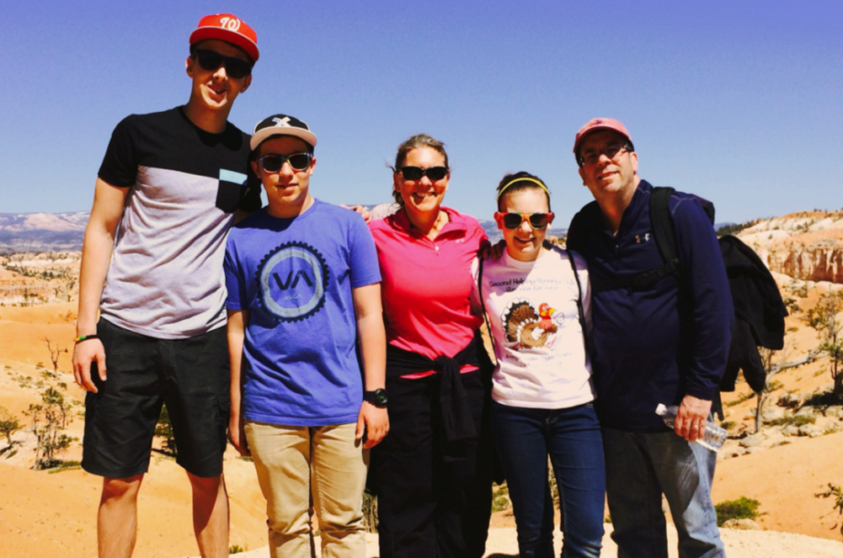
AFS Basics - 200
True or False: AFS Host Families receive a stipend for hosting an exchange student.

Slide 61
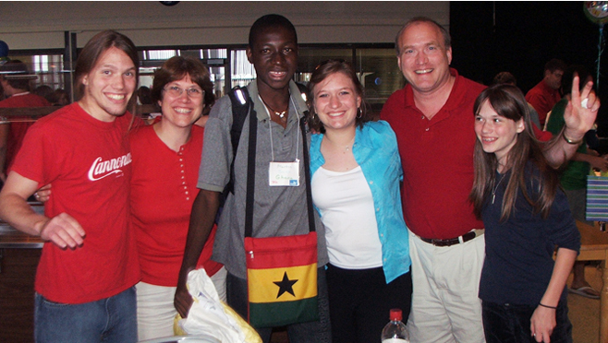
AFS Basics - 200
Answer: False! AFS Host Families volunteer to host students.

Slide 62
AFS Basics - 300
True or False: If your family goes on vacation while hosting an AFS exchange student, your family must also pay for the exchange student to go with you.

Slide 63
AFS Basics - 300
False! AFS Host Families may choose to cover the cost, or they can ask their host student to help pay his or her own way.

Slide 64
AFS Basics - 400
True or False: AFS is a leader in the international high school exchange industry. This means that AFS has no programs available for students who are older than age 18 or are high school graduates.

Slide 65
AFS Basics - 400
False! Many AFS Partner Countries will accept students who are over age 18 or are graduates. AFS also offers Gap Year programs.

Slide 66
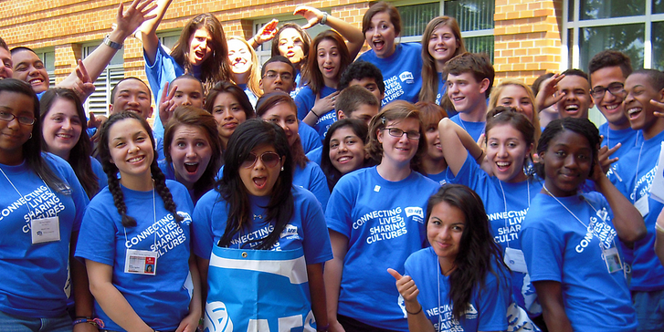
AFS Basics - 500
From which country can you host an AFS exchange student for second semester ONLY?
Argentina
Germany
Malaysia
Russia

Slide 67
AFS Basics - 500
C. Malaysia
Because of the way the Malaysian school year is set up, Malaysian AFS students can only study abroad from January-June.

Slide 68
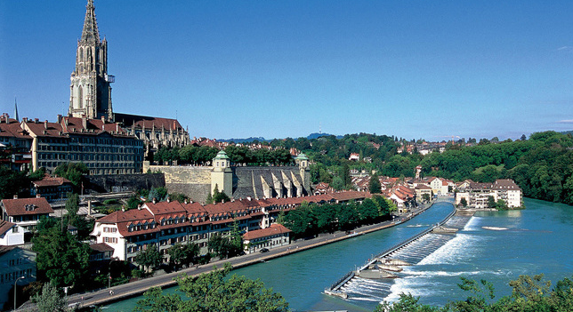
Country Capitals – 100
Bern

Slide 69
Country Capitals – 100
Bern, Switzerland

Slide 70
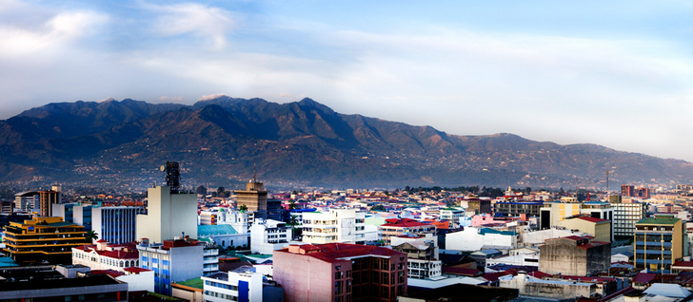
Country Capitals – 200
San Jose

Slide 71
Country Capitals – 200
San Jose, Costa Rica

Slide 72
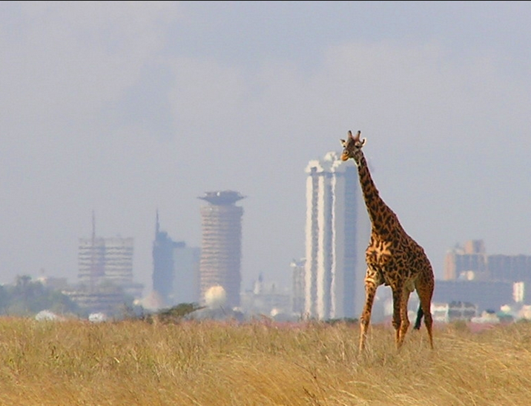
Country Capitals – 300
Nairobi

Slide 73
Country Capitals – 300
Nairobi, Kenya

Slide 74
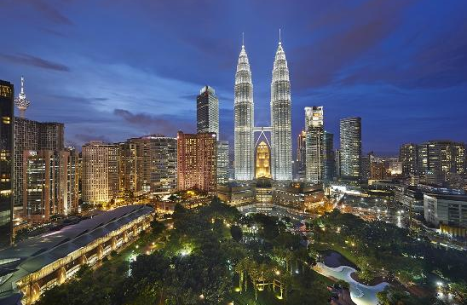
Country Capitals – 400
Kuala Lumpur

Slide 75
Country Capitals – 400
Kuala Lumpur, Malaysia

Slide 76
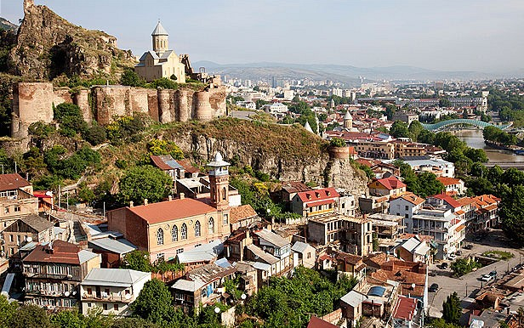
Country Capitals – 500
Tbilisi

Slide 77
Country Capitals – 500
Tbilisi, Georgia

Slide 78
Did You Know? - 100
22 year-old Mario Götze scored the only goal in the final match of the 2014 FIFA World Cup, leading this country to victory.

Slide 79
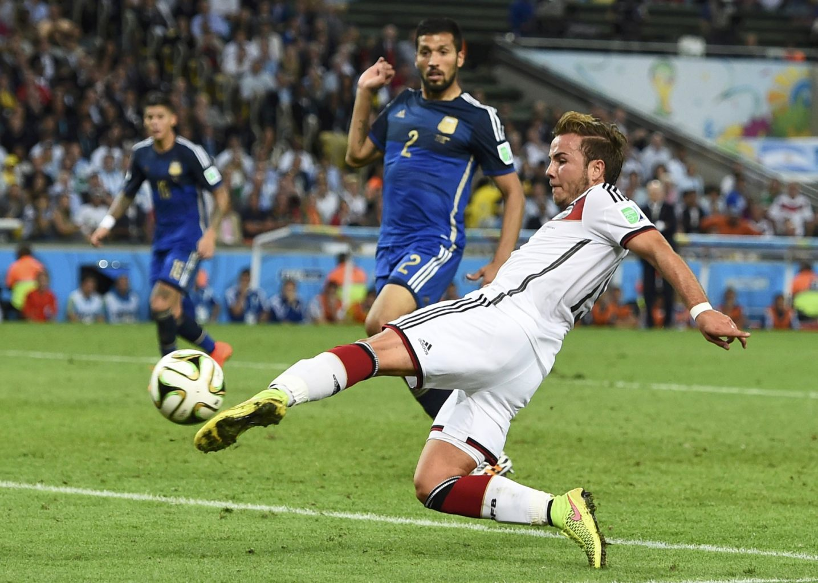
Did You Know? - 100
Answer: Germany

Slide 80
Did You Know? - 200
There are about 450 types of cheese in the world. About how many come from France?
175
250
100
210

Slide 81
Did You Know? - 200
B. 250
Each region of France produces unique types of cheese that can’t be recreated anywhere else in the world.

Slide 82
Did You Know? - 300
In which country are you least likely to meet your nearest neighbor?
Canada
Russia
Mongolia
Saudi Arabia

Slide 83
Did You Know? - 300
C. Mongolia
At 4 people per square mile, Mongolia is the least densely populated country in the world.

Slide 84
Did You Know? - 400
The word “ketchup” comes from the word “koetsiap”, which is what language?
Swedish
Malay
Ukrainian
Chinese

Slide 85
Did You Know? - 400
B. Malay
Koetsiap was originally an Asian fish-based sauce that came to Europe with Dutch traders in the 1600s.

Slide 86
Did You Know? - 500
This country has the world’s largest Muslim population.
Saudi Arabia
United States
Pakistan
Indonesia

Slide 87
Did You Know? - 500
D. Indonesia
Indonesia is home to over 200 million Muslims, which represent 88% of the country’s population.

Slide 88
World Records - 100
Which country is the world’s smallest permanently inhabited country?
Monaco
Liechtenstein
Vatican City
Andorra

Slide 89
World Records - 100
Monaco
Although the Vatican City is smaller than Monaco, it doesn’t have any permanent residences. Monaco is smaller than Central Park in NYC.

Slide 90
World Records- 200
The largest human national flag was created in December 2014 by over 40,000 people in this country.
United States
India
China
Brazil

Slide 91
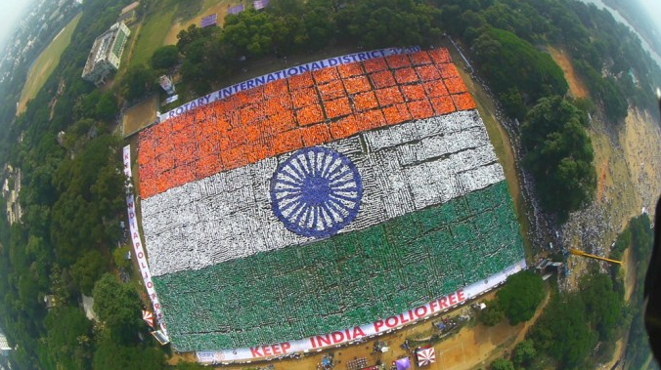
World Records- 200
B. India
It included over 50,000 participants.

Slide 92
World Records- 300
The world’s largest waffle, weighing just over 110 lbs, was created in June 2013 in this country.
Germany
Belgium
United States
Netherlands

Slide 93
World Records- 300
D. Netherlands
It weighed just over 110 lbs.

Slide 94
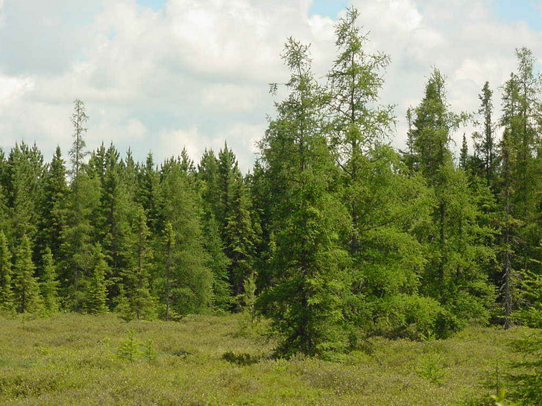
World Records- 400
Which country produces the most oxygen?
Brazil
Russia
Canada
China

Slide 95
World Records- 400
B. Russia
Siberia is home to approximately 25% of the world’s forests that span an area larger than the continental United States

Slide 96
World Records- 500
Where can you find the world’s oldest functioning bridge?
Rome, Italy
Varanasi, India
Damascus, Syria
Izmir, Turkey

Slide 97
World Records- 500
D. Izmir, Turkey
The Caravan Bridge crosses the Meles River in Izmir. It was built around 850 BC, which makes it more than 2,860 years old.

Slide 98
Miscellaneous– 100
Where were French Fries invented?
United States
Belgium
France
Sweden

Slide 99
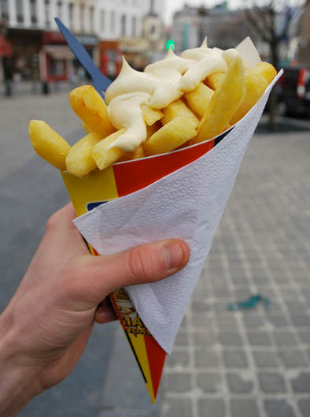
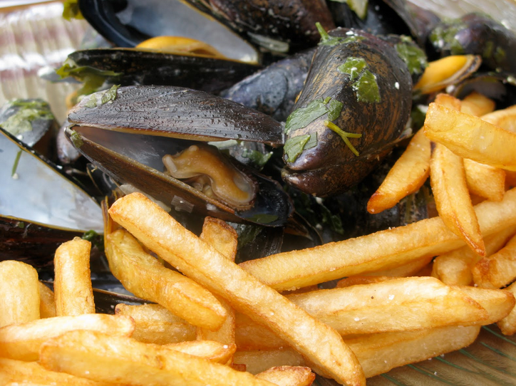
Miscellaneous– 100
B. Belgium
Fries are typically served with mayo or are eaten with mussels.

Slide 100
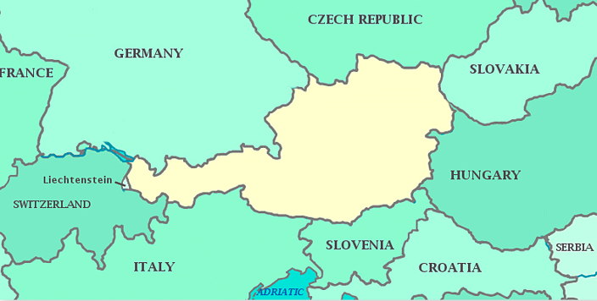
Miscellaneous– 200
Which country is this?

Slide 101
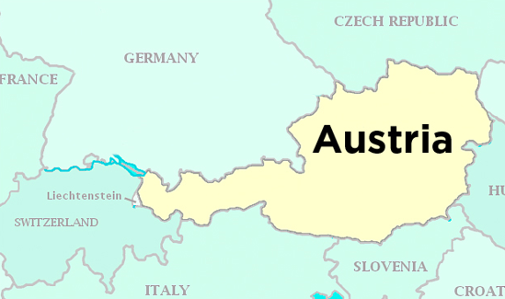
Miscellaneous– 200
Austria

Slide 102
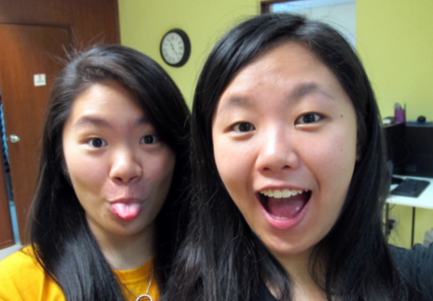
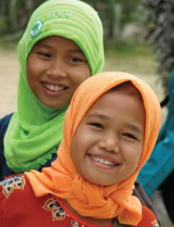
Miscellaneous– 300
If the world was made up of just 100 people, how many would be considered Asian?
30
60
34
12

Slide 103
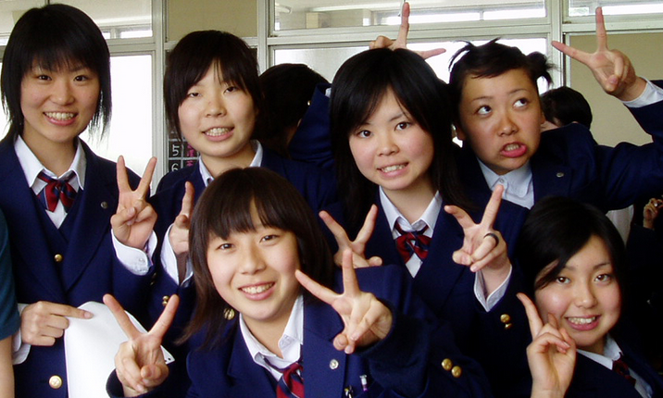
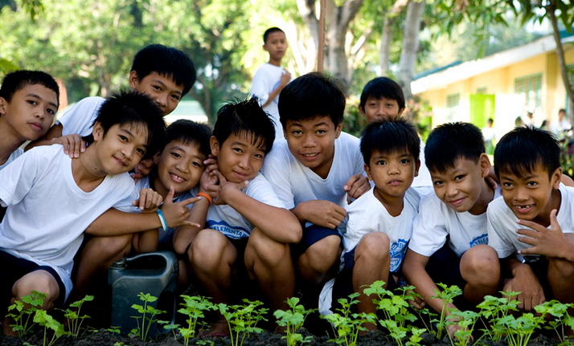
Miscellaneous– 300
B. 60
The 10 nations with the largest population size are all in Asia.

Slide 104
Miscellaneous– 400
Where were Legos invented?
United States
Denmark
Germany
Sweden

Slide 105
Miscellaneous– 400
B. Denmark
The word “lego” is a contraction of the Danish words “leg godt”, which translates to “play well.

Slide 106
Miscellaneous– 500
This country consumes more coffee per person than anyone else in the world.
Italy
France
Finland
United States

Slide 107
Miscellaneous– 500
C. Finland
Finns drink an average of 26.5 lbs of coffee per person, per year.

