Slide 1
Cheapskate’s Guide to Camping Equipment
WINTER EDITION

Slide 2
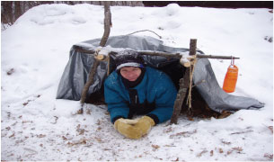
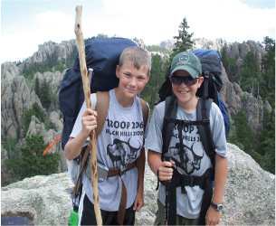
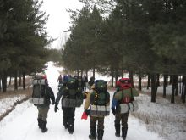
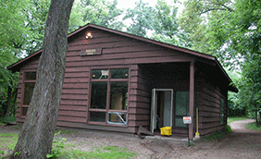
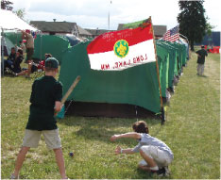
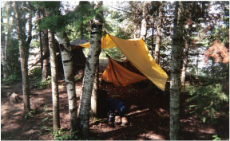
Camping Options – Year Round!

Slide 3
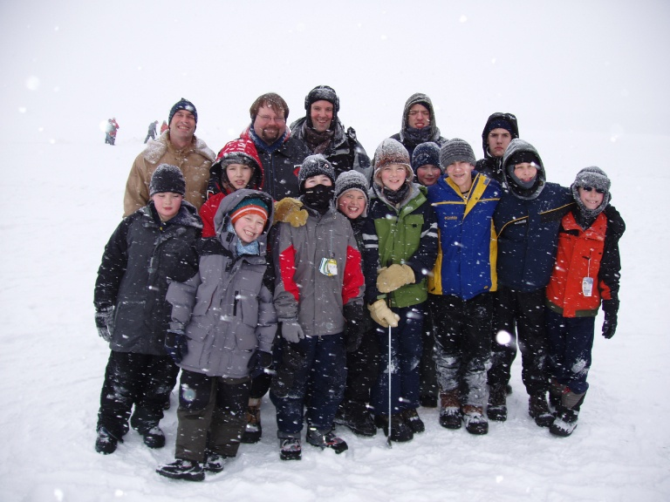
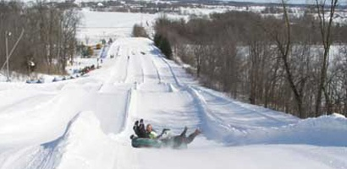
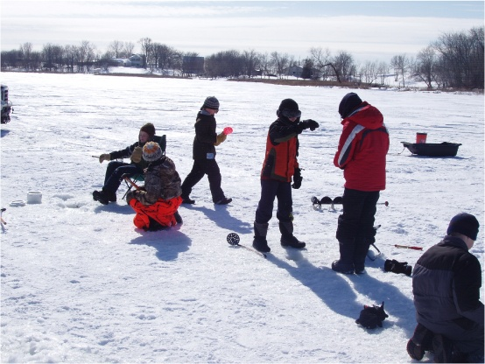
Winter Activities
Sledding
Football
Broomball
Tubing
Fishing

Slide 4
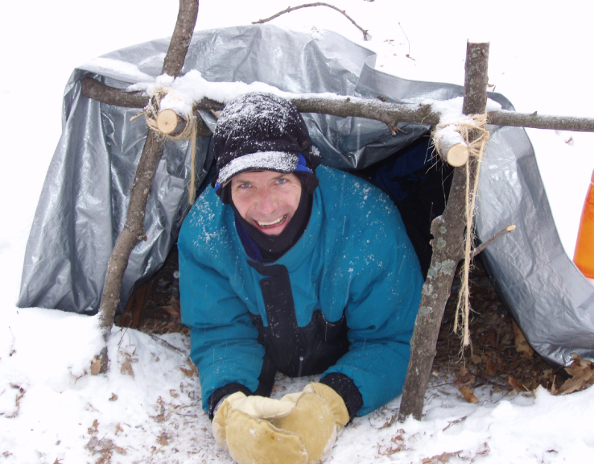
Winter Camping

Slide 5
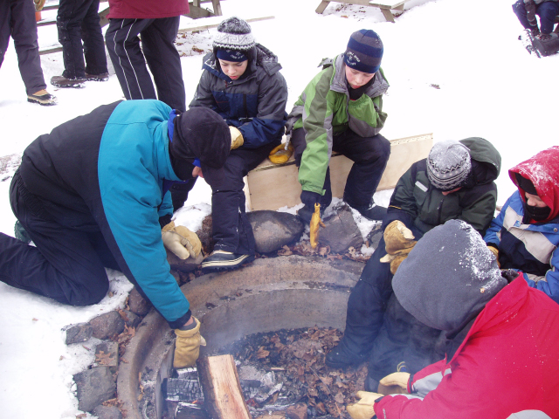
Thawing oil for Cobbler! Really!
Cans & eggs froze too! -25 actual temp

Slide 6
Safety (Sweet 16)
Qualified supervision
Physical fitness
Buddy system
Safe area or course
Equipment selection and maintenance
Personal safety equipment
Safety procedures and policies
Skill level limits
Weather check
Planning
Communications
Permits and notices
First aid resources
Applicable laws
CPR resource
Discipline

Slide 7
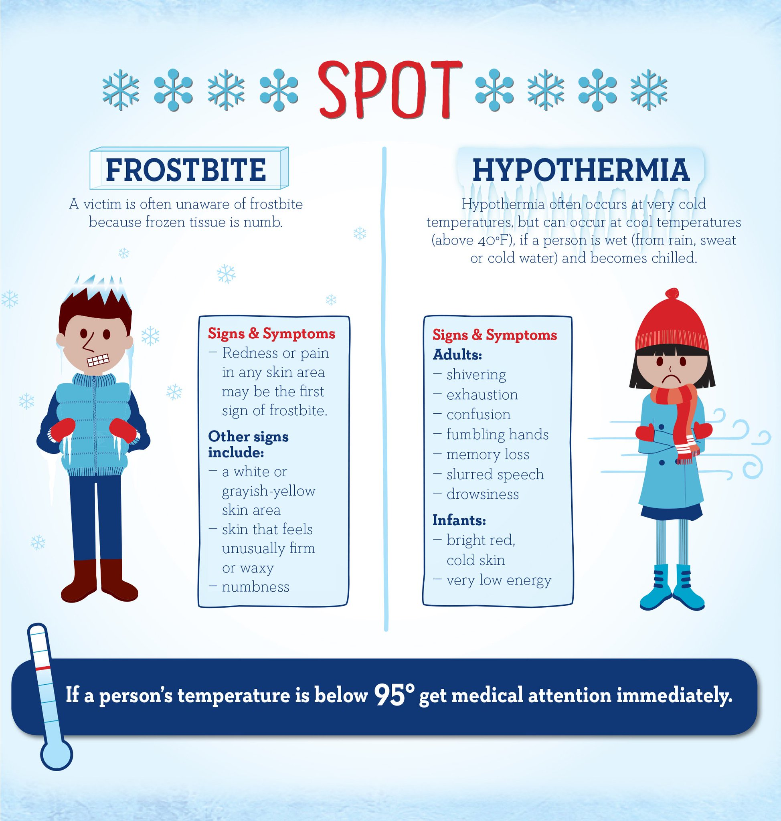

Slide 8
Winter Camping Preparation
Winter Camping does require specialized gear, but it doesn’t have to be expensive if you understand what is necessary.
The essence of staying warm is having proper layers and knowing how to use them effectively.
Clothing, boots, gloves or sleeping bags do not generate heat. They keep you warm by trapping air heated by your body.
Layering is the management of insulation to reduce the conduction of heat through air spaces trapped by garments or other personal equipment.
The trick is to balance body heat generation (which varies with physical activity) with layers to minimize heat loss and avoid perspiration.

Slide 9
Winter Material Basics
Wool: Wool is a natural fiber that traps a large amount of air for insulation and maintains insulation even when wet.
Pile or Fleece: Synthetic material made of plastics that are similar to wool in insulation. However, they have poor wind resistance and a shell (vapor barrier) is usually required.
Down: Feathers are a very efficient insulator providing excellent dead air space for very little weight. However, once wet, feathers tend to clump and dead air space is reduced to the point where they no longer insulate.
Synthetic Fibers: Thinsulate/Primaloft, etc Use hollow plastic fibers similar to down to trap air. An advantage to these fibers is that they do not retain water so will still insulate after getting wet.

Slide 10
Layering
Base Layer lies against your skin and is primarily meant to provide the first layer of insulation and most importantly deal with moisture removal. No Cotton!! Long sleeve athletic clothes are great for this. Applies for legs, feet (sock liners) and hands too.
Insulating Layer(s) trap air which maintains body heat. Wool, “performance fleece” and down are excellent for this. A wool shirt or sweater, wool long johns, wool socks or wool gloves are ideal.
Protective Layer: outer layer that keeps base and insulating layers protected. This layer does not necessarily have to have insulation, but must trap and stop wind and external moisture. GORE-TEX®, nylon, and leather are all good options.

Slide 11
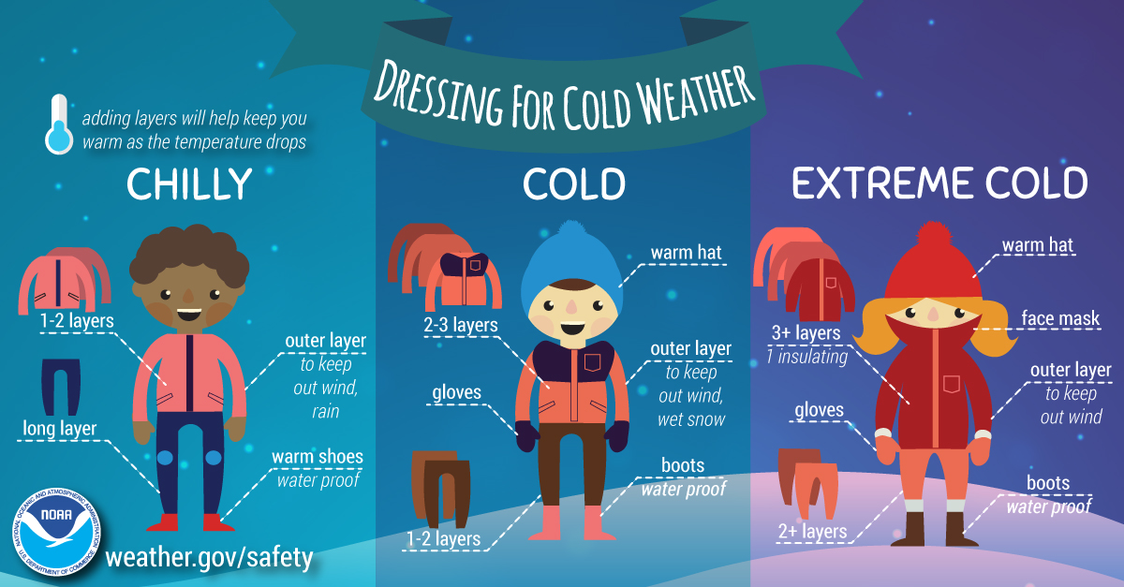

Slide 12
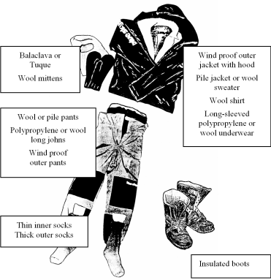

Slide 13
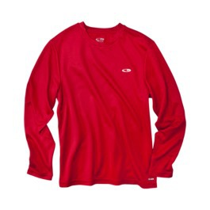
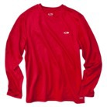
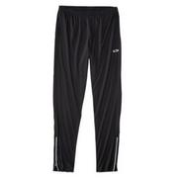
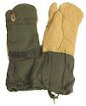
Low Cost alternatives
“Workout” shirts/pants for base layers
Military Surplus
Wool Field Pants ($15-$25)
Long Underwear ($10)
Wool Socks ($5)
ECWS
Parka (Goretex $50)
Gloves ($8 at Ripley)

Slide 14
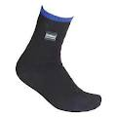
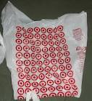
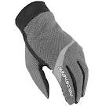
Low Cost alternatives
Footwear Liners – Outside of socks
Knock-off “Sealskinz” ($12 eBay)
Plastic bags for boot liners
Handwear
Lightweight runners gloves ($10)
Chopper Mittens ($15-$20)

Slide 15
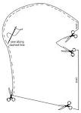
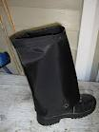
Low Cost alternatives
Make your own Balaclava and Gaiters

Slide 16
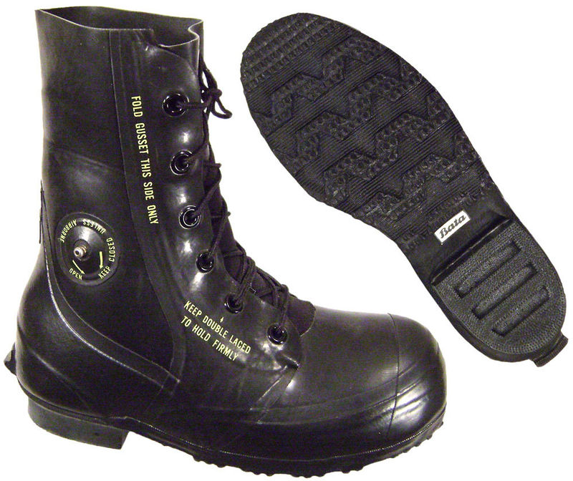
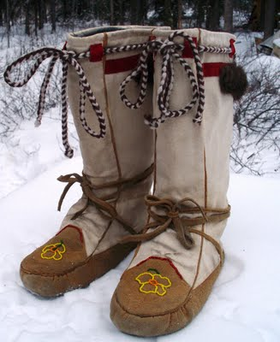
Low Cost alternatives
Boots
Military Surplus
“Mickey Mouse” ($40)
Mukluks
Make your own

Slide 17
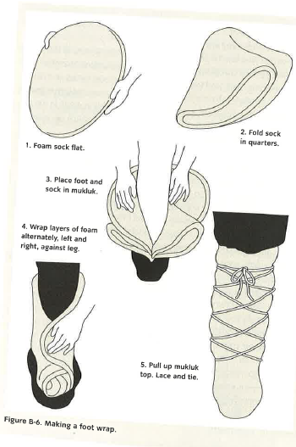
Make your own foam footwraps.
Use 2 open celled 1” foam circles (about 3 1/2’ in diameter)
Fold foam circle in quartes
Insert foot with socks inside one of the foam sections with a single layer on bottom
Wrap alternating left & right until foot is covered.
Finish with nylon or canvas cloth wrap and laces to keep wrap firm.
Unfold and dry the foam every couple of days as needed.

Slide 18
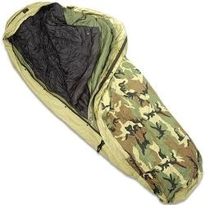
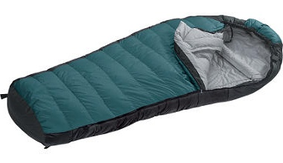
Sleeping Bags
What makes a good winter bag?
Rating as low as -40
Mummy vs Rectangular
Down vs Synthetic
Use multiple bags
Don't use air mattress

Slide 19
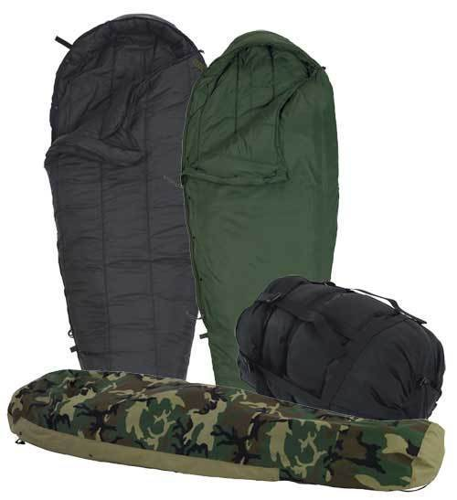
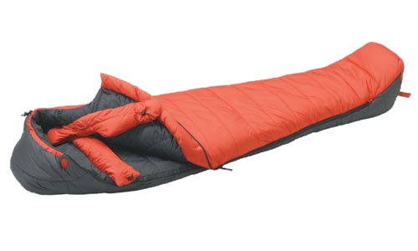
Low Cost Sleeping “Systems”
Use multiple “Medium bags”
Military Surplus ex: ECWS = $70
Insulated Pads (Lawn Furniture cushion)
Wear dry insulating layers in bag
Include Hat, leave space to exhale
Make your own bag

Slide 20
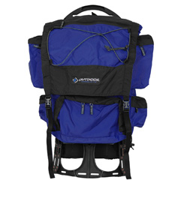
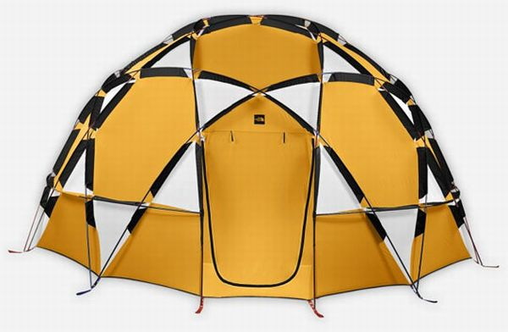
Low Cost Packs & Shelter
Packs –use same as summer, but organize your packing by specialty (group different layers, dry sleeping clothes, etc)
Campmor – Dragonfly $39
Tents – Specialized tents can be extremely expensive ($600-$2,000)– You don’t need one!
Build shelter with snow
Use tarp or natural materials

Slide 21
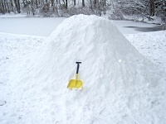
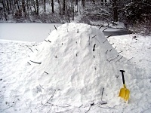
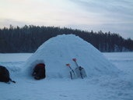
Quincee
Pile Snow into mound
5' – 6' high
Let sit for 1-3 hours
Insert sticks 12”
Hollow inside
Use candle to form skin
Don't forget to cover door

Slide 22
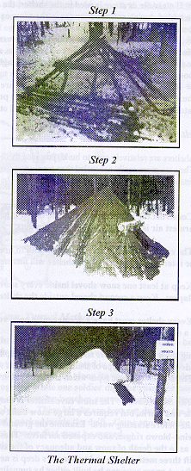
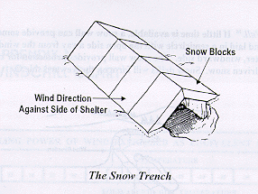
Thermal Shelter
Wood framework usually covered
By tarp and snow is piled on tarp.
Small enty (away from wind) to get
Inside shelter. Can sleep 6-8.

Slide 23
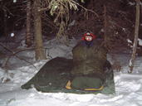
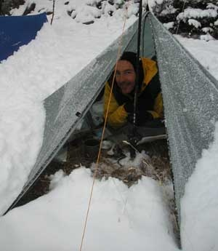
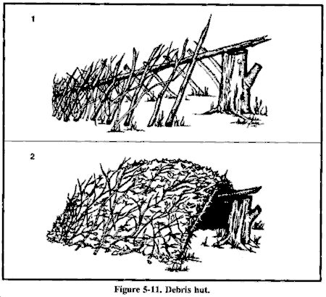
Shelters
Tarp & Lean-to Shelters

Slide 24
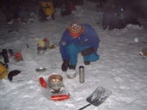
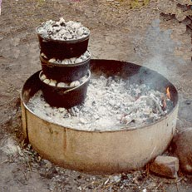
Food
Preparation
Ingredients will freeze
Need more time to cook
Have backup
Lots of hot beverages
Propane stoves may not work well
Colder temp = lower gas pressure
Plan on 2x normal use of propane
Dutch Ovens
Keep out of wind

Slide 25
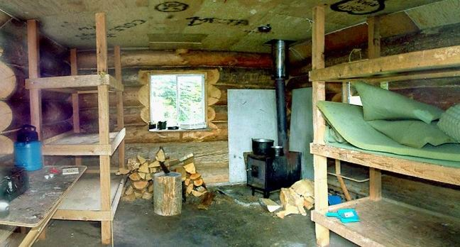
Backup – BE PREPARED
Preparation
Equipment demo at Troop meeting
Nobody sleeps outside w/o adult check
Bring Extra
Sleeping Bags
Gloves, Hats, Boots
Cabin Backup
Wood stove & fireplace for heat

