Slide 1
Cubs Can Camp Too!
January Round Table 2018
Julie Terpstra LMD

Slide 2
Cubs Camp
Why
When and Where
Who
How to plan
How to pack

Slide 3
Why Cubs Camp
One of the methods of Scouting
Advancement opportunities
Teaches life skills
Teaches self-reliance
Teaches how work together
Builds strong bodies (and tires/plays kids out)
Good for mental health
Combats Nature Deficit
WEBELOS transition aid

Slide 4
WHEN
POLAR CUB-RIGHT NOW!!!
Polar Cubs- Locations:
Phillippo Scout Reservation
Rum River Scout Camp
Stearns Scout Camp
Fred C. Andersen Camp
Dates:
Saturdays and Sundays
January 6-March 3
Polar Cubs is for the whole Pack starting with Lions Cubs and going through Arrow of Light Scouts. We also invite siblings to attend with their brothers. Cub Scout age siblings are invited and pay the same fee as their brothers. Siblings older than 5th grade should register as adults. Siblings under the age of 5 can tag along for free, and participate in certain activities that are age appropriate.

Slide 5
Activities Include
Tubing
Sled Chute- No Snow Needed!
Games
Animal Tracking
Kick Sleds- New for 2018
Stem Activities
Tomahawk Throwing
Much much more!

Slide 6
Start Planning for Cub Scout Summer Camp 2018
programs:
Tiger Day Camp (1 day)
Cub Scout Summer Camp
(3 days, 2 nights)
Arrow of Light Camp
(4 days, 3 nights)
LDS Day Camp (1 day)
Family Camp
(3 days, 2 nights)
Discovery Day Camp (5 days)
Registration opens
March 1st
Sterns
Tomahawk
Phillippo
Kiwanis
Base Camp
Rum River

Slide 7
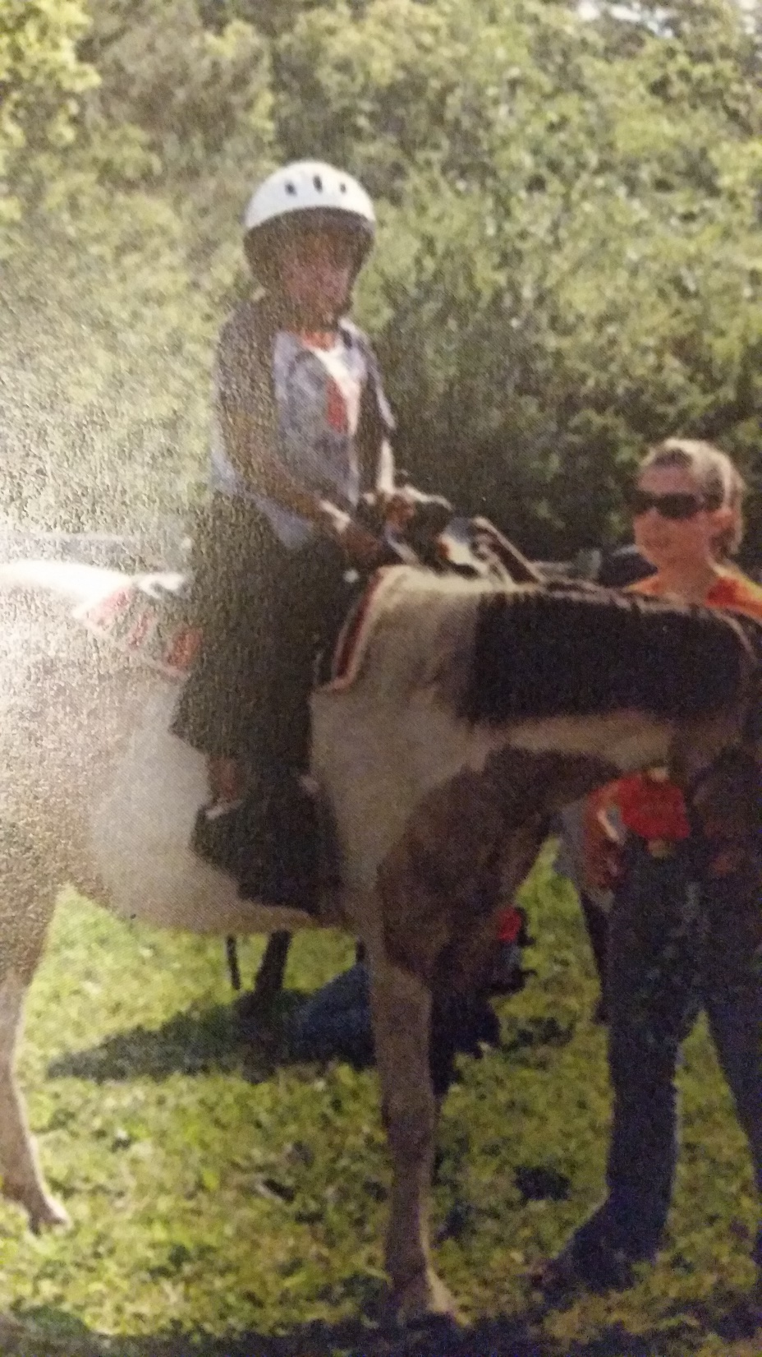
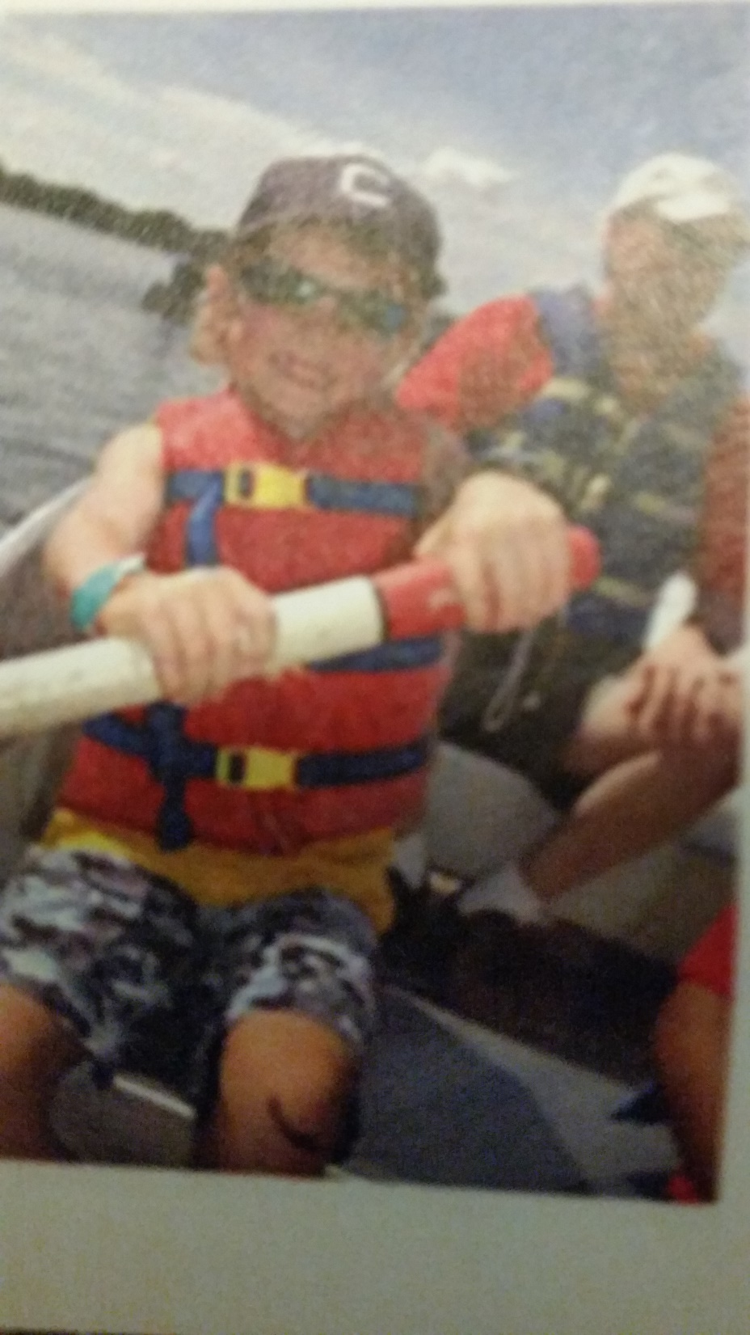

Slide 8
Fall Camps
Fall Day Camps
Saturdays and Sundays, day camp.
Stearns and Phillippo
September-October
Spook-O-Ree
Friday night to Saturday evening, over night.
Stearns- Mid October

Slide 9
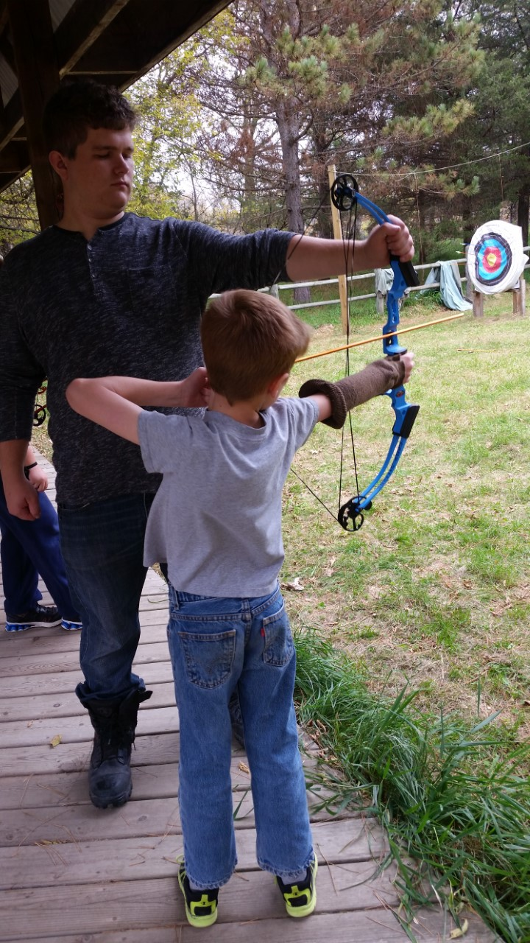
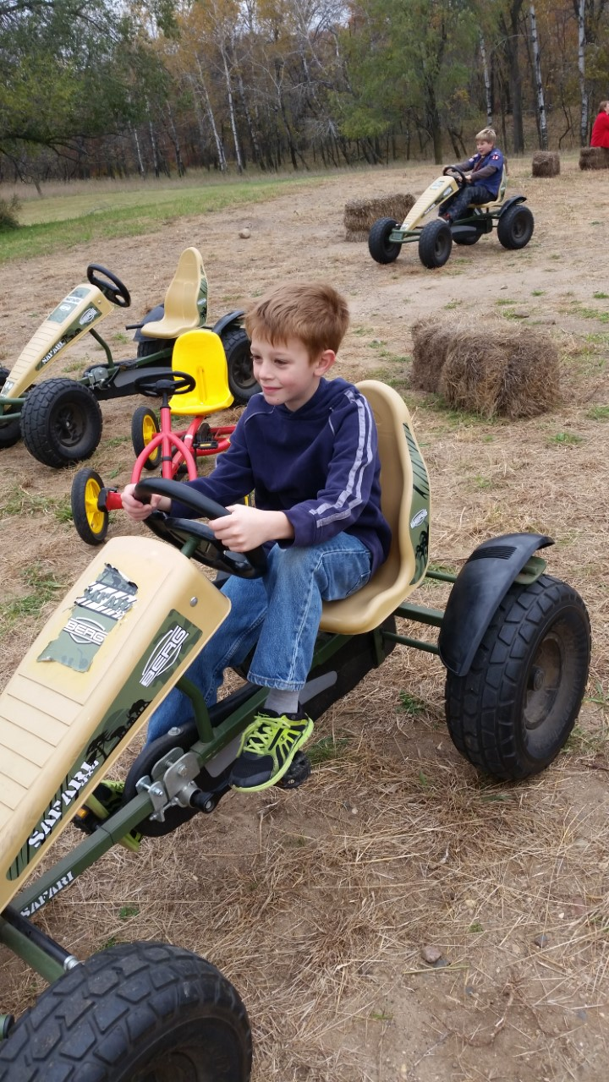
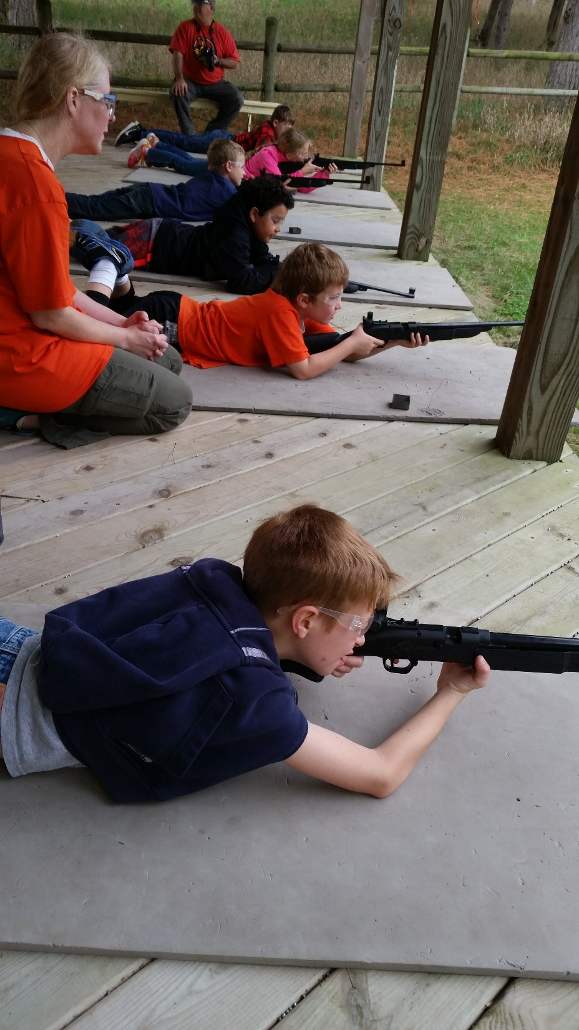

Slide 10
Who Goes to Camp YPT from the Safe Guide to Scouting
BSA Leadership Requirements . . .
Cub Resident Camp - Each Cub Scout must be accompanied by a parent or guardian (a 1:1 ratio).
Webelos Experience - One adult is necessary for every 4 Scouts (1:4 ratio)
Webelos at Camporee - Each Webelos Scout must be accompanied by a parent or guardian (a 1:1 ratio) when not attending with a troop. When attending with a troop, one adult is necessary for every 4 Scouts and two-deep "leadership" rules (2 adults) must apply at all times.

Slide 11
Who else goes to Cub Camp?
Families
Cub age siblings can participate
Girls can now be registered as Cubs
Sorry no Pets

Slide 12
Safety (Sweet 16)
Qualified supervision
Physical fitness
Buddy system
Safe area or course
Equipment selection and maintenance
Personal safety equipment
Safety procedures and policies
Skill level limits
Weather check
Planning
Communications
Permits and notices
First aid resources
Applicable laws
CPR resource
Discipline

Slide 13
HOW TO PLAN FOR WINTER OPPORTUNITIES
Get Ready!
Talk about what to wear for safe outdoor fun. Make simple lists; ask the Cubs to gather their own clothing and equipment, then ask the parents to check how they do against their packing list.
Do some simple short outdoor activities to try out gear. Maybe a winter hike, check out the county parks for naturalist led programs.

Slide 14
Teach C-O-L-D
Tell the Cubs this is what they teach the older boys at Winter Camp, and School and at OKPIK (BSA Northern Tier)
C is for Clean
O is for don’t Over Heat
L is for Loose Layers
D is for Dry

Slide 15
Stoke those Cub Furnaces
Feed for cold
High fats and Carbs
GORP and Trail mix for pocket snacks!
Hot Cocoa, Hot Cider, Hot Tang
Water, water, water!

Slide 16
Let’s look at packing lists…
Winter has it’s own set of rules
Boys can pack themselves as they get older
Parents should check what they pack against the list
Check out their Handbook
See sample lists

Slide 17
Hiking? Camping? Biking? Touring? When Planning any activity, plan to LNT
Remember your LNT…Leave No Trace
Plan Ahead and Prepare
Travel and Camp on Durable Surfaces
Dispose of Waste Properly- Pack it in- Pack it out!
Leave What You Find
Minimize Campfire Impacts
Respect Wildlife
Be Considerate of Other Visitors

Slide 18
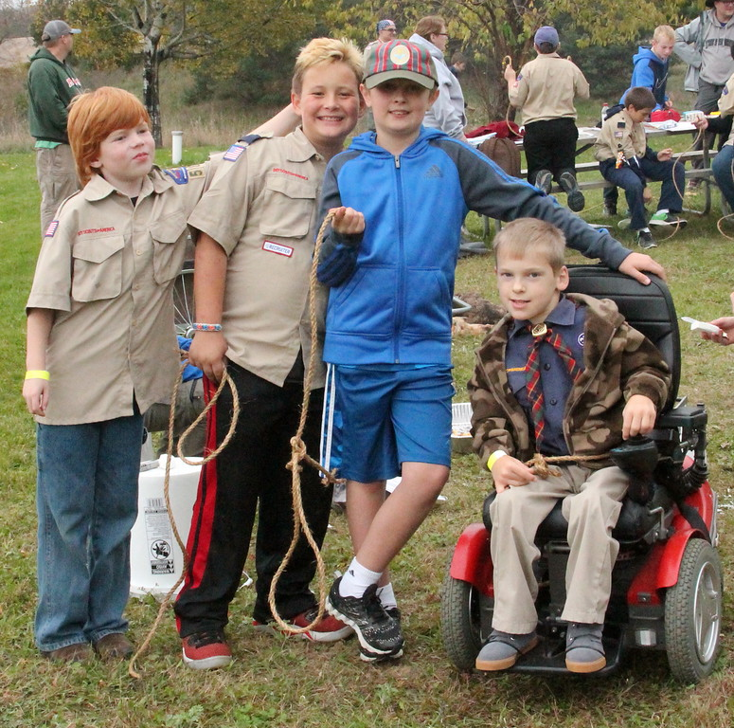
WEBELOS TRANSITION- Boy Scout Camporees

Slide 19
How to get your Pack on Board Start a Tradition!
End of the year is a great time for this, albeit weather doesn't always cooperate. You have all year to talk it up, and it gets folks in a mind set. Prepares for Council Summer and Fall Camp programs.
For a Pack Campout, start simple and local.
Be cool with folks wanting to just come for the day (but be sure their Cub sees your Cub’s tent and sleeping bag).
Make it a time for fellowship, have campfires, with skits (even a Leader skit) and share your camping knowledge.
You can be an Enabler! Don’t be a big know it all, that can be scary to non-campers as it highlights what they don’t know. KISMIF

Slide 20
Pack Family Campout

Slide 21
My Resources
50+ years of Camping and Hiking, and Hunting
30 years with BSA
National and Council Web sites
Guide to Safe Scouting
Leave No Trace
3 decades of BSA Training Syllabus’, Fast Start, National Training Center at Philmont, and Okpik/Northern Tier, NSC Winter Camp School
Trial and Error
Thank You for Listening!

