Slide 1

Welcome
Prospective Eagle Candidates.
Updated April 18, 2017
Notes:
Welcome to Eagle Preview. Before we get started I’d like the Advancement committee members to stand up and introduce themselves and share how long they have been active in the scouting program including time as a Scout….Wow lot’s of cumulative time supporting a great organization.
Who here is an Eagle Scout? Raise your hand. Very nice. Good. How many are Life scouts? How many of you are Star Scouts? Wonderful.

Slide 2
Eagle Preview Agenda
Requirement # 5 “The Service Project”
  Overview
  Proposal Process
  Project Plan – tips and suggestions
Next Steps (brief):
  Application Procedure
  Board of Review
Notes:
We assume each of you are here because you have aspirations, of becoming an Eagle Scout. You know the benefits and the sense of accomplishment finishing something you started many years ago, when you joined Boy Scouts.
The goal today is have you walk away comfortable in the Eagle process and fully understand the expectations of the Leadership Service Project.
(click slide)

Slide 3

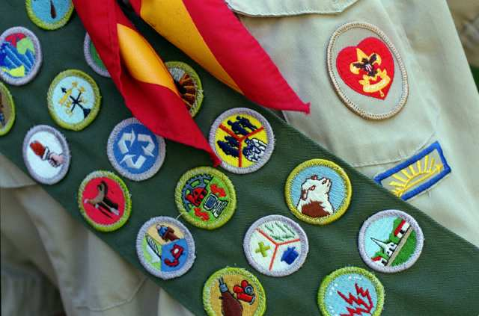
Eagle Requirements:
Become a Life Scout
Complete requirements in the Scout Handbook.
  Be active in Scouting
  Demonstrate that you live by the principles of the Scout Oath and Scout Law
  Serve in a leadership position
  Earn the required # of Merit Badges
  Complete requirement # 5
  Take part in SM Conference
  All before your 18th Birthday
  Pass an Eagle BOR
Notes:
Become a life Scout. For those Star scouts you are not able to start your Eagle Project until you are a life scout.
Read the rest of the slide.
Although all these requirements are important we are going to spend quite a bit of time discussing all the details pertaining to Requirement # 5. “THE EAGLE SCOUT SERVICE PROJECT”. But before we move on I’m going to highlight All these red check mark things need to be completed by your 18th birthday. Do not wait to the last minute It’s easier on your family, troop and other volunteers.

Slide 4
Requirement 5 - Purpose
First “Solo” challenge
Demonstrate ability to Plan, Develop and show Leadership.
Use learned Scouting & Communication Skills
Measures personal growth
Positive experience in Project Management
Find a project that will be valuable to your community and be a challenge to complete
Notes:
Read the slide.

Slide 5
Plan, Develop …
Planning is a key component
The Eagle Project Workbook has 3 Parts:
  The proposal is an outline of the project concept
  The Final Plan details step by step how to carryout the project
  The report is a recap of your experience
Notes:
As you have learned throughout your scouting life proper planning is an essential component of every event. A thoroughly detailed plan generally ensures the event will be safe, well run, successful and enjoyable for all the participants. Your plan will have 3 parts.
The proposal or outline
The Plan or detailed step by step instructions
The Report which is a write-up of your project experiences.

Slide 6
Give Leadership to Others
  No set standards for the number of people
    Most projects involve over 10 volunteers
    Some involve over 30
  No set standards for the number of hours
    National average is 150 hours
    Many projects are 300, 400, even 500 hours
Notes:
Although there are no set standards for how many volunteers you should get involved in your project remember the 2 old sayings:
Many hands make light work and
The more the merrier
To truly demonstrate leadership you need people to lead.
The number of hours needed to complete your project work is open but keep in mind the project should be Big, long lasting, meaningful and helpful. Most projects that we see, that meet those requirements average 150 hours or more. Do the math 10 volunteers working 2, 8 hour days is 160 hours.

Slide 7
Who is a Beneficiary?
Religious Institution, School, or Community
Need not be a registered as a non-profit (but they usually are)
Community has a very broad definition
  Example: A person is unable to maintain his property. If it has become a public eyesore, the “community” may benefit from a project to improve the property.
Notes:
While a Life scout plan, develop and give leadership to others in a “Service Project” helpful to any
religious institution, school, or your community.
but that does not mean they have to registered as a Non-profit
Let’s talk about what “community” means. In addition to parks or other shared resources it could mean “ a person is unable to maintain his property. If it has become a public eyesore, the “community” may benefit from a project to improve the property. However this should be rare and may pose a tax issue for the recipient and those donating.

Slide 8
Types of Projects
Construction
Landscaping
Special Events
Overseas Aid Organizations
Try to be Unique

Slide 9
The Eagle Project
Approval Process
Notes:
Let’s talk about the approval process.

Slide 10

http://LMDBSA.org
Lake Minnetonka District
Boy Scouts of America
Northern Star Council BSA
Stay up to date Programs Fundraising
Roundtable Advancement Camping
Eagle Scouts Resources
Your Eagle Project
Eagle Scout Workbook PC (fillable pdf)
Eagle Scout Workbook MAC (fillable.pdf)
Eagle Project Q&A
Eagle Preview (PowerPoint)
Eagle Project Ideas
Your Benefiting Organization's Guide
Eagle Scout Scholarships
Life to Eagle Packet Materials
Eagle Scout Rank Application…
Service Project Checklist and Tips…
Eagle Scout Leadership Service Project Workbook – PDF
Notes:
Go to the district Website hoover your curser over “Programs”, then “Advancement” and click on “Eagle Scouts”
Click on the workbook and download it for your completion.
Notice all the really cool and very helpful tools and links on this website. Notice the is an eagle project list, generated from projects of prior Eagle Scouts. It lists several beneficiaries and the actual projects which may help your creative juices.

Slide 11
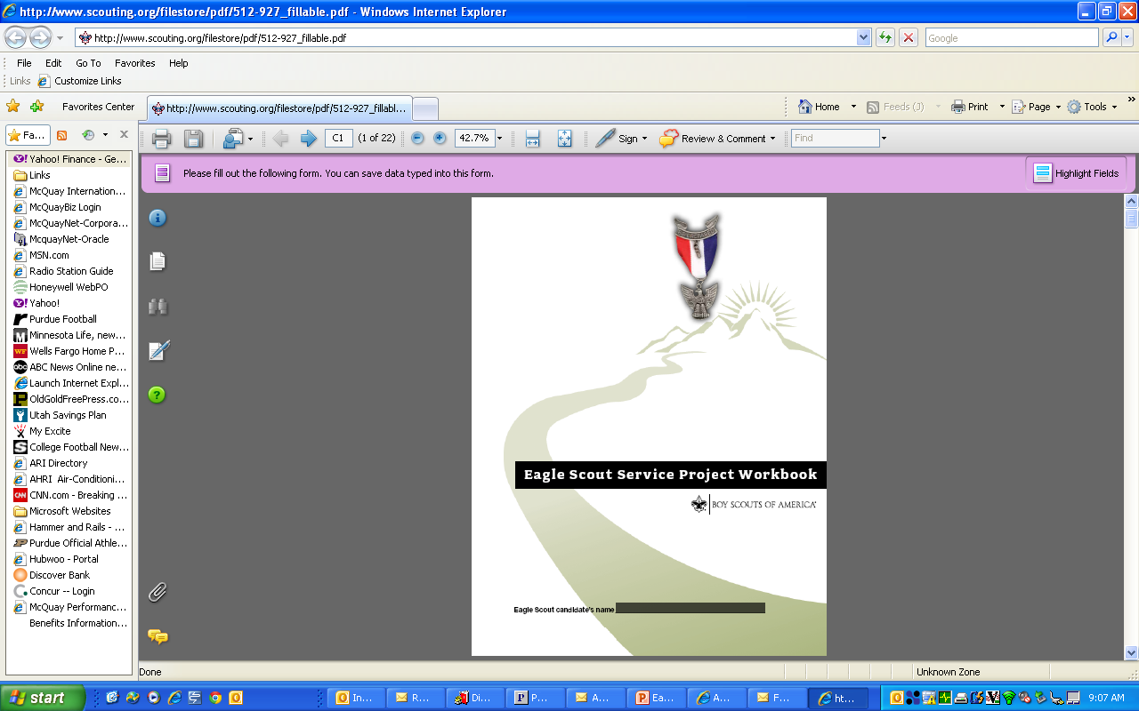
Eagle Scout Project Workbook
Notes:
Here is a copy of the Project work book. Please follow the correct order of steps outlined in the project workbook.

Slide 12
Project Process Overview
Troop, Family & Friends – network for project ideas. Set up exploratory meeting.
SM or Troop Eagle Advisor – Guide you on project concept viability & provide suggestions to overcome obstacles.
Finalize your project with your beneficiary
Write-up your proposal, review it with your Unit Leader and present it to the Unit Committee.
Notes:
The first thing is to find a project.
Networking with leaders within your troop, other Eagle Scouts, family and friends for project ideas can be helpful. Speak with facilities, maintenance or administrators at churches and schools. Three rivers park has a website with a drop down of project lists. You could set up exploratory meeting with various Beneficiaries to find a project that interests you
Your Scout Master or Troop Eagle Advisor are available to help. They will verify if the project is viable and help you overcome obstacles and facilitate the interaction with the Beneficiary
So after you pick a project
Finalized the project details with your Beneficiary. Agree to a the various expectations such as time-line, materials needed and who will pay.
Finish writing up the proposal and review it with your Eagle Advisor and present it to your troop’s unit Committee. They should be asking questions and determine that you have a solid understanding of the project and it’s basic details.

Slide 13
Project Approval Process
Unit Leader Approval |  | Unit Committee Approval
I have reviewed this proposal and discussed it with the candidate. I believe it provides impact worthy of an Eagle Scout service project, and will involve planning, development, and leadership. I am comfortable the Scout understands what to do, and how to lead the effort. I will see that the project is monitored, and that adults or others present will not overshadow him. |  | This Eagle Scout candidate is a Life Scout, and registered in our unit. I have reviewed this proposal, I am comfortable the project is feasible, and I will do everything I can to see that our unit measures up to the level of support we have agreed to provide (if any). I certify that I have been authorized by our unit committee to provide its approval for this proposal.
Signed _John Doe__________________ Date __2015_________ |  | Signed _Scout Master________ Date ___2015________
Name Printed _John Doe____________________________ |  | Name Printed ____Scout Master_________________________
Beneficiary Approval |  | Council or Disdrict Approval
This service project will provide significant benefit, and we will do all we can to see it through. We realize funding on our part is not required, but we have informed the Scout of the financial support (if any) that we have agreed to. We understand any fund raising he conducts will be in our name and that funds left over will come to us if we are allowed to accept them. We will provide receipts to donors as required. |  | I have read sections 9.0.2.0 through 9.0.2.15, regarding the Eagle Scout Service Project, in the Guide to Advancement, No. 33088. I agree on my honor to apply the procedures as written, and in compliance with the policy on “Unauthorized Changes to Advancement.” Accordingly, I approve this proposal. I will encourage him to share it with a project coach who has been designated for him.
Signed ____Community service_________ Date __2015_________ |  | Signed ___________________ Date ___________
Name Printed ____Community Service_________________________ |  | Name Printed _____________________________
  E-mail to District Advancement Committee (DAC):
    Bill.Richmond@lmdbsa.org
    Include the proposal, sketches, notes, contact & signature page
    The DAC member will contact you within 7 days
Notes:
At this point you have your project approved with 3 of the 4 approval signatures and now you are ready to meet with the District Advancement Committee Member.
Send an email to Mr. Richmond and he will assign you to 1 of the 9 District Advancement Committee Representatives., You should hear from a committee member, within 7 days, asking to set up a project review meeting. Please include the project proposal, along with any sketches or pictures the completed contact and approval pages.
The District Advancement Committee Member will contact you within 7 days.

Slide 14
District Approval
The proposal MUST have all 4 approvals before starting any part of the project execution.
Work started prior to all 4 approvals will not count and may void the project.
Notes:
Read the slide
In the Workbook there is a page for all the signatures. It will be extremely important that you have all 4 approvals before starting your project

Slide 15
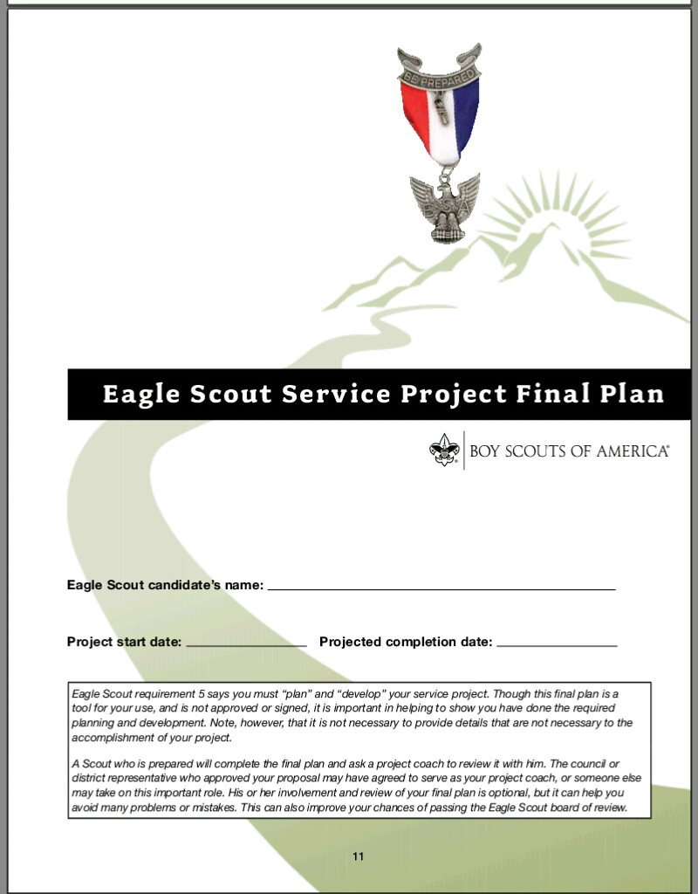
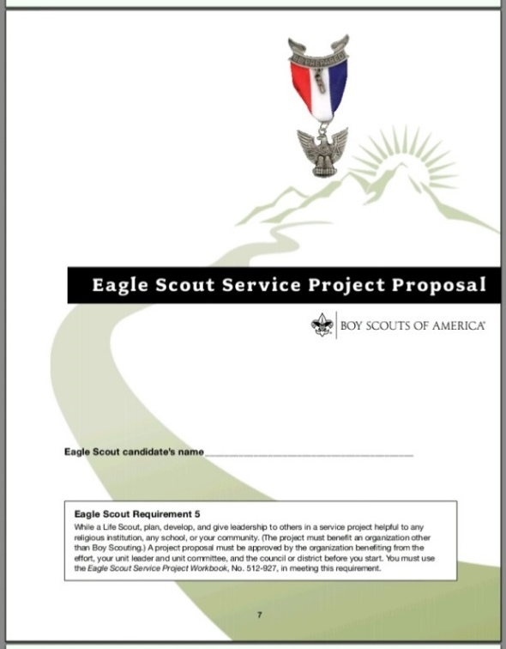

Final Plan
“Approved” Proposal
No Approvals Required
Outline
Detailed to smallest point
Notes:
As we mentioned earlier your proposal is an outline or draft of the final plan.
The more detailed your plan, the better your chances for success.
The Workbook will help you plan the details.
The final plan should be detailed enough that you could hand over the plans to another scout and they could run and compete the project without talking to you. If there is one thing you’ve learned in your scouting career and that is proper planning leads to a successful and safe event. Your service project is no different.
Here are some helpful tips and suggestions to think about when writing up your plan.

Slide 16
Walk through a Time-Line
Time | Action | Notes
3 plus Weeks before | Email volunteers - Safe the Date | Introduce the project
1 week out | Send reminder email | Attire, weather, What to bring
1 or 2 Days before | Send reminder email | Attire, weather, What to bring
Just before | Gather materials, supplies etc | Use volunteers to help with pre work
Day One | welcome, safety, basic instructions, form teams
 | How will each team know what to do.
 | Is there a timing issue IE Power tools - Adult heavy VS. Youth light
Day Two
Notes:
As you complete your final plan …. In your minds eye, envision each step in detail and how you want the event to flow, while keeping in mind the rules for safe Scouting. Remember your project is considered a Scouting event. This is a simple illustration you may have many more steps such as:
Presenting to troop at a weekly meeting,
An announcement at a Church or school.
Meeting with building supply company discuss a possible discount. To name a few

Slide 17
Key Topics / Hints
Volunteers
  How many? Will you need helpers with specific skills? -Adult to operate power tools
  Look for ways to inspire and train other Scouts.
    Teach younger scouts how, practice
    Younger scouts can help measure, etc
  Limit family or relatives
  Exclude employees of the beneficiary
Notes:
Plan your work strategy Read Slide

Slide 18


Adult Volunteers
BSA policy requires two adult leaders be present with at least 1 adult with Youth Protection Training!
Notes:
Remember I said this is a sanctioned Scouting event. Safe Scouting rules say 2 adults must be present and at least 1 must complete “Youth Protection Training”. Note: If your are a register adult with BSA you must have Youth Protection Training. 1 of the 2 adult leaders must be at least 21 year of age.

Slide 19
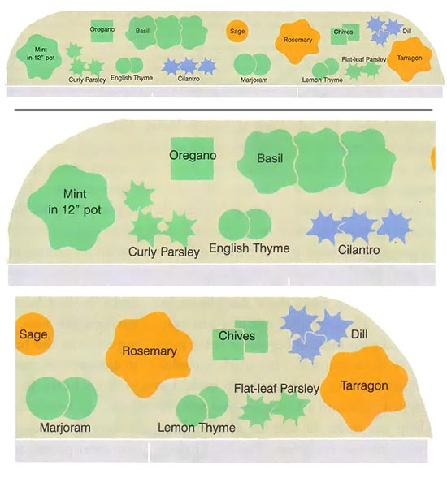
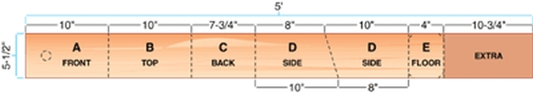
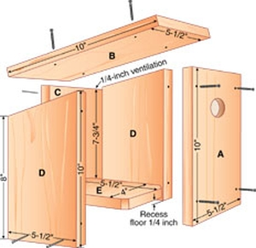
Sample Construction or Landscape Diagram
Using the full width of the 1-inch x 6-inch
How to cut the pieces, lengths etc.
Describe how the pieces fit together
Describe plant layout
Detail how to space and position plants.
Notes:
Here is a sample of 2 types of projects on the left is a construction plan and on the right is landscape plan. Notice the details. You don’t need a special software to design your plans. Hand drawn sketches are fine. Note in your minds eye walk through should I have most of the scouts arrive later because adults are cutting wood or using power tools.

Slide 20

Fundraising
An Application is required if you go beyond:
  Beneficiary
  Candidate or his family
  Members of the Unit/Troop
  Charterer Organization
Be Safe
  Work in teams
  Tell people where you are going.
Money is raised for the Beneficiary not BSA
Notes:
You may need to raise money as part of the project. If you are asking for funding from anyone other than those on this list you must have the fund rasing application signed off with the District Advancement Member.
The most important part of fund raising is your safety. If you are going door to door or business to business work in pairs and tell other where you’ll be and what time to expect you back.
The money is being raised on behalf of the benefiting organization. And leftover funds are given to the Beneficiary.

Slide 21
Safety Hazards
Identify safety hazards
Weather - cold or hot
How will you ensure the safety of your helpers? (Proper clothing, gloves, goggles)
How will you be prepared for an accident if one occurs?
Adults must operate power tools
  Age appropriate use of tools.
  Scouts can use cordless drills
Notes:
Safety is a big deal and in your meeting with us we will spend a lot of time talking about it.
Identify Hazards. When you set up camp and you are going to cut and chop firewood what do you create around the chopping area? Yes a safe zone. Apply the same idea to your project. If cutting wood or using power tools you need to have a safe zone.
Weather - Think about Hydration, mandatory breaks, shade. You might brush up on your sun and heat stroke first aide. What will you do if lightning or thunder occur?

Slide 22
Service Project Report
Last section of Workbook
Summarizes the project
  What went well/What was challenging?
  What changed from the plan?
  Discuss your leadership
  How many hours
  Funding ETC.
Notes:
Read Slide

Slide 23


Create A Word Picture
Take “before” pictures
Take lots of “during” pictures
Preserve the memory with finished project pictures
Notes:
Take pictures before and lots of pictures during and after. You’ll want to preserve the memories and show them off at your COH. If you have done your due diligence and completed a thorough plan There is only one more very important thing to do. Have fun

Slide 24
Eagle Application Procedures

Slide 25
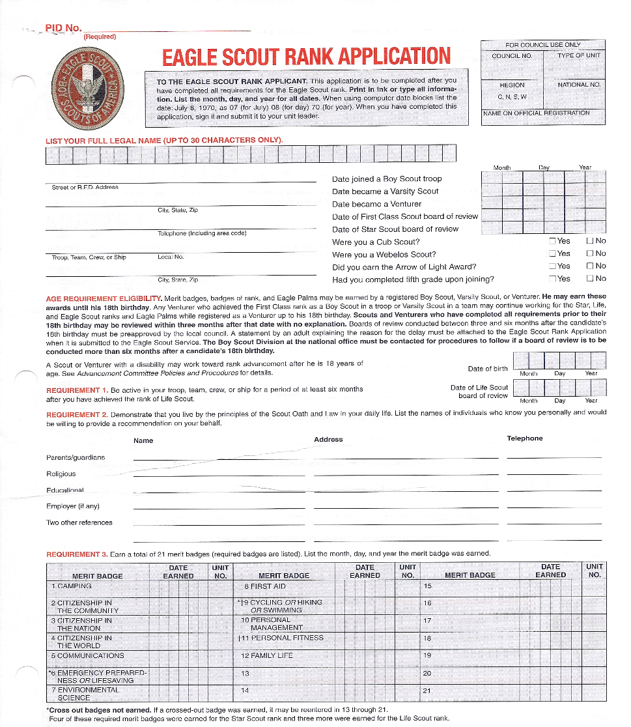
Eagle Scout Rank Application
Download the application from the District or Council web site.
Legibly complete the form.
Give all your paperwork to your Troop Advancement Chair
Notes:
This is what the application looks like. Follow the steps

Slide 26
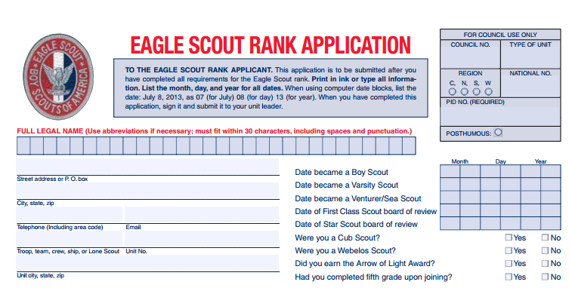
Application Continued
Notes:
Scouting doesn’t record exactly when you became a scout. Most people use the date they crossed over or May1st.

Slide 27
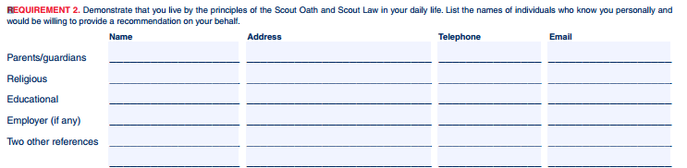
Letters of Reference
Notes:
Five or Six letters of recommendation are required.
If you are not employed you only need five.
They are confidential and only shared with the Eagle BOR.
The author can’t share them.
Written release is not honored.
The Scout should never ever see them

Slide 28
Reference Letter Process
  It is recommended you follow this process:
  The scout asks each if they mind providing a reference
  The Scout gives them a stamped envelope (addressed to appropriate Troop Leader) with a copy of Scout Oath and Law.
  If missing a letter of ref. the appropriate troop leader follows up accordingly.
  After a reasonable period of time and a reasonable follow-up attempts are made, submit completed application to Council for processing.
Notes:
Read the slide:
It is preferred all the letters are with the application but it’s ok to submit the application without all the references.
Note the letters of ref can take time to complete. You can start this at any reasonable time. Remember if using a coach or teacher as a ref. they are on break during the summer. Plan accordingly

Slide 29
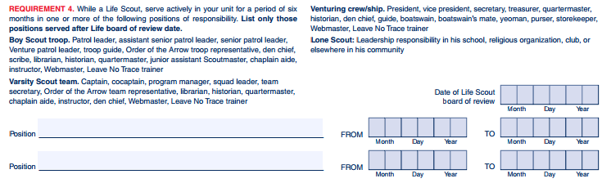
Requirement 4
Notes:
Requirement 4 is about your leadership positions. All of the acceptable positions for Eagle are listed here.
List only those that you have held since becoming a Life Scout.

Slide 30
Statement of Life Goals
  The Scout writes a statement summarizing your future goals.
    Interests and hobbies,
    Educational aspirations etc.
    Strong skills – how you’ll use them
  List your achievements, awards or recognitions.
Notes:
Read Slide

Slide 31
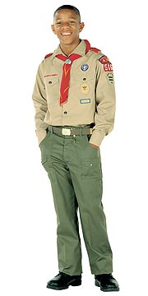
Scoutmaster Conference
All requirements, including Scoutmaster conference, must be completed prior to the 18th birthday. For the conference:
  Completed workbook
  Completed application
  Statement of Life Goals/list of
  Achievements
  All handbook requirements (except BOR)
Notes:
Read slide

Slide 32
Eagle Board of Review

Slide 33
Setting up an Eagle BOR
The Troop Adv. Chair, Eagle Advisor, CC or other troop appointed person plans the Eagle BOR.
Minimum of 3, maximum of 6 impartial members.
One member must be from the District Advancement Committee
  * People who cannot serve on the Board:
    Scoutmaster or Assistant Scoutmasters from the Candidate’s Unit
    Parent, Relatives or Guardian of Candidate
Bring your Scout Handbook
Class A uniform and sash (With all badges and life rank)
Notes:
“We encourage local Board Chairpersons to include community and business members that are familiar with Scouting and the Eagle Award to participate on Eagle Board of Reviews. This adds a certain level of impartiality while highlighting the virtues of scouting to those outside the troop. We find that community/business members are very happy to serve on BOR’s. Another great resource for BOR’s is the “Sponsor from the Benefiting Agency”. What better way to get direct feedback from a non-troop perspective of how the Eagle candidate executed the project?”

Slide 34
The Eagle BOR
Board reviews paperwork
Scout is introduced to the Board
Board vets the scout:
  Family
  Scouting Career
  Project
  Future
Scout is excused, the board talks and votes
Scout returns and is given the vote results.

Slide 35
Once an Eagle, always an Eagle
College Scholarships
  Northern Star Council: http://www.northernstarbsa.org/AdvancementAwards/Scholarships/
  National Eagle Scout Association (NESA): http://www.nesa.org/applications.html
Networking
  Northern Star Council
    Annual ‘Gathering of Eagles Dinner’ – usually in April
    Facebook “Northern Star Council Eagle Scout Network”
  NESA: http://www.nesa.org/
Notes:
Read Slide

Slide 36
Questions & Answers

