Slide 1
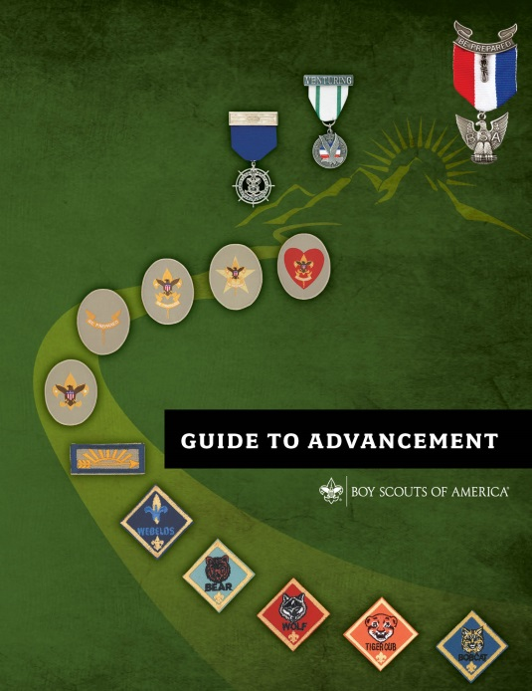
The Essentials of
Merit Badge Counseling
Expiration Date
This presentation is not to be used after December 31, 2016.
Obtain an updated version at www.scouting.org/advancement
Notes:
[Presenter Notes: Begin with a simple opening ceremony such as the Pledge of Allegiance and perhaps the reciting of the Scout Oath and Scout Law. Then welcome everyone and thank them for attending. They could be doing something else with their time, but they chose to be at this presentation.
Challenge participants to ask questions and encourage them to join in the discussions.]
Background note to the presenter with supplies needed:
This merit badge counselor orientation presentation provides new and prospective merit badge counselors with the basic knowledge and skills needed to get started, and can serve as a refresher to veterans. It involves a step-by-step overview of the registration and approval process, speaks to the requirement for Youth Protection training, and discusses helpful methods and resources. Participants will learn about their unique role, the process of counseling, and the related BSA national policies and procedures. The orientation takes approximately 60 to 90 minutes depending on the experience level of those attending.
Like all the orientation and educational experiences produced by the National Advancement Committee and its Webinars and Education Task Force, this session has an expiration date, after which it is not to be used. Upon that date a replacement session will be available at the URL shown on the first slide. This will provide unit, district, and council volunteers with the latest information.
We encourage presenters to have at least one copy of the following publications for use during the presentation:
The Guide to Advancement, No. 33088
Any issue of Advancement News
Boy Scout Requirements, No. 33216
A few merit badge pamphlets (at least one that is Eagle-required)
Application for Merit Badge (blue card), No. 34124
Merit Badge Counselor Information form, No. 34405
BSA Adult Application, No. 524-501
We also encourage presenters to have copies of their latest council newsletter and a handout with key council contact information, and any instructions about special certifications or training that the council advancement committee requires in order to approve counselors for specific merit badges.
A flip chart or white-board, and pens may come in handy.
If your session will include volunteers unfamiliar with Scouting, it may be helpful to prepare signs or flip chart sheets showing the Scout Oath and Scout Law.
The National Advancement Team welcomes any and all feedback through advancement.team@scouting.org, but would ask that questions and concerns first be shared with local district and council volunteer or professional advancement administrators.
The National Advancement Committee's Webinar and Education Task Force’s dedicated Scouting volunteers who helped develop this presentation wish you great success in giving merit badge counselors the tools they need to better serve today's young people.

Slide 2

This Training Will Cover
Scouting overview: mission, aims, and methods
Merit badge program role and benefits
Merit badge counselor qualifications
How to become a counselor
The merit badge counseling process
Merit badge requirements: fulfill as written
Effective counseling
Group instruction and camp settings
Notes:
[Presenter Notes: Ask participants to review this slide and then invite them to bring up any specific details or issues they would like to be sure are addressed. List these on a flip chart or white-board. At the end of the session you can go back and pick up any topics that were not covered.]

Slide 3
Boy Scouts of America
Mission Statement
The mission of the Boy Scouts of America is to prepare young people to make ethical and moral choices over their lifetimes by instilling in them the values of the Scout Oath and Scout Law.
Notes:
[Presenter Notes: Hold up your copy of the Guide to Advancement, opening it to the inside of the front cover. Point out the BSA Mission Statement found there.
If your class includes people who are learning about Scouting, point out the signs or flip chart sheets showing the Scout Oath and Scout Law.
Explain that all merit badge counselors should have a copy of the Guide to Advancement and should carefully study section seven.]

Slide 4
Aims of the Scouting Program
Character development
Citizenship training
Mental and physical fitness
Every activity in Scouting should support
one or more of these aims.
Guide to Advancement topic 2.0.0.3
Notes:
The BSA mission and the aims of the Scouting program that appear on this slide represent the desired outcomes of the merit badge program.
The skills and knowledge developed through merit badges are important, but not so much so as achievement of the aims and mission. The mission and aims of Scouting, for the most part, are accomplished through the merit badge process, as opposed to the learning that’s related to the subject matter. This doesn’t mean the subject matter is unimportant. It is important. But it does mean that the process of learning and interacting with others in successfully challenging and completing all the requirements is the key to success. This is why we don’t “retest” in Scouting. We’re more interested in what the Scout experiences along the way.

Slide 5
Methods of Scouting
Scouting ideals
Patrol method
Advancement
Association with adults
Outdoors
Leadership development
Uniform
Personal growth
Guide to Advancement topic 2.0.0.4
Notes:
Scouting uses eight specific methods to achieve its aims. Since earning merit badges is included in rank requirements, the merit badge program primarily relates to the advancement method. But it has the potential to make use of the other seven as well. For example:
Association with adults takes place through unit leader discussions, and through work with merit badge counselors and any specialists or guest speakers who assist them.
Many merit badges include requirements that take place in the outdoors.
And opportunities for leadership development and personal growth abound as Scouts grow in knowledge and self-confidence and work through requirements that require teaching and leading others.

Slide 6
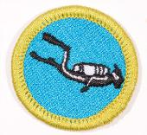

Four Steps
in Boy Scout Advancement
The Scout learns.
The Scout is tested.
The Scout is reviewed.
The Scout is recognized.
Merit badge counselors
are directly involved in the first two steps.
Guide to Advancement topic 4.2.1.0
Notes:
The “mechanics” of advancement are covered in section 4 of the Guide to Advancement. An understanding of the four steps in Boy Scout advancement is critical to the process. It is in going through the steps that we meet the aims of Scouting, and each step is equally important as any other. Merit badge counselors are directly involved in the first two; the others come later.
It is vital to remember that the advancement method, including the earning of merit badges, is just a method. Advancement and merit badges are not ends in and of themselves.

Slide 7
Merit Badges:
Their Role in Advancement
Merit badges are integral to advancement.
Any Scout may earn them at any time, including
qualified Venturers and Sea Scouts.
Merit badges are required for Star, Life, and Eagle.
A total of 21 must be earned for the Eagle rank.
Some merit badges are “elective;” some “required.”
Thirteen specific badges are required for Eagle.
Guide to Advancement topic 7.0.0.1
Notes:
The merit badge program is integral to the Boy Scout advancement program. We’re famous for merit badges. Even businesses and some educational institutions are copying the concept. The process and the lessons work together not only to build practical knowledge and skills, but also to develop the whole person.
Merit badges may be earned by any registered Boy Scout or Varsity Scout at any time and at any rank, but they are not part of the requirements for the first three ranks—Tenderfoot, Second Class, and First Class.
Venturers and Sea Scouts who are not yet 18 years old may also earn them if they attained the First Class rank while members of a troop or Varsity team.
Merit badges are required for the ranks of Star, Life, and Eagle Scout in a combination of “required” and “elective” badges. With the addition of Cooking on January 1, 2014, thirteen specific merit badges, plus any other eight—for a total of 21—must be earned for Eagle.
[Note to presenter: If asked, the Eagle-required merit badges are as follows: First Aid, Citizenship in the Community, Citizenship in the Nation, Citizenship in the World, Communications, Cooking, Personal Fitness, Emergency Preparedness OR Lifesaving, Environmental Science OR Sustainability, Personal Management, Swimming OR Hiking OR Cycling, Camping, and Family Life.]

Slide 8
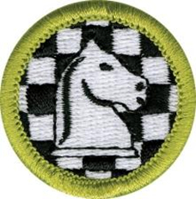

Broad Range of Subjects
More than 130 merit badges in 14 subject areas:
Agribusiness
Arts and crafts
Business and industry
Communications
Conservation
Hobbies
Natural science
Personal development
Physical science
Professions
Public service
Sports
Trades
Transportation
Guide to Advancement topic 7.0.0.1
Notes:
Merit badges may be grouped into 14 subject areas. Council advancement committees may approve counselors for the badges they wish to counsel according to their skills and education.
If you give leadership to the merit badge program in your district or council, this list of subject areas may be helpful in organizing your counselors into groups—each one with a lead counselor who helps in the recruitment of sufficient counselors to meet demand.
8

Slide 9

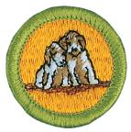
Benefits of Merit Badges
  Contribution to the aims of Scouting: citizenship, character, and fitness
  Development of confidence,
  self-reliance, and social skills
  Physical fitness and healthy lifestyles
  Career and hobby choices may result
  Exposure to positive role models:
You!
Guide to Advancement topic 7.0.0.1
Notes:
Now with an understanding of how merit badges fit into the advancement method, let’s take a look at their benefits to the Scouts and how they contribute to meeting our aims.
The three citizenship badges—Citizenship in the Community, Nation, and World—are pretty obvious contributors, while Family Life speaks to citizenship at home.
Communication and Public Speaking have the potential to build confidence, and thus contribute to character development, but any merit badge that’s properly presented can help develop the kind of confidence and self-reliance that comes from overcoming difficult obstacles in the achievement of a goal.
Social skills will develop as well, especially as Scouts work with you and take advantage of other opportunities for interaction with adults. This is a valuable experience. Scouts might be shy and fearful in a new situation, but a good counselor can draw them out with a relaxed, informal, and friendly atmosphere.
Scouts will also learn through merit badges such as Swimming, Athletics, and Personal Fitness, that fun aerobic activities can lead not only to physical fitness, but also to healthy lifestyles and combatting childhood obesity—if the counselor interjects these ideas into the discussion.
A world of career choices also begins to unfold as merit badges are accumulated. Scouts good in math and science may find badges like Chemistry, Astronomy, and Oceanography attractive and may learn more about potential careers in these fields. Scouts who enjoy working with animals may find that Veterinary Science, Insect Study, and Dog Care can have the same sort of result.
Many of you here today who were Scouts may attribute the basis for your careers to one of the merit badges you earned, and others of you may have begun a hobby through a merit badge experience. Fishing and Stamp or Coin Collecting might be good examples.
You, as the merit badge counselor, have the opportunity to work with Scouts of different backgrounds and unique talents. Some will be self-starters and require little guidance, while others will need your personal attention to help them understand the subject matter. Above all, you’re someone they will look up to for support and encouragement. You will be seen as the expert. Share your knowledge as well as your passion, and set that positive example so they will share it with others.
9

Slide 10
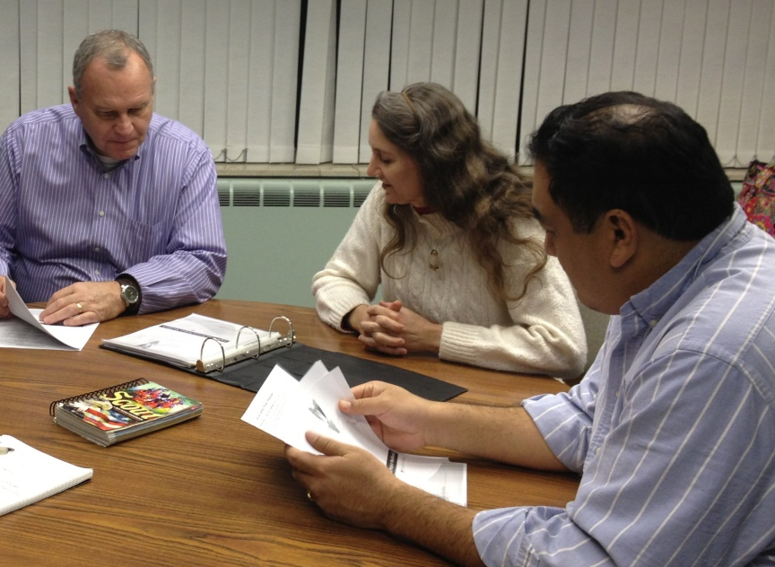
Qualifications to Become a
Merit Badge Counselor
At least 18 years of age
Good character
Recognized as having
skills and education
in the subject area
Good rapport with leaders and Scout-age youth
Guide to Advancement topic 7.0.1.1
Notes:
In order to qualify as a merit badge counselor, prospective volunteers must have the education and skills needed to provide instruction and to evaluate performance. It is also important they are older than the Scouts and are able to set that positive example. This calls for both good rapport and good character.
These are the only qualifications the BSA National Council places on merit badge counselors—regardless of the merit badge. Local councils, however, when approving counselors, may look for more, but they are not allowed to accept less.
10

Slide 11


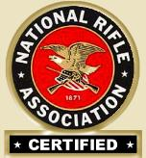



Special Certifications and Trainings
Specific training is required for some BSA activities, including merit badges.
A counselor must hold the specific certification or work with someone who does.
Guide to Advancement topic 7.0.1.1
Notes:
The BSA considers some merit badge activities riskier than others. A list of these badges is provided in the Guide to Advancement, topic seventy-eleven, “Qualifications of Counselors;” along with the specific qualifications required of those supervising the activities. For example, most of the requirements for the shooting sports merit badges require BSA National Camp School or National Rifle Association certification; and scuba diving activities must be presented by a trained instructor sanctioned by an agency such as PADI, the Professional Association of Diving Instructors. Of course, for the aquatics badges, all Swimming and watercraft activities must be offered in accordance with BSA Safe Swim Defense and BSA Safety Afloat, respectively.
If the merit badge counselor does not meet the specific qualifications listed, then he or she may use the services of others who do meet them. This is supported in topic seventy-thirty-two of the Guide to Advancement, where it says, “It is permissible for guest speakers, guest experts, or others who are not merit badge counselors to assist in the counseling process.”
As a side note, it must be remembered that any activities that take place within the merit badge program must be conducted in accordance with the Guide to Safe Scouting.
[If you are asked, the Guide to Safe Scouting is available at www.scouting.org/scoutsource/healthandsafety/GSS.aspx.]

Slide 12
Registering as a
Merit Badge Counselor
Even if already registered, every counselor must submit a BSA adult application for the position of merit badge counselor (code 42). There are no exceptions.
Merit badge counselors who are re-registering need not complete a new application.
“Merit badge counselor” is a council or district position.
Approval of merit badge counselors is the responsibility of the council advancement committee, not the unit.
Guide to Advancement topic 7.0.1.5
Notes:
[Note to the presenter: We anticipate most of your participants will already be registered and approved as merit badge counselors. For others who may be attending to discover if counseling is a good fit, it would be helpful to have information about local council procedures on hand.]
You must submit an adult application for registration with your local council as a merit badge counselor. This must be done even if you’re already registered in another position. You must complete a new registration form in order to serve. Be sure to use position code 42.
This goes for merit badge counselors working at summer camp or at merit badge “colleges,” “fairs,” or “midways” as well. There are no exceptions. This is important because of the resulting background check that occurs upon registration.
Local councils establish the procedure for submitting applications. [Explain the procedures for the council(s) with participants involved in this session]
The cost to register is zero dollars. That’s right, it is free!
12

Slide 13
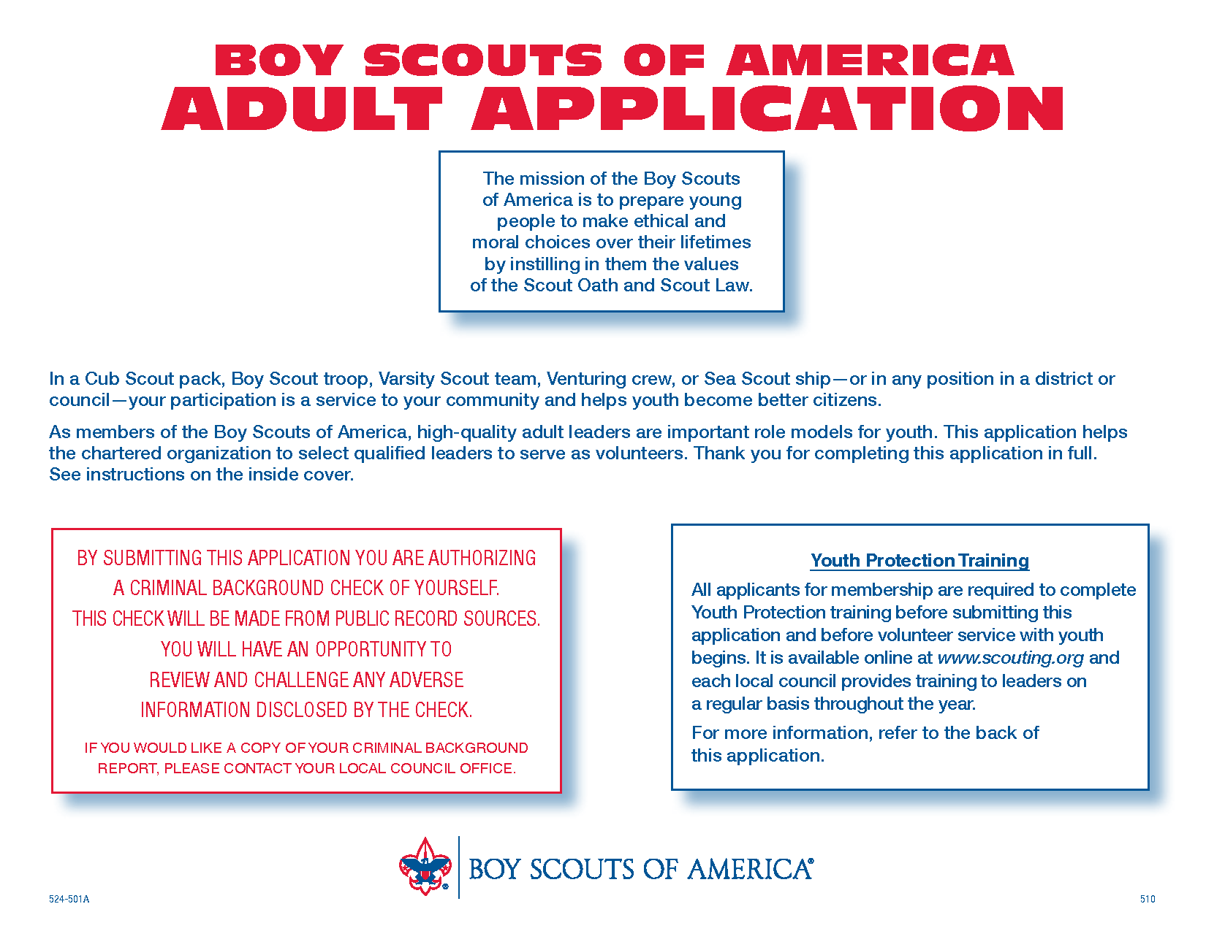
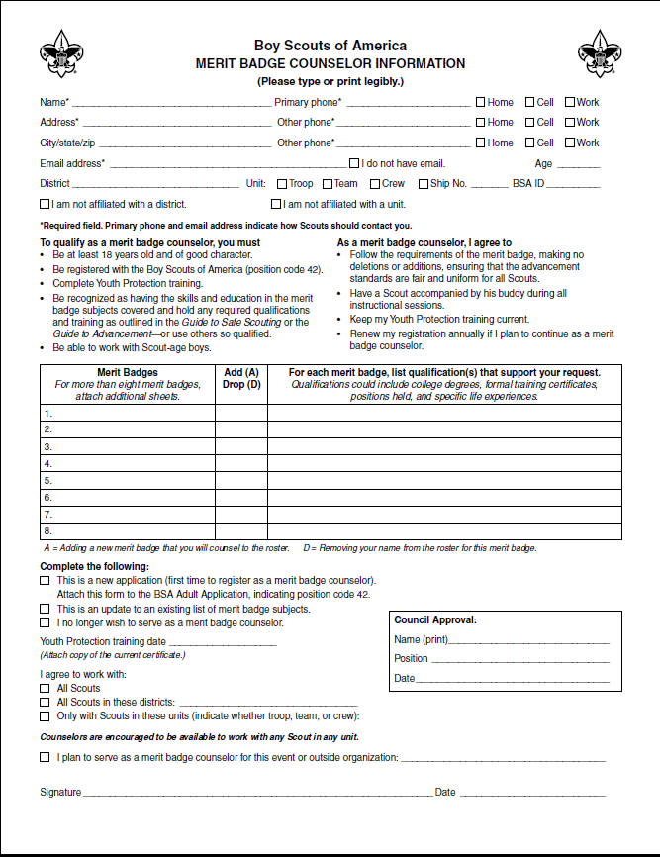
Forms Needed to Register as a
Merit Badge Counselor
Use position code 42.
Guide to Advancement topic 7.0.1.5
Notes:
Here are the forms that merit badge counselors submit. The first is the standard BSA adult application form and the other is the Merit Badge Counselor Information sheet that lists each badge the counselor wishes to work with. This is the form upon which the council bases its approval of a counselor.
The Merit Badge Counselor Information sheet is where counselors have the opportunity to describe their skills and education related to each badge they wish to counsel. The description could include college degrees, formal training, various certifications, jobs held, specific life experiences, and so forth.
Multiple forms may be used if counselors are applying to work with more badges than will fit on just one form. This same form is used if a counselor wishes to add or remove merit badges when it comes time to reregister.
Note that the National Council has established no limit on the number of merit badges for which one may be approved to counsel except to the extent that a person lacks skills and education in the given subjects. But that said, it is permissible for councils to limit the number of badges as a method to assure that only those with sufficient skills and education are approved. It is not advised that there be a hard and fast rule, however, such as no more than 10 badges to a counselor. It is better to be flexible in order to be sure there are adequate counselors for all the badges.

Slide 14
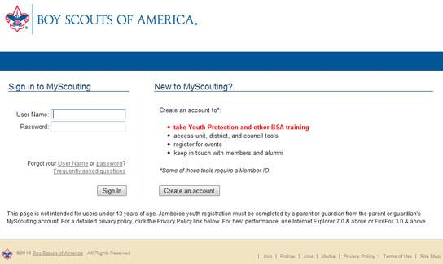


Complete
Youth Protection Training
Good for
www.myscouting.org
Guide to Advancement topic 7.0.1.1
Notes:
Before working with Scouts, counselors must complete Youth Protection training. The online course is available by logging into myscouting.org. Counselors, who live in states that require face-to-face, instructor-led training, are encouraged to contact their local councils for training dates and times.
When completing the course, volunteers should attach a copy of their certificate to their adult registration application and information sheet, and follow council guidelines for submitting these documents.
14

Slide 15
Approval by Local Council
Local councils establish procedures for registration, re-registration, and approval, and for reviewing:
  Background checks
  Youth Protection training
  Any council-required certifications
Approval is for specific merit badges.
Counselors may work with just one unit, but registration and council advancement committee approval are still required.
Guide to Advancement topic 7.0.1.4
Notes:
When you submit your adult application and information sheet, your council advancement committee has the responsibility to review and approve your service as a counselor. Merit badge counselors must be approved for each badge they plan to work with.
The council will do a background check, ensure your Youth Protection certification is on file, and check additional certifications if the council requires them. Remember, your Youth Protection training must be renewed every two years.
Just as with any other registered BSA volunteer, merit badge counselors must re-register annually. The local council establishes the procedure for this process, and it may be as simple as confirming a desire to remain a counselor. The re-registration process as spelled out in the Guide to Advancement under topic seventy-fifteen, includes the opportunity to update contact information and the merit badges to be counseled during the coming year, as well as a reminder to renew Youth Protection training if it has expired.
As a merit badge counselor, you may request that you work only with selected units (see the Guide to Advancement, topic seventy-twenty-three). We urge you, however, to leave yourself open to all. In this way you allow more Scouts to broaden their horizons and work with people outside their own units.
[Note to presenter: This is a good place to cover any local council procedures as appropriate.]
15

Slide 16
The Process of Counseling
A Scout indicates his interest and discusses the badge with his unit leader.
The unit leader signs a blue card and provides at least one counselor.
The Scout contacts a counselor.
The Scout and counselor meet—often several times.
The requirements are fulfilled.
Guide to Advancement topic 7.0.3.0
Notes:
Before a Scout contacts you he must first have discussed the badge with his unit leader. This step allows the leader to provide counseling on what the young man may face in challenging the badge. Following the discussion, the unit leader signs and gives the Scout his merit badge application—commonly known as the “blue card.” A merit badge counselor is to be recommended at that point, but it is not required that the Scout use that particular counselor. When a Scout contacts you, remind him to bring his signed blue card and buddy with him.
[Note to the presenter: This is a good time to pass around a sample blue card. Please note that the card has been changed. If you cannot locate the 2013 printing then tell participants the statement that appears above the unit leader signature line now reads, “I have discussed this merit badge with this Scout and have recommended at least one merit badge counselor.” It previously read, “and is qualified to begin working for merit badge noted on the reverse side.”]
Three things should take place during the initial meeting. First, you should welcome the Scout and his buddy. Then take a look at the blue card to make sure it has been signed by the unit leader. Once this is done you may get started.
At times, Scouts may come prepared with evidence of completed work like reports or photographs of things they have built. These should be initialed by the Scout’s unit leader or otherwise verified. They may have a note from their unit leader showing the dates and locations of camping trips taken with the troop. Some may even present you with a blue card bearing initials from a previous counselor and list of requirements completed. This is known as a “partial.” The right questions will help you gauge what they know and have accomplished thus far, and point to an action plan for finishing the badge.
If no prior work is provided, you and the Scout should agree on a reasonable timeframe for working on and finishing the merit badge. Let him know what your expectations are and how you will evaluate his progress. Encourage the Scout to ask for help if he needs it.
The Scout should leave each session knowing what tasks he must complete according to his action plan. Remind him to pay attention to words like “show,” “demonstrate,” or “write,” as these are important things he must do in order to get the merit badge. Your satisfaction that all the requirements have been fulfilled, no more, no less, is the key.

Slide 17
The Process of Counseling
The counselor approves completion and signs the blue card.
The Scout returns the signed blue card to his unit leader for signature.
The unit leader gives the Scout the applicant record section.
The unit reports the merit badge as advancement.
The merit badge is presented.
Guide to Advancement topic 7.0.3.0
Notes:
Once you’re satisfied the Scout has completed all the requirements—having tested him along the way—your final step is signing his blue card. Congratulate him for a job well done. At this point your role in the counseling process is finished.
In just a moment we’ll talk more about the parts of the blue card.
The mechanics leading up to the Scout receiving his badge are pretty straightforward. The Scout gives the signed blue card to his unit leader for a final signature. He signs, and gives the Scout his copy to keep; and gives the troop copy to the volunteer in charge of recording advancement, purchasing the emblem, and providing it to the unit leader for presentation to the Scout. The merit badge process is complete when the Scout receives the merit badge.

Slide 18

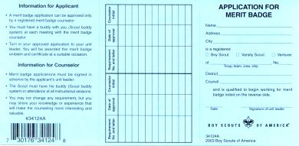
The Merit Badge Process
Scout indicates interest; discusses with unit leader;
gets MBC name and blue card
Unit reports advancement and obtains badge for presentation
Scout contacts counselor
Scout returns completed
merit badge card to unit leader
Scout/counselor first meeting
Counselor approves completion
Subsequent
Scout/counselor meeting
Subsequent
Scout/counselor meeting
Subsequent
Scout/counselor meetings
Scout completes requirements
Notes:
In review, here’s a chart that outlines the process the BSA considers the best approach to getting the most out of the merit badge program.
[Note to presenter: Give participants a chance to review the chart and invite them to ask questions.]

Slide 19
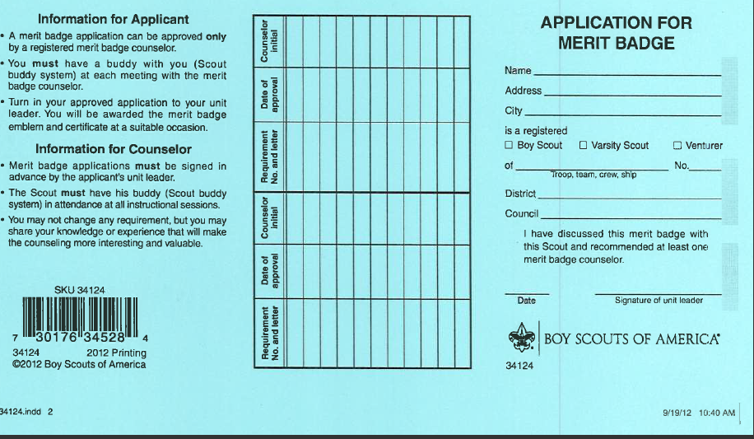
Application for Merit Badge
The Blue Card
The unit leader
signature:
Required for Scouts to
work with counselors
Does not indicate unit
leader “approval”
Evidence of discussion between unit leader and Scout
Indicates registered counselor has been recommended
Not required for Scout to get started on requirements
“I have discussed this merit badge with this Scout
and recommended at least one merit badge counselor.”
Guide to Advancement topic 7.0.0.2
Notes:
The unit leader’s signature is required on the application before the Scout begins working with the merit badge counselor. This does not mean the young man must wait for the signature to begin work on the merit badge itself. For example, past campouts count for the Camping merit badge, and coins and stamps already collected count for those badges.
The unit leader’s signature does not necessarily indicate approval. It merely shows that the Scout and the unit leader have had a discussion about the badge and that the unit leader has recommended at least one registered merit badge counselor.
What do you do if a Scout shows up without a signature on his blue card? Ask him where he got the card. If the Scout indicates the unit leader knew of his desire to begin working on the badge, but forgot to sign—or if there are other compelling extenuating circumstances—you may proceed with the initial session and ask him to get his unit leader’s signature prior to the next meeting.
19

Slide 20
Application for Merit Badge
The Blue Card
Scout’s information
Record of completed requirements
Guide to Advancement topic 7.0.0.2
Notes:
At some point in the next few years, as the BSA computer systems are upgraded, it is possible the blue card will be replaced—at least in part—by an electronic process. In the meantime, the blue card is the nationally recognized merit badge record. When it is not used it can create problems as Scouts transfer to different units or to different councils, or if in the future the need arises to produce acceptable documentation of merit badges earned.
The Scout’s information, of course, should be completely filled in. [Refer to the screen]
The space provided in the middle portion is for listing requirements completed with date of completion and counselor’s initials. This information is most important when one counselor is not going to be able to approve all the requirements for a particular badge. This often happens in camp settings where another counselor “back home” will approve requirements that could not be fulfilled at camp. Again, the blue card in this case is called a “partial.”
Partials have no expiration except the Scout's 18th birthday.
20

Slide 21
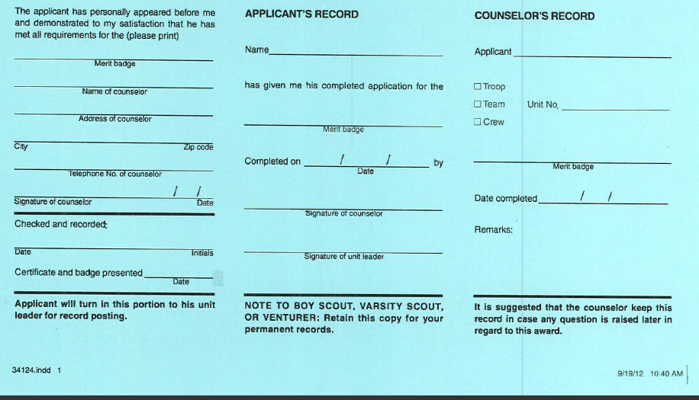
Application for Merit Badge
The Blue Card – Reverse Side
Counselor’s information
Counselor signs in two places once all requirements are complete
Unit
leader’s
second
signature
1/3 goes to the unit as application for
the badge
1/3 goes to Scout for his records
1/3 goes to the counselor’s
records
Guide to Advancement topic 7.0.0.2
Notes:
The reverse side of the blue card is used to record merit badge completions and is divided into three parts:
Left section: unit leader’s portion showing counselor’s personal information, signature, and date merit badge was completed
Middle section: Scout’s portion listing when the merit badge was completed and his counselor’s and unit leader’s signatures
Right section: counselor’s portion showing Scout’s name, unit number, and date merit badge was completed
The counselor should retain his or her portion for at least one year in case a question is raised later. The Scout should treat his portion as a keepsake, and hold on to it as proof he earned the badge. The unit leader’s portion should remain with the unit.
21

Slide 22
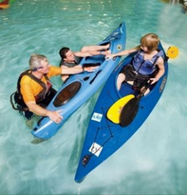
Role of a Merit Badge Counselor
Interview the Scout (with a buddy present)
to determine:
  His preparedness
  His current knowledge
  His interest
  In subsequent meetings:
  Evaluate progress
  Review completed work
Notes:
As a counselor you have several duties that hopefully will lead to approving a merit badge.
After reviewing the signed blue card, and with a buddy present, begin a discussion with the Scout to determine:
If he is prepared to start the merit badge.
How much knowledge he already has in the subject.
His level of interest in the subject.
Then keep an eye on him as he progresses. In doing this you’ll be playing the roles of both coach and mentor.

Slide 23
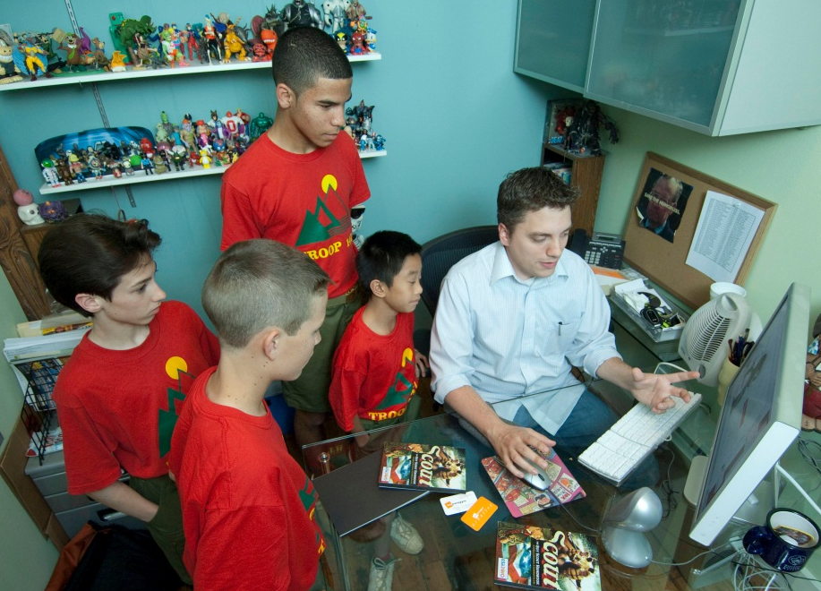
Role of a Merit Badge Counselor
Coaching:
Teach required skills.
Provide opportunities
to practice.
Provide encouragement,
and also praise when
appropriate.
Encourage goal setting and provide help and support in reaching goals.
Evaluate progress and respond accordingly.
Notes:
As a “coach,” the merit badge counselor...
Gauges a Scout’s readiness level and thinks about what will be needed to help him complete the badge. An observant counselor may need to spend more time working on skills with younger Scouts and allow them time to practice skills with their buddies. Comments like “You’re doing a good job!” give Scouts the confidence they need to complete the required work.
Encourages Scouts to set goals and monitors their progress, providing friendly reminders with the understanding that the ultimate responsibility to get things done rests with the Scout.
Helps the Scout evaluate his progress and encourages him to ask for the help he needs.

Slide 24
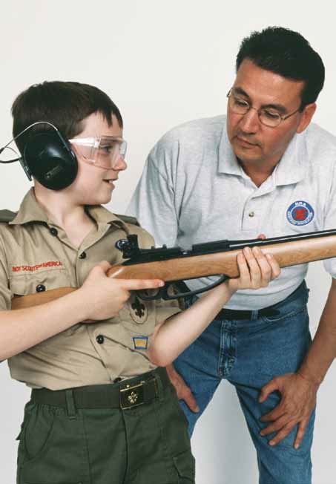
Role of a Merit Badge Counselor
Mentoring:
  Establish a relationship,
  taking a genuine interest
  in the Scout’s projects.
  Spark curiosity.
  Go for the deeper dive.
  Encourage long term goal-setting.
Notes:
Merit badge counselors don’t always have the chance to serve as mentors. Doing so requires a relationship that’s not likely achievable at a merit badge college or midway, for example, unless a Scout and his buddy schedule follow-up sessions and work together with you over a period of time. Mentors take more than a passing interest in a Scout’s projects and they share experiences that spark curiosity.
The Scout whom you mentor may get more serious about the subject matter and may want to gain a deeper understanding. This is fine as long as you understand nothing can be added to the requirements.
As one gains experience counseling youth, one gets a sense of these certain young men who take a real interest in a subject. If time permits, it’s appropriate to share specific skills needed to be successful in the counselor’s line of work. Career-minded Scouts working on the Law merit badge, for example, may appreciate knowing which courses to take in preparation for law school.
Helping Scouts set longer-term goals to accomplish not only the required work, but additional studies as desired, is a big part of mentoring. Goal setting, of course, helps them prioritize the merit badge tasks that call for more preparation and planning, but more importantly, the ability to set and attain challenging objectives could change his life.

Slide 25
Merit Badge Requirements
Finding current requirements for a merit badge
Boy Scout Requirements (current edition)
Merit badge pamphlet (latest printing)
www.scouting.org
Are the requirements flexible?
No; they must be fulfilled as written.
Wording matters!
“Show,” “demonstrate,” “describe,
“make,” “list,” etc., are to be taken literally.
Notes:
Thanks to the National Advancement Committee’s Merit Badge Maintenance Task Force, most of our 130-plus merit badges have been reviewed and prepared for update. The advancement committee is phasing in the resulting changes as the affected merit badge pamphlets come up for revision and reprint. Then in January each year, the updated requirements appearing in the pamphlets that were reprinted during the previous year actually become effective when they come out in the new edition of Boy Scout Requirements. During the time between when new requirements appear in a merit badge pamphlet and the effective date in January when the requirements book comes out, Scouts have a few options.
Unless otherwise stated in the requirements book or in the merit badge pamphlet, Scouts who have already started on a merit badge when a revised pamphlet is released may switch to the new requirements or continue with the old ones until the badge is completed.
Scouts who have not already started when a revision is introduced may choose to use the new requirements and the new pamphlet, or they may use the old requirements and old pamphlet until the badge is completed.
Once the new requirements book is released, Scouts who have not already begun work on a merit badge must work with the new requirements and the new pamphlet.
It’s important that both you and your Scouts have copies of the current merit badge pamphlets. The content supports each of the requirements and is provided by experts in each subject. Many of the pamphlets also have an introductory “Note to the Counselor” that informs counselors of safety considerations as well as any training or special qualifications that might be needed for presenting merit badge activities. These notes represent part of the Boy Scouts of America’s risk management plan, and counselors are expected to understand and work with them.
Merit badge pamphlets are available at all Scout shops and can also be ordered through the BSA Supply Group at www.scoutstuff.org. Pamphlets may also be found in troop libraries or even public libraries, but the chances of finding out-of-date copies from those sources is high. The National Council has been planning for the production of digital versions of the pamphlets, which would be available for sale online—much like “e-books.” Watch Advancement News for any developments. If you don’t subscribe to the News, you should do so by sending a message to advancement.team@scouting.org.

Slide 26
Meeting More Than One Requirement At a Time
A single activity may fulfill more than one requirement if…
Requirements match and have the same intent.
It is not specifically disallowed.
The Scout remembers safety content.
Common sense suggests that meeting the
requirement more than once is unnecessary.
More work will be needed if requirements are only similar.
Guide to Advancement topic 4.2.3.6
Notes:
From time to time it may be appropriate for a Scout to apply what was done to meet one requirement toward the completion of another. In deciding whether to allow this, merit badge counselors should take a case by case approach.
When two requirements match up exactly and have the same basic intent—for example, camping nights for Second Class and First Class ranks and for the Camping merit badge—it is appropriate and permissible, unless stated otherwise in the requirements, to use those matching activities to meet both requirements.
Where matching requirements are oriented toward safety, however, such as those related to first aid or CPR, you should be satisfied the Scout remembers what he learned from the previous experience.
A counselor’s decision to allow “double counting,” as it is often called, should be driven by common sense. Think about what BSA is trying to accomplish in achieving the aims of Scouting. Will requiring two separate activities for two exactly matching requirements really add value? Or is allowing just one activity a legitimate recognition that the Scout has already had the experience and that meeting the requirement again is simply unnecessary?
Some requirements may have the appearance of aligning, but are really only similar. The Communication and Citizenship in the Community merit badges are a good example. Each requires the Scout to attend a public meeting, but that is where the similarity ends. For Communication, the Scout is asked to practice active listening skills during the meeting and present an objective report that includes all points of view. For Citizenship, he is asked to examine differences in opinions and then to defend one side. The Scout may attend the same public meeting, but to pass the requirements for both merit badges he must actively listen and prepare a report, and also examine differences in opinion and defend one side.

Slide 27
Policy on Unauthorized Changes
to Advancement Program
No council, committee, district, unit, or individual has the authority to add to, or subtract from, advancement requirements.
There are limited exceptions relating only to youth members with disabilities. For details see section 10, “Advancement for Members With Special Needs.”
–The Guide to Advancement, No. 33088
Notes:
Earlier, we introduced the advancement concept, "no more, no less," and it's worth revisiting. On the screen is the official BSA policy as it appears in the Guide to Advancement. We expect all merit badge counselors to take this very seriously and to apply it in every setting where merit badges are earned—whether at camp, at a merit badge fair or college, or in your living room.
In a nutshell, Scouts are required to actually and personally complete all merit badge requirements as they’re written. No exceptions. If, for example, a requirement uses words like “show”, “demonstrate”, or “discuss”, then every Scout must do just that. Counselors may expand on the material by sharing their experiences, skills, and knowledge, however, they must not add to the current published requirements. Your duty is to help Scouts meet the requirements and certify when they’ve been completed.
Please understand that Scouts coming away from merit badge experiences with merit badges they did not actually earn is far and away the biggest complaint that Scoutmasters and other unit leaders voice to the office of the national Advancement Team in Irving, Texas. It is your duty as a merit badge counselor to see that your Scouts get the “whole meal deal.” If you see situations where the policy on unauthorized changes is not being properly administered, we would ask that you please report these to your council advancement committee.
As you can see, the policy on unauthorized changes does make some limited exceptions for Scouts with special needs. These exceptions, however, do NOT apply to the requirements for individual merit badges.

Slide 28
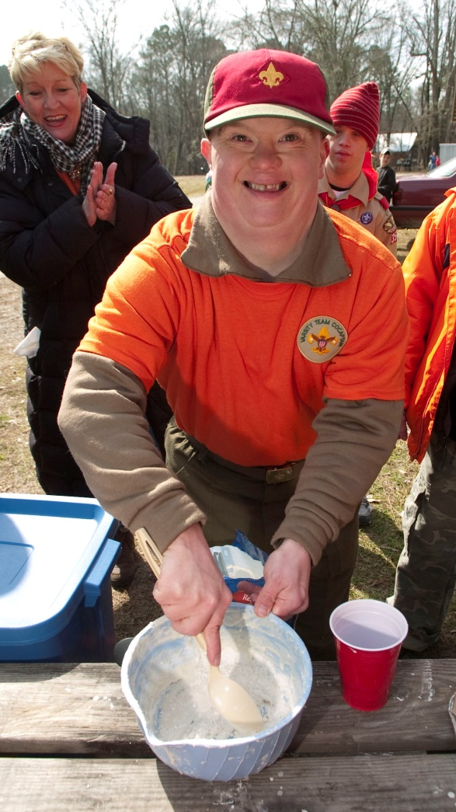
Scouts with Special Needs
Merit badge requirements must not be waived or changed for any Scout.
Scouts with disabilities—either permanent, or expected to last at least two years or beyond age 18—still may advance.
The “Application for Alternative Eagle Scout Rank Merit Badges” may be found at: www.scouting.org/filestore/pdf/512-730.pdf
Guide to Advancement section 10
Notes:
Individual requirements for merit badges may not be modified or substituted under any circumstances for any Scout.
Youth with disabilities, however, who want to advance beyond First Class may be approved for alternative merit badges to those required for Eagle. This is allowed on the basis of one entire badge for another. To qualify, a Scout (or a Venturer or Sea Scout) must have a permanent physical or mental disability, or a disability expected to last more than two years, or beyond the age of eligibility.
They must submit the “Application for Alternative Eagle Scout Rank Merit Badges.” The URL is on the screen. The application must be accompanied by documentation from a qualified health-care professional and be approved by the unit leader, unit committee chair, and the district and council advancement committees.
Before applying, however, the youth must earn as many of the Eagle-required merit badges as possible, and any alternatives must present the same challenge and learning level as those they replace.
28

Slide 29
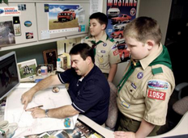
Buddy System
A Scout must have a buddy with him at every meeting with a merit badge counselor.
A buddy could include:
Another Scout
A parent or guardian
A brother or sister
A relative or friend
Guide to Advancement topic 7.0.3.1
Notes:
A Scout must have a buddy with him at each meeting with a merit badge counselor—preferably a fellow Scout or someone else known to him.
As a merit badge counselor, you must avoid being alone with a Scout, even just for a moment. BSA Youth Protection training further explains Scouting's policies prohibiting one-on-one contact with youth. Since all of you have either already taken the training, or must do so before you begin counseling, there’s no need to discuss this further—except to say that youth protection is a critical issue that we know you will all take seriously.

Slide 30

Tips for Counseling
Make Scouts feel welcome
and relaxed.
First impressions matter.
Ask a few simple questions.
Show them something related to the subject.
Invite them to demonstrate a simple skill.
Remember: This is Scouting. Have fun.
Notes:
Let’s talk about a few counseling techniques that make the experience better for the Scouts.
For the Scout to get the most benefit from the counseling session, he must feel welcome and relaxed. A friendly greeting and a few simple questions, such as, “What got you interested in the Astronomy merit badge?” will go a long way.
Another way to put a Scout at ease is to show him something related to the merit badge subject. For example, you might show him your coin collection, but it is best not to overwhelm him.
Remember, part of your role is to help Scouts be responsible for their own full participation in the process. One way to accomplish this is to carefully review all of the requirements together. Be sure to emphasize those key action words like: "demonstrate,“ “make a list,” or "collect, identify, and label.” Working together—interacting—and developing an understanding from the very beginning that there are no short cuts to earning the badge may help Scouts take the initiative and become fully engaged.
Lastly, keep in mind that the merit badge experience should be gratifying to both you and the Scouts. Remember, this is Scouting. It's supposed to be fun.

Slide 31
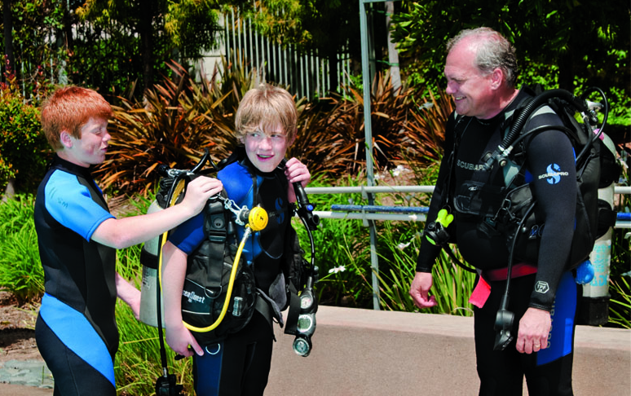
Tips for Counseling
Use the EDGE method.
Explain
Demonstrate
Guide
Enable
Notes:
Using the EDGE method in providing learning experiences has the potential to increase retention.
Explaining is important because it clarifies the subject for the learner and for the instructor.
Demonstrating is important because it allows learners to see, as well as hear, how something is done. They can follow the process from beginning to end.
Guiding is important because it allows learning by doing. It allows the instructor to see how well learners are grasping the skill.
Enabling is important because it allows learners to use the skills themselves. It also encourages repetition—an important part of mastering a skill.

Slide 32

Group Instruction
Benefits
Guest experts
Interactive learning
Slide shows, skits, demonstrations,
and other dynamic approaches
The Challenge
Every Scout must actually and personally fulfill every requirement as written.
Guide to Advancement topic 7.0.3.2
Notes:
It is acceptable and sometimes desirable for merit badges to be taught to groups of Scouts. Popular forums include summer camp, of course, and also merit badge midways, fairs, and clinics, and the use of technology through webinars and videocasts. The greatest benefits to group instruction probably stem from the ability to bring in subject matter experts from neighboring colleges and universities, and to have Scouts work together to discuss concepts and learn skills. Getting several Scouts together for merit badges also tends to encourage the use of slide shows and other approaches that might not seem feasible with just a counselor, a Scout, and his buddy.
The biggest challenge to group instruction is monitoring each individual Scout’s progress. The larger the group, the more difficult it is to maintain a degree of personal attention to every participant. If the group becomes too large, then more counselors must be brought to bear, or other methods must be used to assure that every Scout actually and personally fulfills every requirement. If this challenge cannot be met, then group instruction must be abandoned. Awarding badges to Scouts on the basis of sitting in classrooms watching demonstrations or remaining silent during discussions is totally and completely unacceptable.
32

Slide 33
Group Instruction
Ensuring Quality
Limit group instruction to cases where the benefits are compelling.
See that all counselors are registered
and approved.
Establish processes where counselors confirm prerequisites have been completed.
Report any issues to the council advancement committee.
Guide to Advancement topic 7.0.3.2
Notes:
In order to offer quality merit badge programs in a group setting, council and district advancement committees should put reasonable checks and balances in place.
First, assure that only merit badge counselors who are known to be registered and approved are allowed to participate, and that they agree to sign off only those requirements each Scout has actually and personally completed. And be sure that any guest experts or guest speakers, or others assisting who are not registered and approved counselors, are just that and do not behave like counselors, signing blue cards, for example.
Second, counselors should agree on a way to verify that prerequisites for certain merit badges have been completed prior to Scouts attending the session. It must not be assumed that prerequisites have been completed without evidence of some sort, that the work has been done.
Third, concerns about summer camp or other group instructional merit badge programs should be reported to your council advancement committee. The form “Reporting Merit Badge Counseling Concerns” in the Guide to Advancement appendix may be used for this purpose.
33

Slide 34
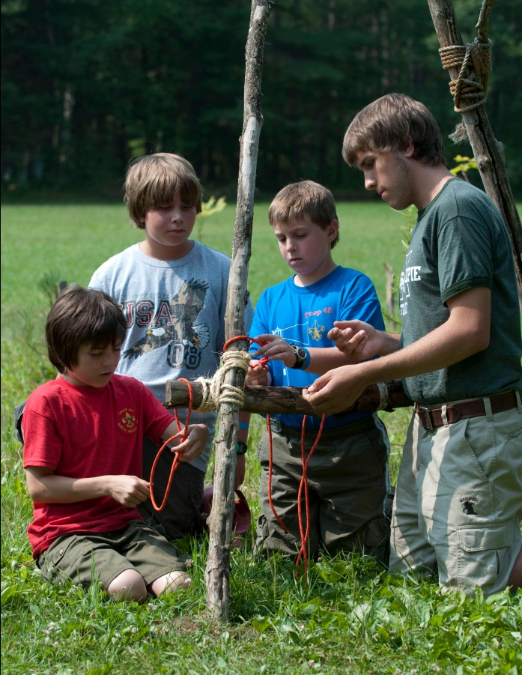
Camp Settings
No exemption from merit
badge counselor qualifications.
Staff members under 18
may assist, but must work
with qualified counselors.
Instruction must be done in accordance with the “group instruction” procedures found in the
Guide to Advancement.
Guide to Advancement topics 5.0.1.3 and 7.0.3.2
Notes:
Most Scouts will attend summer camp at some point and have the opportunity to earn outdoor-related badges like Swimming, Rifle Shooting, Canoeing, and many of the handicraft-related badges. Merit badge instruction is almost always conducted in group sessions often led by staff members under 18.
Councils must ensure, however, that a registered, qualified, and approved counselor is present to oversee these sessions, and to sign the blue cards verifying that each Scout has actually and personally fulfilled all the requirements as they are written.
There are no camp-related exemptions from the qualifications described under “Qualifications of Counselors,” topic seventy-eleven, in the Guide to Advancement. Councils may not change the rules about who qualifies; this includes eligibility age, as well as registration and approval as counselors.
34

Slide 35
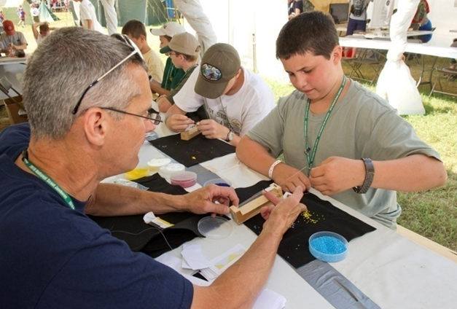
Merit Badge Events
Merit badge fairs may provide an overview or introduction to multiple badges.
It should be rare that Scouts begin and finish badges at one- or two-day events.
Prerequisites should
be made known early.
Scouts must actually
and personally fulfill
all requirements.
Guide to Advancement topic 7.0.3.2
Notes:
Merit badge fairs, colleges, or midways provide an opportunity for councils, districts, or even units, to offer Scouts an overview or introduction to multiple merit badges. Unless participants have completed many or most of the requirements ahead of time, it should be rare that merit badges can be completed during these one- or two-day events. Few if any merit badges lend themselves to such a fast pace. If the event is operated according to BSA policies and procedures, most Scouts will get a good start on the requirements with the ability to finish them later with another registered and approved counselor.
Expectations should be established, and made known well before the date of the event, as to which requirements must be fulfilled ahead of time in order to actually finish merit badges at the event. Then at the event there must be attention to each individual’s projects and confirmation that requirements are “actually and personally” completed. As we discussed earlier, every Scout must participate fully. It is unacceptable to give credit for simply attending.
35

Slide 36
Merit Badge Events
Only minimal fees should be charged for events.
Events staged as fundraisers are discouraged.
Non-Scouting organizations or businesses are not allowed to use protected BSA trade names, images, logos, or artwork without national BSA permission.
Non-Scouting organizations must have local council approval to present classes that are for the sole purpose of earning merit badges.
Guide to Advancement topic 7.0.4.9 and 7.0.4.10
Notes:
Although it is permissible to charge fees for merit badge fairs or clinics, or similar events, any such charges should be limited to recovering the costs directly related to presenting the opportunity. Local councils and districts may also include in the fee, a reasonable contribution to the council’s overhead and administrative costs.
Using merit badge events as fundraisers is not prohibited; however, the National Advancement Team discourages the practice, and councils may exercise their authority not to approve them. It is better to keep any fees at the absolute minimum so all Scouts have the opportunity to participate.
There may be opportunities for Scouts to earn merit badges through participation in activities presented by organizations or businesses not affiliated with the BSA. Zoos, museums, recreation centers, major home improvement stores, and even individuals may be involved.
Without prior BSA approval, these opportunities are permitted only when fulfilling merit badge requirements is “incidental” to the opportunity. For example, a youth recreation center could present a basketball camp and mention in promotional material that participants might, as a result of attending, fulfill some of the requirements for the Sports merit badge. Of course, registered and approved merit badge counselors would have to sign off any requirements met. However, even when merit badge opportunities are incidental to the programs presented, outside organizations are not allowed to use protected BSA trade names, images, logos, or artwork without the express written consent of the National Council.
Outside organizations and businesses must have approval from the local council if they plan to present classes, events, or similar activities that are largely devoted to the purpose of offering merit badges. For example, the recreation center mentioned above would not be allowed to present a Sports merit badge camp without permission. The 2013 Guide to Advancement covers this in more detail in section seven.
36

Slide 37
Worksheets and Learning Aids
Merit badge “worksheets” from the Web or other sources are unofficial, but may aid in learning.
These tools must relate to current BSA requirements, which still must be fulfilled as written.
Worksheets may be used to meet “in writing” requirements.
Worksheets are not a substitute for “telling,” “showing,” or “demonstrating,” etc.
Scouts must not be required to use them.
Guide to Advancement topic 7.0.4.8
Notes:
Worksheets and other materials that may be of assistance in earning merit badges are available from a variety of sources including the Internet and troop libraries. Use of these aids is permissible as long as they can be correlated with the current requirements. Completed “worksheets” may suffice where a requirement calls for something in writing, but they do not work as substitutes where Scouts must discuss, tell, show, or demonstrate something.
The Boy Scouts of America does not currently produce any worksheets or other similar learning aids for merit badges simply due to the costs and additional effort related to keeping them up to date. The National Advancement Team, however, recognizes the value of such tools, and permits their use as long as merit badge counselors and unit leaders understand this is not official material and that use of the tools must not serve to alter merit badge requirements or provide unauthorized shortcuts. Scouts are still expected to complete all the official requirements as written.
It is important to note that regardless of the value of these worksheets or other learning aids, Scouts must not be required to use them.

Slide 38
Completing the “Partial” Blue Card
  The merit badge counselor records and initials the front of the card in the middle section as each requirement is completed.
  The back of the card is not signed in either place until all requirements are fulfilled.
  Partials do not expire as long as the Scout is a registered youth member.
  Accepting a “partial” is at the follow-up counselor’s discretion.
Guide to Advancement topic 7.0.3.3
Notes:
[Presenter note: hold up a blue card while working with this slide, or ask participants to refer to their copy if you provided one in a packet you distributed. Point out the areas on the card as you describe the steps below.]
We’ve touched on “partials” several times, and by now you should have a good understanding that they may often be the appropriate outcome from a summer camp or merit badge event experience.
As you issue partials, there are a few fine points to keep in mind:
Use the table area on the front of the second panel of the blue card to list and initial each requirement as the Scout completes it. Please don’t ever rely on your memory.
Do not sign the counselor signature line on the front two panels of the card until all requirements are fulfilled.
Partially completed merit badges don’t expire. The Scout has until his 18th birthday to complete the requirements.
In the case of a partial completion, the original counselor does not retain the counselor’s portion of the card. [Point to this portion.] Any subsequent counselors will need to work with it. Future counselors may choose not to accept partial work, but this should be rare, and if a Scout believes he is being treated unfairly in this, he may work with his Scoutmaster to find another counselor.
38

Slide 39
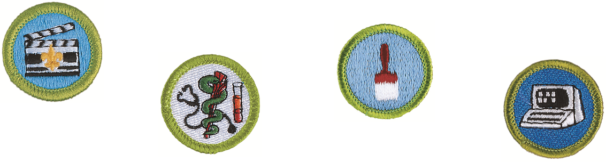
Once It’s Earned, It’s Earned
A Scout who has earned a merit badge from a registered and approved counselor by actually and personally fulfilling the requirements as written, will have met the purpose of the merit badge program and the contributions to the aims of Scouting. The badge is his to keep and count.
Guide to Advancement topic 7.0.4.6
Notes:
The key word here is “earned.” [Pause, give participants a chance to read the slide.]
If a Scout learns the material for a particular merit badge and a registered and approved counselor successfully tests him on the requirements, and then a brief review with the unit leader confirms the Scout has earned the badge (note that’s “review” not “retest”), then the advancement is recorded and the Scout is recognized with the merit badge patch. End of story. The aims of Scouting—with regard to this merit badge—have been met.
Even though this topic is now worded somewhat differently in the Guide to Advancement, it will still raise questions. So let’s see how you might answer them.
First question: What if the Scout doesn’t retain what he learned? Is there any recourse? Why or why not? [Allow participants to respond.]
[The answer:] There is no recourse. He still gets to keep and count the badge. According to topic twenty-oh-three in the Guide to Advancement, “Personal Growth Is the Primary Goal.” “As a Scout learns a skill and then is tested on it, and reviewed and recognized, he develops confidence. He comes to realize he can learn and do other similar things. The retention of Scouting skills and knowledge is important, of course, but for retention to take place, it will be because Scouting skills and knowledge are used in our programs.”
Second question: What if the counselor is not registered or not approved, but the Scout still, actually and personally, fulfilled all the requirements as written? [Allow participants to respond.]
[The answer:] The Guide to Advancement, in topic seventy-forty-six, says, “The badge is his to keep and count…if a Scout, without intent to violate national BSA procedures or policies, fulfills merit badge requirements with someone who is not registered and approved as a counselor.” It goes on to say, “This could happen, for example, if a Scout, in good faith, contacts someone who has inadvertently been dropped from a unit or district charter.”

Slide 40
A Second Counselor Review
May Be Warranted If…
  A Scout, to whom it has been made clear that only registered and approved counselors are to be used, chooses to ignore this mandated procedure.
  It becomes plainly evident that it could not have been possible for a Scout to actually and personally fulfill requirements as written. In this case a limited recourse is available, according to the details outlined in topic 7.0.4.7.
Guide to Advancement topics 7.0.4.6 & 7.0.4.7
Notes:
It is the unit leader’s responsibility to help Scouts understand that only registered and approved counselors are to be used. If this has been communicated and a youth shows he has a clear understanding of the mandate, but yet he ignores it, then the unit leader may require the young man to work with another counselor who is properly registered and approved, and who will verify that the requirements were met and then sign the blue card. The unit leader should discuss potential follow-up counselors with the Scout and provide the name of at least one, but Scouts must be allowed to work with registered and approved counselors of their choice.
If it is suspected that it would have been impossible for a youth to complete a merit badge, there is a limited recourse available that may result in a decision that the requirements could not have been fulfilled, and thus, the merit badge was not actually earned. This might be the case if a Scout, for example, returns from camp with an extraordinary number of signed blue cards—over and above what most Scouts ever earn at camp.
The unit leader begins the process by consulting with those involved, such as the merit badge fair coordinator, camp director, or counselor. Then in a positive, supporting manner, the unit leader should hold a conference with the youth and discuss aspects of the merit badge class, such as who taught the program, when and where it was held, what sort of activities took place, how testing was done, and what the youth took home from the program. Note that this is not a re-testing session.
If it becomes clear and evident that requirements could not possibly have been completed, then the unit leader offers the name of at least one other counselor the youth may work with to fulfill the incomplete requirements. Again, however, the youth may choose any registered and approved counselor.
Special Note: In this case the merit badge is not taken away because, although signed-off, it was never actually earned. Additionally, this procedure is not to be viewed as an opportunity to retest on requirements; to inject another set of standards; or to debate whether the youth was strong enough, mature enough, or old enough to have completed the requirements.
More information on using this limited recourse is detailed in the Guide to Advancement, topic seventy-forty-seven.

Slide 41
Addressing Merit Badge Myths
  At what age or rank may Boy Scouts work on merit badges?
  What is the maximum number of merit badges a Scout may work on at the same time?
  Is a Scout allowed to begin work on a merit badge without his unit leader’s approval?
  If a Scout has too many unfinished merit badges, may the Scoutmaster limit how many others he may begin?
Notes:
As we wrap up our session, we’re going to take a minute to review some policies and procedures that are often misapplied. Take a look at these questions, and then we’ll run down them quickly. We have the answers on other slides.
[Note to the presenter: Perhaps use a flip chart to record consensus of participants’ answers to each question on this and the next to slides.]
41

Slide 42
Addressing Merit Badge Myths
  Is it appropriate to tell a Scout he must earn all or most of his Eagle-required badges before he earns any others?
  Is the Scoutmaster permitted to serve as a troop merit badge counselor for some merit badges like Camping or Hiking?
What is the maximum number of badges a youth may earn from one counselor?
How many badges may one counselor be approved to counsel?
Notes:
Same exercise as previous slide.

Slide 43
Addressing Merit Badge Myths
  May you counsel your own son?
  May you counsel in other units, districts, or councils?
  Due to tight schedules, is a camp staff member allowed to make minor adjustments so requirements can be finished at camp?
  Once you are registered and approved as a counselor, at what point must you re-register and become re-approved?
  When does a “partial” expire?
Notes:
Same exercise as previous slide.
43

Slide 44
Merit Badge Myths – Review
  At what age or rank may Boy Scouts work on merit badges?
  There is no limit if registered as a Scout.
  What is the maximum number of merit badges a Scout may work on at the same time?
  There is no limit.
  Is a Scout allowed to begin work on a merit badge without his unit leader’s approval?
  Approval is no longer required; a discussion
  is now held.
Notes:
There is no minimum age or rank. Any registered Scout can work on any merit badge at any time.
There is no limit to the number of badges a Scout may work on at one time. At one point or another we’ve all had too many “irons” in the fire. The Scout should be allowed the same learning experience.
The 2013 Guide to Advancement covers this. The unit leader does not provide an approval, but instead has a discussion with the Scout about what to expect, how to fulfill the requirements, and any difficulties that could be faced. The discussion may be a lot like a Scoutmaster conference and it could even cover establishing a goal for completing the work. But in a way, this is a “trick question.” The unit leader’s signature is required before the Scout begins to work with a merit badge counselor. It is not required to begin work on the merit badge itself.
44

Slide 45
Merit Badge Myths – Review
  If a Scout has too many unfinished merit badges, may the Scoutmaster limit how many others he may begin?
  During the discussion of a new merit badge,
  the Scoutmaster should provide counseling
  on what to do.
  Is it appropriate to tell a Scout he must earn all or most of his Eagle-required badges before he earns any others?
  A Scoutmaster could only suggest this.
Notes:
All the Scoutmaster could do is counsel the Scout to perhaps finish what was begun.
There are some Scouts who might do well to begin with required badges, but this choice belongs to the Scout.

Slide 46
Merit Badge Myths – Review
  Is the Scoutmaster permitted to serve as a troop merit badge counselor for some merit badges like Camping or Hiking?
  This is permitted only if the unit leader is registered and approved as a counselor.
What is the maximum number of badges a youth may earn from one counselor?
There is no BSA limit. A unit leader may set a limit, but it must apply to all Scouts in the unit.
Notes:
All merit badge counselors must be registered and approved for each merit badge they counsel. There are no exceptions for unit leaders, camp staff, merit badge event faculty, or anyone else.
The National Council does not place a limit on the number of merit badges a youth may earn from one counselor; however, the unit leader is permitted to place a limit on the number of merit badges that may be earned from one counselor, as long as the same limit applies to all Scouts in the unit.

Slide 47
Merit Badge Myths – Review
  How many badges may one counselor be approved to counsel?
  National places no limit on this. Councils may do so, within reason.
  May you counsel your own son?
  Yes, but generally it is better for Scouts to learn from a variety of adults.
  May you counsel in other units, districts, or councils?
  Yes.
Notes:
The National Council does not limit the number of badges for which a counselor may be approved, but councils are permitted to do this as a method of assuring a higher level of education and skills. But remember that any such local procedure should be flexible so that all merit badges are covered.
Yes, but unless the Scout is in a remote location or there are other reasons why the parent is the best choice as a counselor, it is better for Scouts to learn from, and associate with, a variety of adults.
Yes. It is permissible for counselors who are registered and approved in one council to work with Scouts from other councils, units, or districts.
47

Slide 48
Merit Badge Myths – Review
  Due to tight schedules, is a camp staff member allowed to make minor adjustments so requirements can be finished at camp?
  Absolutely not.
  Once you are registered and approved as a counselor, at what point must you re-register and become re-approved?
  Annually.
  When does a “partial” expire?
  When the youth is no longer eligible to register as a Boy Scout.
Notes:
Just to be clear, the answer, of course, is NO!
Yes. Every year.
Partials expire on the 18th birthday unless a man with a permanent and severe disability is approved by the council executive board to register as a youth member beyond the age of eligibility, according to section 10 of the Guide to Advancement.
48

Slide 49
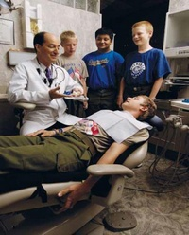
Merit Badge Counselors
Share passion
Teach skills
Touch lives
Notes:
As a merit badge counselor, you will have the opportunity to share your passion with Scouts. You will teach skills that may last a lifetime and you will positively touch—and in some cases, dramatically change—the lives of many men. You may not get to know this as you work directly in the program, but it will happen.
Enjoy the opportunity you have in front of you! And thank you for your commitment.

Slide 50
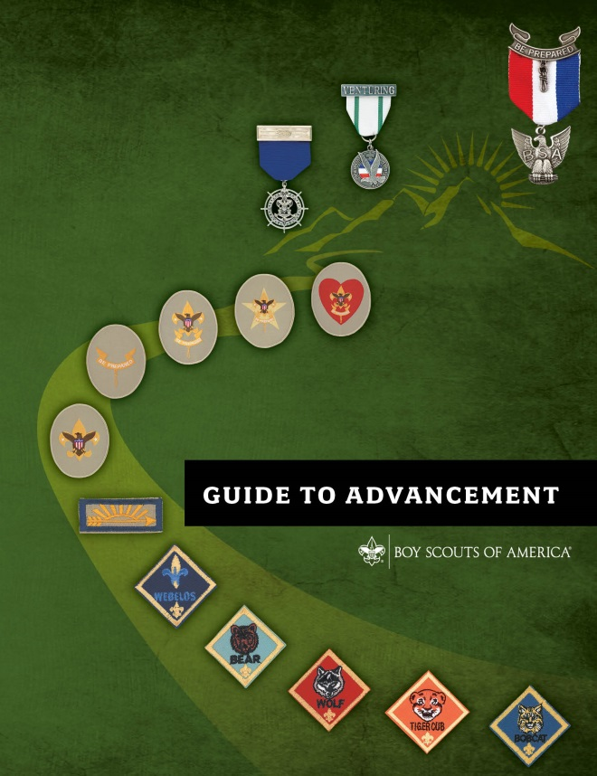
For More Information
Other advancement presentations available at:
www.scouting.org/advancement
Resources
Guide to Advancement, No. 33088
BSA’s Guide to Safe Scouting, No. 34416
Merit badge pamphlets
Boy Scout Requirements, No. 616334
Application for Merit Badge, No. 34124
A Guide for Merit Badge Counseling, No. 34532
Boy Scout Handbook, No. 34554
Merit Badge Counselor Information, No. 34405
BSA Adult Application, No. 524-501
Notes:
[Note to the presenter: This is your opportunity to review any details or issues participants indicated earlier that they wanted to be sure were covered. Provide the answers to any that were not covered, and allow further questions from the group as time allows. This is also the time to gather feedback for passing on to the National Advancement Team. Please send any comments or suggestions to advancement.team@scouting.org.]

