Slide 1
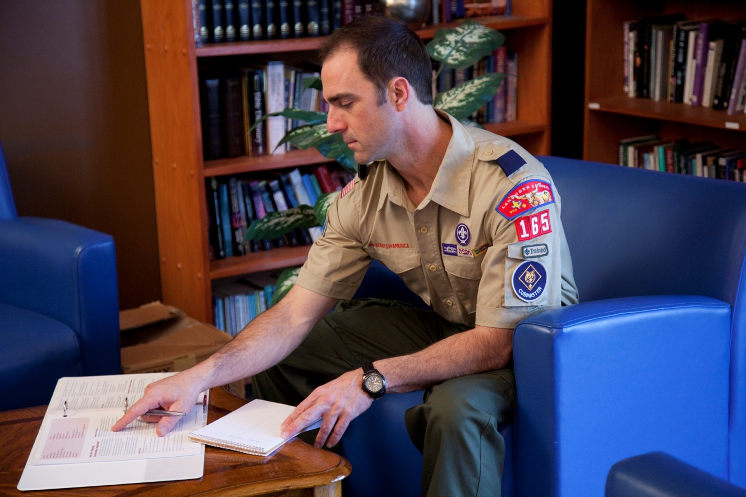
The Cubmaster
Notes:
Say (in your own words):
Welcome to Cubmaster Training. My name is _____. The other trainers are
_______. We are here to help you learn about your role in the pack and how that
will affect the lives of boys.
Do:
Be sure that you exhibit energy and enthusiasm as you introduce yourself
and the other trainers.

Slide 2
Objectives
Define the roles of the Cubmaster and assistant Cubmaster.
Describe the Cub Scout advancement program.
Review the importance of pack program planning.
Plan a pack meeting.
Describe the Cubmaster Award.
Succeed as a Cubmaster.
Notes:
Say (in your own words):
This session will show you what it takes to be a Cubmaster.
Most of the Fast Start session was devoted to planning your first pack meeting. Today’s
session will go into more details about planning and conducting those meetings. You will
have an opportunity to plan a pack meeting.
Do:
Briefly discuss each objective. Reassure participants that when they have completed
this training, they will be ready to function as a Cubmaster and lead pack meetings and
other pack activities.
Show the Cub Scout Leader Book and tell the participants that most of their
questions are answered in the book.
Resource: Cub Scout Leader Book, Den & Pack Meeting Resource Guide

Slide 3
The Pack
Chartered Organization
Chartered Organization
Representative
Local Council
Pack Committee
Pack Trainer
Cubmaster
Assistant Cubmaster
Tiger Cub Den Leaders
Cub Scout Den Leaders
Webelos Den Leaders
Adult Partners
Assistant Cub Scout
Den Leaders
Assistant Webelos
Den Leaders
Den Chief
Den Chief
Den Chief
Notes:
Say (in your own words):
As Cubmaster and assistant Cubmaster, you are the leaders of the pack.
Do:
Discuss the position of the Cubmaster in the organization chart. The Cubmaster
leads the pack with the assistance and approval of the pack committee and the
chartered organization.
Resource: Cub Scout Leader Book

Slide 4
The Cubmaster
Complete Cubmaster Fast Start training and leader position-specific training. Attend monthly roundtables.
Plan and help carry out the Cub Scout program in the pack—including leading the monthly pack meeting—according to BSA policies.
With the pack committee, develop and execute a year-round recruitment plan for recruiting boys into Cub Scouting.
Work on program ideas, selecting and recruiting adult leaders, and establishing a budget plan.
Guide and support den leaders through their required training.
Notes:
Say (in your own words):
The Cubmaster provides these services to the pack.
Do:
Review the requirements for the position with participants. Show the Cub Scout
Leader Book and the Cubmaster Position Summary handout in the back of this book.
Resources: Cub Scout Leader Book, Cubmaster Position Summary handout

Slide 5
The Assistant Cubmaster
Help the Cubmaster as needed. Be ready to fill in for the Cubmaster, if necessary.
Complete Cubmaster Fast Start training and position-specific Basic Leader Training.
Attend monthly roundtables and participate in pack meetings.
Supervise den chiefs and see that they are trained.
Conduct the monthly den chief planning meeting for all den leaders, assistant den leaders, and den chiefs to plan and coordinate weekly den meetings and pack meeting participation.
Along with the pack committee, develop and promote an ongoing plan for recruiting new boys.
Notes:
Say (in your own words):
Assistant Cubmasters hold an important role. They help Cubmasters plan and
conduct pack meetings and assist at outings and other pack activities.
Do:
Review the requirements for the position with the participants. See the Cub Scout
Leader Book.
Resource: Cub Scout Leader Book

Slide 6
Cubmaster Support
Pack committee
Den leaders
Chartered organization
District and council, through
Commissioners
District Cub Scout roundtables
District committee
District executive
District training team
Notes:
Say (in your own words):
The Cubmaster and assistant Cubmaster do not work alone; they are supported
by many other people.
Do:
Describe how the Cubmaster is helped by the people listed in the slide.

Slide 7
Leadership Skills
Working with the pack team
Effective communications
Understanding and working with boys
Projecting Cub Scout spirit
Showmanship as the pack’s “Master of Ceremonies”
Notes:
Say (in your own words):
Effective Cubmasters have great leadership skills.
Do:
Briefly discuss the importance of each of the listed skills.
Explain that since the Cubmaster is the leader of the pack, showing good Cub
Scout spirit is essential in helping the leaders and boys know what is expected
of good Cub Scouts!
At this point, ask the participants how a Cubmaster can demonstrate these skills.
Give plenty of time for discussion. You may also wish to give a few good
examples from your local packs.
Resource: Cub Scout Leader Book

Slide 8
The Advancement Method
Grade-related and progressive
An asset for parents
Parents’ roles change as boys mature.
Notes:
Say (in your own words):
We have discussed advancement before, but now we’ll discuss it from
a Cubmaster’s perspective.
Do:
Explain the advancement method as shown in the slide, and point out that as
boys get older, they are expected to be able to do more but that from the Tiger Cub’s
adult partner to the Webelos Scout’s den leader, adults are necessary to the process
and the result is not only advancement, but a boy who has good, strong relationships
with the adults in his life.
Emphasize that Cub Scout activities, even those that lead to advancement, are
meant to be fun and should never be like homework or similar activities.
Resource: Cub Scout Leader Book

Slide 9
Cub Scout Advancement
The Bobcat badge
The Tiger Cub badge
The Wolf badge
The Bear badge
The Webelos badge
The Arrow of Light Award
Notes:
Say (in your own words):
Remember the sequence of advancement?
Do:
Highlight the sequence: All boys earn the Bobcat badge first and then the rank
for their age and grade level.
Remind participants that boys cannot earn badges for earlier ages, and tell
them that the Cubmaster has particular responsibility for ensuring, for instance,
that third graders earn the Bear Cub Scout badge, not the Tiger Cub badge.
Resource: Cub Scout Leader Book

Slide 10
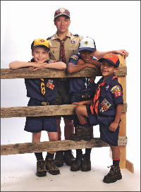
Cub Scout Uniforming
Sense of belonging
Recognition
Identification with Scouting
Notes:
Say (in your own words):
The uniform lets the boys show that they are part of Cub Scouting.
Do:
Discuss the importance of uniforming. Show the Tiger Cub, Cub Scout,
and Webelos Scout Uniform Inspection Sheet and recommend that it be used at
a pack meeting several times a year to encourage proper uniforming.
Talk about how to get boys into uniforms. Suggest second-hand clothing
stores and pack uniform exchanges for those who have financial difficulties.
Explain the value of an “experienced” uniform in making new boys feel that
they are truly part of the pack.
Resources: Cub Scout Leader Book; Tiger Cub, Cub Scout, and Webelos
Scout Uniform Inspection Sheet; and the Insignia Guide

Slide 11
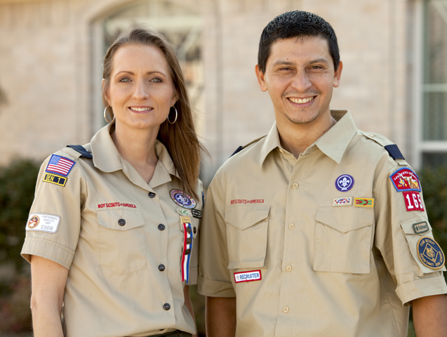
Adult Leader Uniforming
Sets the example
Notes:
Say (in your own words):
Adults, particularly the Cubmaster and assistant Cubmaster, set the example for
the boys in Cub Scouting.
Do:
Remind participants that the Cubmaster and assistant Cubmaster need to be
properly uniformed to present the best possible image for the boys to follow.
Conduct a uniform inspection with the participants. Tell them it is their responsibility
to encourage all pack leaders, including committee members and trainers,
to be properly uniformed at all Cub Scouting events. Note that non-official
and extraneous pins and badges, while interesting, are not part of the uniform
standard and should not be worn with the uniform. Show the Insignia Guide
and explain how it can help.
Resources: Cub Scout Leader Book, Adult Leader Uniform Inspection Sheet,
and the Insignia Guide

Slide 12
Summary
Advancement is grade-based and progressive.
A partnership between parents and leaders is key to advancement.
Leaders set the uniforming example for all.
Notes:
Say (in your own words):
We have discussed what it means to be a Cubmaster and covered these items.
Do:
Briefly discuss the slide content. Conduct a morale feature to enhance the
participants’ learning experience. Announce a short break.

Slide 13
Planning in the Pack
Annual program planning conference
The monthly pack leaders’ meeting
Pack meeting built around monthly Core Values.
Core Values tie each pack meeting together
Utilize
Cub Scout Leader Book
Den & Pack Meeting Resource Guide
Scouting magazine
Boys’ Life
Notes:
Say (in your own words):
Planning is essential to pack success. As the Cubmaster, you will be a key in planning
for the pack program and meetings.
Do:
Show the resources that are used in planning the pack program and meetings.
Discuss monthly Core Values. The participants have already been introduced to the
Core Value idea, so this should be a brief discussion.
Resources: Cub Scout Leader Book, Den & Pack Meeting Resource Guide,
Cub Scout Leader How-To Book, Cub Scout Songbook, Group Meeting Sparklers,
Webelos Leader Guide

Slide 14
Nine Elements of Planning
1. Objective
2. Fun
3. Variety
4. Action
5. Boy Appeal
6. Family Appeal
7. Achievement
8. Resources
9. Flexibility
Notes:
Say (in your own words):
When planning the Cub Scouting program, include the following elements:
1. Objective. Program activities should meet the purposes of Cub Scouting
and provide opportunities for physical, spiritual, mental/emotional, and social growth.
2. Fun. Cub Scouting must be fun, not only for the boys, but for the whole
family. If the program is fun, boys will continue to attend.
3. Variety. A variety of activities is used to achieve the purposes of Cub Scouting.
Include games, crafts, skits, songs, stunts, ceremonies, trips, and outdoor activities
for a well-rounded program.
4. Action. Activities that require action and participation help boys enjoy the
experience. Boys need to do, not just watch. Action does not necessarily mean
running around (although boys love to do that). It means being engaged
in an activity versus passively receiving information.
5. Boy Appeal. Plan activities that are appropriate for Cub Scout–age boys,
such as those that include action, experimenting, mystery, and excitement.
6. Family Appeal. Cub Scouting is a family program, with families working
and playing together. Activities should help strengthen and enrich families.
7. Achievement. Boys need recognition so that they will feel a sense of achievement
while they are having fun.
8. Resources. Make good use of all people, facilities, materials, and equipment
available. Use the talents and skills of leaders, families, boys, and neighborhood friends.
9. Flexibility. Have a backup plan for unexpected changes or surprises.
Be prepared to change the program for special circumstances that affect
the local community or area.

Slide 15
Program Planning Steps
1. Annual pack program planning conference
2. Monthly pack leaders’ planning meetings
Notes:
Say (in your own words):
Planning a Cub Scout program can seem daunting at first, but don’t be
intimated. By working as a team and breaking planning down into steps, leaders
can create a great program for Cub Scouts. Cub Scout program planning
involves two main steps:
1. Conducting an annual pack program planning conference.
2. Conducting monthly pack leaders’ planning meetings.

Slide 16
Annual Pack Program Planning Conference
Led by the pack chair.
Supported by the pack committee and Cubmaster.
Den leaders and interested parents attend and participate.
Notes:
Say (in your own words):
The annual pack planning conference is probably the most important Scouting
meeting each year as it sets the direction and calendar for the year. And parents
are waiting for the calendar.
Do:
Reinforce that the meeting is led by the committee chair but is the joint responsibility
of the committee and the Cubmaster.
Tell leaders about the pack program planning chart and how it can be used
build the pack’s program for the year.
Let attendees know that the annual meeting will cover program, financial,
and membership goals and plans.

Slide 17
Key Outcomes of Annual Pack Planning Meeting
Pack schedule
Pack budget
Pack leadership
Notes:
Say (in your own words):
The annual planning meeting is the time to set the direction of the pack for the
upcoming Scouting year.
Do:
Discuss the importance of planning the pack’s calendar, budget, and leadership,
and communicating the outcome early to the pack family.
Resources: Cub Scout Leader Book

Slide 18
Pack Budgeting
Led by the pack committee
Developed annually
Defines what the pack will do
Outlines how funds will be raised
Notes:
Say (in your own words):
Cub Scouts need to develop an appreciation for money and how to earn, spend,
share, and save it responsibly. The Pack Budget Plan offers suggestions for leaders
to guide Cub Scouts in this important matter, and it lets families know exactly
what benefits they are receiving from the dues they pay.
Do:
Explain that planning the pack budget is the responsibility of the pack committee—
with the help of other pack leaders and families—and that it is best to plan the
budget after the annual pack program planning conference is complete.
Resources: Cub Scout Leader Book

Slide 19
Pack Activities
Blue and gold banquet
District and council activities
Field trips and hikes
Pinewood derby®
Raingutter regatta
Space derby
Scouting Anniversary Week celebrations
Service projects
Year-round program!
Notes:
Say (in your own words):
These are some common pack activities.
Do:
Describe each of the activities.
Show pinewood derby® cars and other
derby props.
Discuss the importance of service projects.
Show the Cub Scout Leader How-To Book as a resource for planning many of
these events.
Resources: Cub Scout Leader Book, Cub Scout Leader How-To Book

Slide 20
Cub Scout Camping
Day camp
Resident camp
Family camping
Pack camping (overnighters)
Be sure to include pack camping in your annual program plans.
Notes:
Say (in your own words):
Remember to include camping in your pack program.
Do:
Discuss the difference between family camping and pack overnighters.
Note that packs may camp only in council approved locations under the supervision of
a BALOO-trained individual.
Resource: Cub Scout Leader Book

Slide 21
Monthly Pack Planning Meeting
Led by the pack chair.
Supported by the pack committee and Cubmaster.
Den leaders and interested parents attend and participate.
Follows a regular order:
Part 1: Evaluating the previous month
Part 2: Finalizing the current month
Part 3: Planning ahead
Part 4: Unit Leadership Enhancements
Part 5: Social time and fellowship
Notes:
Say (in your own words):
Part 1: Evaluating the previous month
The pack committee chair calls the meeting to order. The Cubmaster reviews the
previous month’s den and pack meeting activities and asks for comments and
suggestions. This evaluation will help with planning for the upcoming month.
Part 2: Finalizing the current month
The Cubmaster confirms assignments for the current month’s pack meeting.
Special committees report on plans for the current month’s pack meeting
or special event. Den leaders turn in den advancement reports to the person
responsible for obtaining awards for the next pack meeting. Den leaders turn
over den dues to the pack treasurer and receive a receipt.
Part 3: Planning ahead
The pack committee chair leads a general discussion about the upcoming month’s
den and pack meetings. The Cubmaster comments on next month’s den and pack
meetings and confirms assignments concerning den participation in next month’s
pack meeting. Special committees report on plans for the upcoming pack meeting
or special events for the upcoming month. Den leaders report on their den meeting
plans for the upcoming month. Activity badge counselors report on projects
planned for next month’s activity badges.
The pack committee chair reports on pack needs, problems, and progress. The pack
committee completes plans such as the organization of new dens, pack-troop
relations, financial matters, improving family participation, etc.
Part 4: Unit Leadership Enhancements
As part of the regular new business items at monthly pack leaders’ meetings, the
pack trainer should include one of the Unit Leadership Enhancement topics.
Part 5: Social time and fellowship

Slide 22
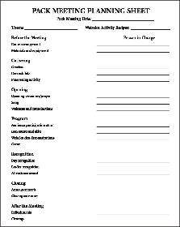
Cub Scout Pack Meetings
Before the Meeting
Gathering
Opening
Program
Recognition
Closing
After the Meeting
The Den & Pack Meeting Resource Guide contains a model pack meeting plan for each month!
Notes:
Say (in your own words):
As the Cubmaster, you are responsible for planning and conducting the pack meeting.
Your first leader training activity was conducted as a pack meeting. Lots of fun,
activity, and recognition are all part of a successful meeting.
Do:
Show the Pack Meeting Planning Sheet. Note that a written agenda is extremely
important for success, and it is important that everyone knows who is responsible
for each agenda item.
Review and discuss the Den & Pack Meeting Resource Guide and its preplanned
pack meeting.
Tell participants that they will not be alone in conducting the pack meeting; other adults
will be there as support.
Resource: Cub Scout Leader Book, Den & Pack Meeting Resource Guide

Slide 23
Before the Meeting
Room arrangements
Materials and equipment
Meeting agenda review
Recognition review
Put on a smile.
Get ready to have FUN!
Notes:
Say (in your own words):
The Cubmaster and other participating leaders complete preparations just
before the pack meeting. They make sure the room is in order and that all needed
materials are ready, and they review the agenda together to be sure nothing has
been forgotten.
Do:
Discuss the remaining points on the slide. Explain that the Cubmaster sets the tone
for the meeting—that excitement and leadership in others come from the
positive attitude the Cubmaster shows.
Resource: Cub Scout Leader Book

Slide 24
Gathering
Greeters
Den exhibits
Pre-opening activity
Notes:
Say (in your own words):
A den should be assigned to greet the people attending each pack meeting;
adult assistance will be necessary. A sign-in sheet can also be used to keep
track of who is there for an attendance award.
Do:
Explain the importance of the pre-opening activity: It is to keep arriving boys busy. If
you don’t find something for them to do, they will find it themselves—and it may
not be what you want them to do!
Resource: Cub Scout Leader Book

Slide 25
Opening
Opening ceremony/prayer
Flag ceremony
Pledge of Allegiance
Song (fun and active)
Welcome and introductions (short and sweet)
Notes:
Say (in your own words):
A good opening ceremony marks the start of the meeting. A flag ceremony is often
used. It can be followed by a non-denominational or interfaith prayer.
Then the fun begins!
Do:
Emphasize that it’s important to include everyone: Select songs that everyone
knows, use an opening ceremony that is appropriate to the event and the den
conducting the ceremony, use a prayer that includes all faiths represented in the pack.
Tell the participants that the Cubmaster welcomes Cub Scouts and families, and
introduces any special guests, recognizes the committees for their efforts and success
in setting up the meeting place, and keeps remarks brief to hold everyone’s attention.
Show the Den & Pack Meeting Resource Guide, the Cub Scout Leader How-To
Book, the Cub Scout Songbook, and Group Meeting Sparklers as good resources for
planning a pack meeting.
Resources: Den & Pack Meeting Resource Guide, Cub Scout Leader How-
To Book, Cub Scout Songbook, and Group Meeting Sparklers

Slide 26
Program
Tiger Cub and Cub Scout den skits and stunts
Webelos den demonstrations
Games
Include as many boys as possible!
Involve parents and others, too.
Organization is necessary.
Be prepared.
Notes:
Say (in your own words):
In this part of the meeting, we give the boys a chance to shine. Various skits and
stunts can be done. Cheers are always used to recognize the work the boys do!
Do:
Remind the participants that the boys need a chance to show what they are doing in
the dens. This part of the program is for that purpose.
Say that this helps inactive boys get active quickly. If you focus them on activities in
this part of the program, they will be active in ways you want them to be.
Tell the Cubmasters that they need to be prepared for things to go wrong or for
dens that are not ready for their part of the program, and that it helps to have extra
activities ready to use.
Resource: Den & Pack Meeting Resource Guide, Cub Scout Leader How-To Book,
Cub Scout Songbook, and Group Meeting Sparklers

Slide 27
Recognition
Boys
Advancement
Special awards
Leaders
Special thanks
Leader award presentation
Attendance awards
Organization
Notes:
Say (in your own words):
The recognition part of the meeting is important to the boys, to their parents and other
family members, and to the den leaders.
Do:
Remind participants that the advancement chair of the pack committee is responsible
for obtaining the advancement badges and awards before the pack meeting. Before
the pack meeting starts, the awards should be organized by den or by activity. Large
packs need a lot of preparation in this area to keep the pack meeting flowing.
An award should always be given to the adult family member, who then gives it to
the boy. Don’t take for granted that family members will attend; make sure they have
been alerted several days in advance.
Attendance awards can be given to recognize dens with the highest percentage of
members present.
Resources: Cub Scout Leader Book

Slide 28
Closing
Announcements
Keep them short
Important items only
Handouts for the other items
Closing ceremony
Cubmaster’s Minute
Flag ceremony, etc.
Notes:
Say (in your own words):
The meeting is nearly over. It’s time to end.
Do:
Briefly discuss the points on the slide.
Say that the closing ceremony might involve the flag or may be selected from
many different sources. The main thing is to keep it simple.
Describe a Cubmaster’s Minute. You may wish to provide an example.
Resources: Den & Pack Meeting Resource Guide, Cub Scout Leader How-To Book,
Cub Scout Songbook, and Group Meeting Sparklers

Slide 29
After the Meeting
Serve refreshments.
Clean up.
Start getting ready for the next meeting.
Notes:
Say (in your own words):
Some packs provide refreshments after the meeting. Others may choose not to.
Consider your facility in making the decision. After the meeting, get plenty of
help in cleaning up the facility and leave it as you found it, or better.
Do:
Suggest that the pack’s relationship with the provider of the facilities must be
considered when you hold a pack meeting. Be sure you leave the facility as
clean as or cleaner than it was before the pack meeting. Put things back in place.
Throughout the time any pack members are in the building, supervise the boys
and their siblings to keep them out of areas where they are not authorized to be.
Resource: Cub Scout Leader Book

Slide 30
The Ideal Pack Meeting
Well-planned
Everyone participates.
Exhibits
Proper uniforms
Pack meeting program is followed.
Start and stop on time.
Keep moving.
Advancement
KISMIF
Notes:
Say (in your own words):
Here’s what makes a pack meeting great.
Do:
Discuss the importance of each item.
Explain that properly planned pack meetings move along at a good pace,
keep everyone involved, include something for everyone, and have a limited
amount of “adult stuff.”
Introduce the term KISMIF: Keep It Simple, Make It FUN!

Slide 31
Let’s Plan a Pack Meeting
Notes:
Say (in your own words):
Now it’s your turn to plan a good pack meeting.
Do:
Divide the participants into groups of three.
Distribute a Pack Meeting Planning Sheet to each group.
Show Den & Pack Meeting Resource Guide, the Cub Scout Leader How-To
Book, the Cub Scout Songbook, and Group Meeting Sparklers as resources.
Suggest that the pack meeting for the next month in Den & Pack Meeting
Resource Guide be used as a model. Each group should use the available
resources to replace two elements of the model pack meeting.
Have the groups write down their pack meeting plan. Assume that there is one
Tiger Cub den, one Wolf Cub Scout den, and one Webelos den.
After 15 minutes, have the groups share their pack meeting plans. Be sure they
highlight the elements they selected from resources other than Den & Pack
Meeting Resource Guide.
Resources: Pack Meeting Planning Sheet, Den & Pack Meeting Resource
Guide, Cub Scout Leader How-To Book, Cub Scout Songbook, and Group
Meeting Sparklers

Slide 32
Working With Adults
Leadership in a busy society
All-volunteer force
Encourage, don’t instruct.
Gain consensus.
Many hands make light work.
Sometimes, things might not get done.
Notes:
Say (in your own words):
Cub Scouting today exists in a very busy society. All of us—boys, adult family
members, and pack leaders—are involved in many activities besides Cub Scouting.
Do:
Highlight the remaining points on the slide.
Suggest that since we are all volunteers, it is best to ask for assistance and to encourage
other adults to participate. If the Cubmaster asks each one to do one job a year, and
makes sure they understand the commitment, no one will be overburdened, but the
needed tasks will be completed. Stress that it’s important to state the requirements of
each task clearly.
Review the Cub Scout Leader Book. Suggest that the participants look to this
section for guidance on how to work with families and adults in the pack.
Explain that not all planned activities may get done, and that it often is necessary to
coax people to help by suggesting that without their help, the activity will not happen.
Resource: Cub Scout Leader Book

Slide 33
Working With Boys
Keep the program lively.
Find things they like.
Have more than you need.
Keep moving.
Make parents responsible.
Notes:
Say (in your own words):
As the Cubmaster, you represent Cub Scouting to the boys. If you understand
the boys in your pack, you can find things they like to do in the pack meetings.
Do:
Suggest that these points on the slide are just the starting point.
Point out that the Cub Scout Leader Book is related to the boys in the program and
how to work with them. The Cubmaster should encourage all pack and den leaders
to be familiar with this section.
Stress that adult family members should always be responsible for the actions of
their boys. It is appropriate to provide general reminders to the pack about that
responsibility.
Resource: Cub Scout Leader Book

Slide 34
It’s “Your” Pack
Have fun.
Keep organized.
Know what’s next.
Smile.
Have a positive attitude.
Notes:
Say (in your own words):
So you volunteered to be a Cubmaster or assistant Cubmaster! Some people say that
this is the best job in Cub Scouting. You are the role model and you can have the most
fun by making the pack meetings and pack activities fun for all the boys and families.
Do:
Briefly discuss the contents of the slide.
Suggest that it is necessary to follow an agenda in order to know what’s next and
keep the pack meeting from deteriorating into confusion. Every pack meeting and
every outdoor activity needs an agenda.
Remind participants that the most important advice you can give is to smile and have fun.

Slide 35
Cubmaster Award
Tenure
Serve as a registered assistant Cubmaster for one year and a registered Cubmaster for one year, or serve as a registered Cubmaster for two years.
Training
Complete “The New Cubmaster” Fast Start training, Youth Protection training, Cubmaster position-specific training, and This Is Scouting.
Attend a Cub Scout leader pow wow or University of Scouting, or at least four roundtables.
Notes:
Say (in your own words):
Thanks for your hard work in creating the pack meeting plan. As you continue
as Cubmaster, you will become eligible for the Cubmaster Award.
Do:
Discuss the requirements for the award.
Resource: Cub Scout Leader Book

Slide 36
Review and Questions
Notes:
Say (in your own words):
Do you have any questions?
Do:
Answer questions as time allows.

Slide 37
Congratulations!
Notes:
Say (in your own words):
Congratulations—you have completed Cubmaster Training and earned the
Trained Leader emblem for completing training appropriate to your position.
Now go have fun with your pack!
Do:
Award the participants their training completion cards. You may also wish to present
a completion certificate. Make sure that all participants are furnished with the
dates, times, and locations of their district roundtable before they leave. Encourage
them to attend roundtable regularly.
Confirm completion of all elements of the Trained Leader requirements before
authorizing the “Trained” status.

