Slide 1
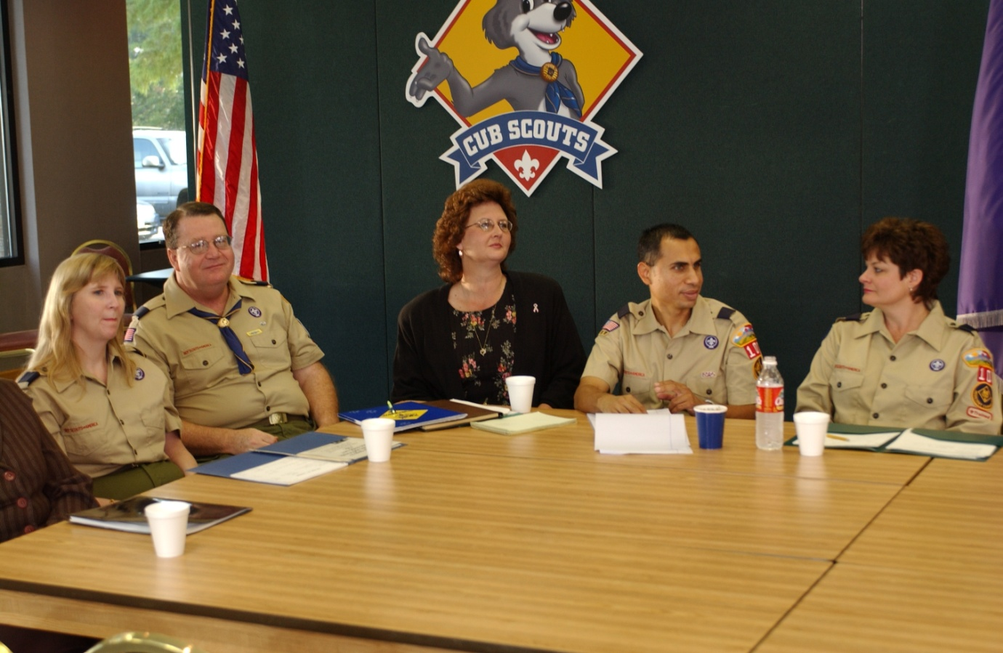
The Pack Committee
Notes:
Say (in your own words):
Welcome to the pack committee training.
Do:
Introduce yourself and the other trainers.
Make sure you use a lot of energy.

Slide 2
Objectives
Define the role of the pack committee.
Describe the makeup of the pack committee.
List the people who support the pack committee.
Explain the pack planning process.
Discuss how packs are funded.
Describe where packs get help.
Notes:
Say (in your own words):
This session will show you what it takes to be a member of a Cub Scout pack committee.
Do:
Briefly discuss each objective.
Call the committee meeting to order.
You may wish to lead a brief interfaith prayer or thought for the day as part of your meeting opening.

Slide 3
The Pack
Chartered Organization
Chartered Organization
Representative
Local Council
Pack Committee
Pack Trainer
Cubmaster
Assistant Cubmaster
Tiger Cub Den Leaders
Cub Scout Den Leaders
Webelos Den Leaders
Adult Partners
Assistant Cub Scout
Den Leaders
Assistant Webelos
Den Leaders
Den Chief
Den Chief
Den Chief
Notes:
Say (in your own words):
The pack committee is the administrative part of the pack structure. The committee
chair is like a CEO. The committee members are key to the success of the pack in many
different ways.
Do:
Briefly discuss the location of the pack committee in the pack structure.
Resource: Cub Scout Leader Book

Slide 4
The Pack Committee
Oversees the development of the annual pack plan including:
Pack calendar
Pack budget
Pack leadership
Selects leadership
Provides program support
Provides a safe meeting location
Helps with charter renewal
Supervises finances and equipment
Works closely with the Cubmaster
Notes:
Say (in your own words):
The pack committee is responsible for these activities.
Do:
Briefly discuss the roles on the slide. Add that this is just an overview.
Resource: Cub Scout Leader Book, Responsibilities of the Pack Committee
handout in the back of this book

Slide 5
Pack Leaders
 | Member of Pack Committee
Chartered organization representative | X
Pack committee chair and members and/or parent coordinator—three registered leaders required | ☑
Pack trainer | X
Cubmaster and assistant | X
Den leaders and assistants | X
Den chiefs | X
Notes:
Say (in your own words):
The pack functions because of the various adult leaders who have volunteered to help
the boys.
Do:
Briefly discuss the qualifications and required positions. Since the committee is
responsible for selecting and approving leaders, it is important for them to hear
and understand this information.
Resource: Cub Scout Leader Book, Responsibilities of the Pack Committee
handout in the back of this book

Slide 6
Pack Committee Functions (Members)
Chair
Secretary
Treasurer
Advancement
Public relations
Outings
Membership and re-registration
Friends of Scouting
Some pack committees may not have all positions!
Notes:
Say (in your own words):
Not all pack committees are the same. Some packs have many volunteers and can have
each of these positions filled with a different person. Other packs have fewer volunteers
and may have one person supporting for more than one position.
Do:
Hand out position responsibilities and explain the responsibilities of each of
these committee positions and why they are necessary for the pack to succeed.
Explain that these roles represent the voting members of the pack committee.
The Cubmaster is not a voting committee member unless he or she also holds one of
these roles.
Resource: Cub Scout Leader Book, Responsibilities of the Pack Committee handout in
the back of this book

Slide 7
The Pack Committee Is Supported by the
Chartered organization
District and council, through
Commissioners
District Cub Scout roundtables
District committee
District executive
District training team
Notes:
Say (in your own words):
Thank you for your committee reports. I want to assure you that the pack does
not function in a vacuum. There are many sources of support for the pack.
Do:
Discuss the role of the chartered organization representative and the chartered
organization in helping the pack.
Describe the remaining district and council supporting people. Explain that
commissioners are unit service people who volunteer to help packs succeed and
that not all units have a commissioner.

Slide 8
Pack Policies
Pack bylaws
Bank account control
Asset control
Insurance
Tour permits
Adult recruitment and training
Enforce two-deep leadership
Notes:
Say (in your own words):
Packs need to develop policies to clarify how the pack operates and to avoid
problems. Pack bylaws cover many different aspects of pack operation.
Do:
Describe why having policies is important.

Slide 9
Cub Scout Advancement
Encouragement and recognition of achievement
Grade-related and progressive
A tool for parents
The role of parents changes
Notes:
Say (in your own words):
The boys join Cub Scouting to have fun. The adults support that by helping
them achieve something while having fun. Lord Baden-Powell, the founder of
Scouting, said, “Scouting is a game with a purpose.”
Do:
Review the reason for advancement in Cub Scouting. Suggest that the pack committee
plays a big role in the advancement success of the boys through the development
of an active and exciting program.

Slide 10
Parents and Advancement
Tiger Cub parents are “adult partners.”
Cub Scout parents work with their boys.
Webelos leaders work directly with Webelos Scouts.
Parents are encouraged to serve as activity badge counselors.
Notes:
Say (in your own words):
Remember that boys will advance with the help of adults. Tiger Cubs rely on their
adult partners. Cub Scouts have family adults as their advancement helpers. Webelos
Scouts advance with the help of their den leaders.
Do:
Explain that while parent involvement in advancement changes as the boys get older,
parent involvement in the pack should increase. Parents will have more time to help
the pack succeed since they are spending less time helping their boys to advance.

Slide 11
Cub Scout Uniforming
Sense of belonging
An equalizer—all Cub Scouts are the same
Recognition
Encourages proper behavior
Identification with Scouting
Promotes advancement
Notes:
Say (in your own words):
We have discussed uniforms before, but I want to remind you that uniforms are
important.
Do:
List the points on the slide.
Talk about local resources for uniforms, which may be a local council Scout shop
or store. Suggest the use of a uniform “chest” at the pack level—a pack uniform
exchange, where graduating Tiger Cubs, Cub Scouts, and Webelos Scouts can
donate “experienced” uniforms for younger boys.
Adults should be properly uniformed to set the example for the boys.
Resource: Cub Scout Leader Book

Slide 12
Summary
The role of the pack committee
Advancement
Grade-based and progressive
Parents are key to advancement for Tiger Cubs and Wolf and Bear Cub Scouts.
Leaders are key to advancement for Webelos Scouts.
Leaders set uniforming example for everyone.
Notes:
Say (in your own words):
We have discussed what the committee does, reviewed advancement, and talked
about uniforming.
In the next section, you will be learning about how to plan a pack program and
prepare a pack budget.
Do:
Take a break at this time.
You may wish to include a morale feature to enhance the training experience.

Slide 13
Planning in the Pack
Annual program planning conference
The monthly pack committee meeting
Pack built around monthly Core Values
Core Values tie each pack meeting together
Notes:
Say (in your own words):
Planning is another part of pack success. On a yearly basis, the pack will plan
various activities to meet the needs of the boys. Planning for pack meetings is also
essential. While the Cubmaster plans each pack meeting, the pack committee assists by
planning the overall year.
Do:
Suggest that two different types of planning meetings are necessary: the annual
pack planning conference in late spring or early summer to plan the next year’s
activities, and the monthly pack planning meeting to look at the next month’s
activities and planning needs.
Resource: Cub Scout Leader Book

Slide 14
Key Outcomes of Annual Pack Planning Meeting
Pack schedule
Pack budget
Pack leadership
Notes:
Say (in your own words):
The annual planning meeting is the time to set the direction of the pack for the
upcoming Scouting year. It is the most important Scouting meeting.
Do:
Discuss the importance of planning the pack’s calendar, budget, and leadership,
and communicating the outcome early to the pack family.
Tell leaders about the pack program planning chart and how it can be used to
build the pack’s program for the year.
Resource: Cub Scout Leader Book

Slide 15
Yearly Planning Cycle–1
Spring update meeting
Summertime activities
Camping—Scouting-approved programs
Picnics and other outings
Summertime Pack Award
Begin planning pack budget
Cub Scouting is a year-round program!
Notes:
Say (in your own words):
The Cub Scout Leader Book is the guide for pack program planning. Here is a
partial list of activities to plan.
Do:
Discuss things that have to be accomplished on a yearly basis, including
summertime activities. More information is on the next slide.
Resource: Cub Scout Leader Book

Slide 16
Yearly Planning Cycle–2
Fall recruiting
New den formation
Leader training
Charter renewal
Blue and gold banquet—February
Include council and district activities
Fund through unit budget plan
Notes:
Say (in your own words):
And here are some more pack planning requirements.
Do:
Introduce the additional activities. Highlight that these represent activities
that require planning for a successful pack. Others may be added as the pack
committee develops the yearly plan.
Resource: Cub Scout Leader Book

Slide 17
Activities
Pack meetings
Belt Loop/Pin Activities
Hiking Clubs
Camping
Outings
Derbies and regattas
Council and district activities
Cub Scouting is a year-round program!
Notes:
Say (in your own words):
The pack committee supports the den leaders by planning many different types
of activities to interest the boys. Varying activities throughout the year and from
year to year keeps the boys enthusiastic about the program.
Do:
Reinforce that Scouting is a year-round program. Planning events to occur
throughout the summer keeps the boys and their families active and motivated.
Even though summer family schedules can become difficult, the pack should
still plan and conduct events.
If possible, show a calendar of district and council events that the packs may attend.
Show a completed pinewood derby car or raingutter regatta boat.

Slide 18
Cub Scout Camping
Cub Scout day camp
Cub Scout/Webelos Scout resident camp
Webelos Activity Badge Days
Northern Star Council
Three Rivers Park District
Council-organized family camping
Pack overnighters
Be sure to include pack camping in your annual program plans.
Notes:
Say (in your own words):
Most boys join Scouting to camp. Cub Scouting offers several different
camping opportunities for Cub Scouts through day camps, resident camps,
Webelos den overnight campouts, council-organized family camps,
and pack overnighters.
Do:
Describe local day camp programs and provide information about local
camping opportunities.
Explain the difference between family camping and pack camping. Emphasize
to the participants that pack camping may be done only at council-approved
locations and must be attended by a BALOO (Basic Adult Leader Outdoor
Orientation)-trained leader.
Resource: Cub Scout Leader Book

Slide 19
Cub Scout Pack Meetings
Before the Meeting
Gathering
Opening
Program
Recognition
Closing
After the Meeting
Notes:
Say (in your own words):
While the Cubmaster plans and conducts the pack meeting, the committee
plays an important part in its execution.
Do:
Discuss how the committee helps make the pack meeting a success:
1. Planning activities based on Core Values
2. Finding a location
3. Selecting the pack leadership
4. Providing money for snacks
5. Creating fliers for upcoming events
6. Conducting uniform inspections (prior to re-registration)
7. Planning a summer outdoor pack meeting
8. Securing advancement awards
Ask which committee member would be responsible for each of the tasks above.

Slide 20
Let’s Plan a Cub Scout Year
Notes:
Say (in your own words):
It’s time to plan a year for your pack. Once your plan is put together, it must
be supported by the pack budget. We will talk about that next.
Do:
Using the Pack Program Planning Chart, explain each of the rows and columns.
Point out that the Den & Pack Meeting Resource Guide has pre-planned den and
pack meetings. Packs are encouraged to use this successful resource or they must
develop their own monthly programs.
Den-home projects: Projects may be planned to help the pack minimize cost.
If all dens use the same project, buying in bulk can reduce cost.
Pack Activities: Record the dates of the pack meetings and pack leader meetings. Consider
various activities to make the boys’ experience a lot more exciting. Pinewood derby,
pack camping, and other activities should be considered. Remember summertime activities
as well.
Show a council and district calendar and highlight a few planned activities that are available.
Webelos den leaders may choose to rearrange the order of the activity badges their
dens complete. The pack committee can provide support for the dens by locating special
resource people to help the boys complete their activity badges. Record the days that the
Webelos dens will be camping.
Here is where you record the pack service projects and other similar activities. In this area,
you also need to record the dates of registration, the blue and gold banquet, and membership rallies.
Create small groups of up to five. Have them plan a pack year. Provide each group with a
copy of the Den & Pack Meeting Resource Guide, the local council and district calendar,
and the Pack Program Planning Chart. At the end of 15 minutes, have one or
two of the groups share their chart.
Resources: Cub Scout Leader Book, Den & Pack Meeting Resource Guide,
Pack Program Planning Chart, council and district calendars

Slide 21
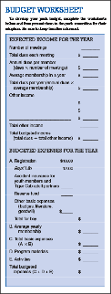
Pack Budget Plan
Who?
When?
What?
How?
Notes:
Say (in your own words):
We need to provide money for the pack program. Our pack budget plan will
help us do that.
Do:
Prepare for this section by carefully reviewing the Cub Scout Leader Book. It
describes how things should work.
Explain who pays for Scouting: the boys and their families, the chartered organization,
the pack, and the community.
The Pack Budget Plan helps the pack raise and manage the money need to
keep the pack functioning.
Discuss the following:
Who is responsible? The pack committee must plan for both income and expenses.
When? At the annual pack program planning conference.
What? The planned activities, the amount of money needed, and how to raise it.
How? Explain the budget to the pack and pack parents. Get approval.
Pack Budget Plan is available at www.scouting.org/cubscouts/resources/packbudget;
it may also be available through your local council service center. It contains a four-page
pack budget plan, complete with instructions and an easy-to-use form.
Resources: Cub Scout Leader Book, Pack Budget Plan

Slide 22
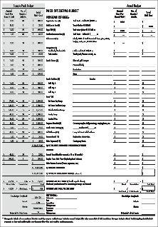
Pack Budget Plan
Registration
Boys’ Life
Unit accident insurance
Reserve fund
Other expenses
Program materials
Activities and camps
Notes:
Say (in your own words):
Expenses will determine how much money needs to be raised each year.
Do:
Discuss the suggested expense categories listed in the slide.
(The form on this slide is from the Pack Budget Plan.)
Resources: Cub Scout Leader Book, Pack Budget Plan

Slide 23
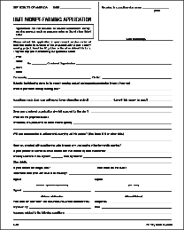
Earning Money
Weekly or program year dues
Family and leader registration
Chartered organization
The pack
The community
Unit money-earning projects (requires council approval)
Notes:
Say (in your own words):
Money for Cub Scouting comes from many different sources.
Do:
Explain that family and leader registration fees come from the individuals. It’s
important to include registration fees and Boys’ Life subscription costs in the
registration fee income of the pack.
Say that some chartered organizations provide funding for their packs while others
provide facilities only; each situations is different.
Discuss that the pack can do a fund-raising activity. Some local councils provide a
councilwide fund-raising project, and in some cases, packs can get sufficient funding
from this to pay for all pack activities and registrations.
Discuss community support: The community supports Scouting through donations
to the BSA local council.
Note that Cub Scout packs may not solicit monetary donations from individuals or
businesses in the community, or seek sponsorships of the pack.
Point out that fund-raising must represent the best of Scouting. Products must be of
high quality, yet not substantially compete with local merchants. Emphasize
that the uniform may not be worn during any fund-raising activity unless approved
by the local council.
Remind participants that all money-earning activities must be approved by the
local council in advance. This is accomplished by filing a Unit Money-Earning
Application with the council well before you plan to begin the activity.
Resources: Cub Scout Leader Book, Unit Money-Earning Application

Slide 24
Let’s Build a Budget
Notes:
Say (in your own words):
It’s time to look at the budget process.
Do:
Assist the participants in completing a budget. Using the same groups as before.
After 10 minutes, have two of the groups discuss their budgets.
Resource: Sample Unit Budget handout

Slide 25
Pack Success
Journey To Excellence – http://programtools.northernstarbsa.org
Leader training
Functioning pack
Membership
Activities
On-time charter renewal
Notes:
Say (in your own words):
With proper planning and funding, a pack is ready to succeed. You can evaluate
the success of your pack through the Centennial Quality Unit Award.
Do:
Discuss what makes a unit a quality unit. Use the slide.
Show the Centennial Quality Unit Award form from www.scouting.org or a
local council service center.

Slide 26
Cub Scouter Award
Tenure
Complete two years as a registered adult leader in a Cub Scout pack
Training
Complete Fast Start training for your position, Youth Protection training, position-specific training for pack committee member, and This Is Scouting.
Attend a Cub Scout leader pow wow or University of Scouting, or at least four roundtables.
Notes:
Say (in your own words):
After all of this hard work, it is time for a reward for committee members.
Do:
Discuss the requirements for the Cub Scouter Award.

Slide 27
Review and Questions
Notes:
Say (in your own words):
Do you have any questions?
Do:
Solicit questions and supply answers.

Slide 28
Congratulations!
Notes:
Say (in your own words):
Thank you for attending this important training session.
Do:
Present the participants with their training cards. Training certificates may also
be presented. Do this with enthusiasm.
Conduct a closing activity to adjourn the pack committee meeting.
Confirm completion of all elements of the Trained Leader requirements before
authorizing the “Trained” status.

