Slide 1
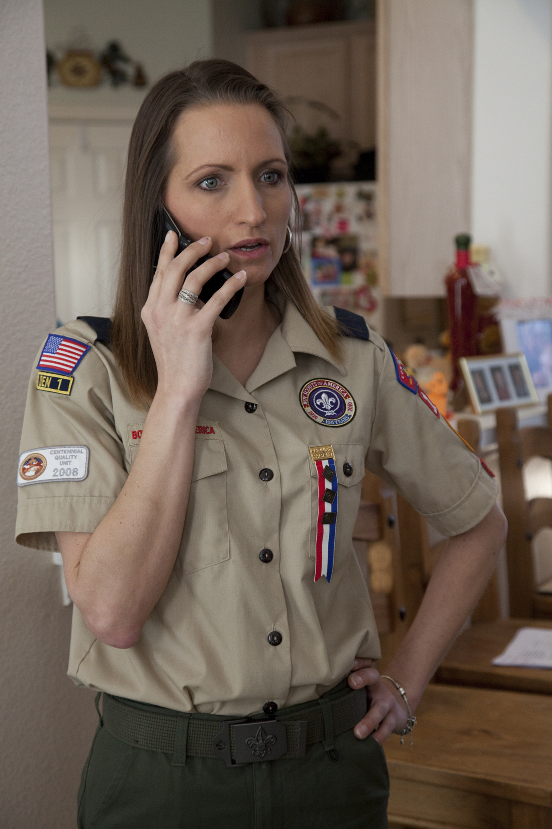
The Pack Trainer
Notes:
Say (in your own words):
Welcome to Training for the Pack Trainer. My name is _____. The other trainers
are _______. We are here to help you learn about your role in the pack and
how that will affect the lives of boys.
Do:
Be sure that you exhibit energy and enthusiasm as you introduce yourself and
the other trainers.

Slide 2
Objectives
Discuss the role of the pack trainer.
Describe the required training for
Cub Scout leaders.
Describe the supplemental training for
Cub Scout leaders.
Notes:
Say (in your own words):
This session will show you what it takes to be a pack trainer.
Do:
Briefly discuss each objective.

Slide 3
How Pack Trainers Help
Conducting orientation of new families and
pack leaders
Encouraging new pack leaders to participate in online training and attend Cub Scout Leader Basic Training, which includes Cub Scout Leader Position-Specific Training and This is Scouting
Helping with Unit Leadership Enhancements during pack leaders’ and/or committee meetings
Notes:
Say (in your own words):
The pack trainer is an important contributor to the success of the pack. This
individual is an experienced Cub Scout leader who helps the other pack leaders
learn about their responsibilities and provides training for them as needed.
Do:
Reinforce the pack trainer responsibilities listed on the slide. Refer to the
Cub Scout Leader Book and the Pack Trainer Position Summary handout for
additional information.
Resources: Cub Scout Leader Book, Pack Trainer Position Summary handout
in the back of this book

Slide 4
How Pack Trainers Help
Conducting other training as designated by the district and/or council
Encouraging pack leaders to attend ongoing training, such as roundtable, pow wow, BALOO, Outdoor Leader Skills for Webelos Leaders, and Wood Badge
Notes:
Say (in your own words):
Pack trainers may also be asked to help with district and council training activities.
Do:
Suggest that by doing additional training, the pack trainer becomes more qualified
to help the pack. That example encourages pack leaders to attend other training
events to improve their own skills.
Resource: Cub Scout Leader Book

Slide 5
How Pack Trainers Help
Remaining current on training materials and program updates
Keeping track of pack training records
Encouraging den chiefs to attend
den chief training
Notes:
Say (in your own words):
The pack trainer is also a valuable resource person. As an experienced
leader, the pack trainer knows where to look for new training materials and how
to recognize program changes.
Do:
Discuss sources for new information such as district roundtables, Scouting magazine,
the district executive, the district committee, and other similar sources.
Ensure that the pack trainers understand that they are responsible for preparing
and submitting training reports for those events that they host.
Resource: Pack Trainer Position Summary handout in the back of this book

Slide 6
New Parent Orientation
Immediately provide information and an orientation to new parents in the pack.
Ease the transition to Scouting.
Family orientation is covered in the
Cub Scout Leader Book.
Notes:
Say (in your own words):
One of the most important duties of the pack trainer is to provide an orientation
meeting for new parents in the pack.
Do:
Discuss how the orientation can help the parents and boys move successfully into
the pack family. Suggest that the participants review the Cub Scout Leader Book.
Resource: Cub Scout Leader Book

Slide 7
Unit Leadership Enhancements
Provide information to leaders during pack
adult meeting
Topics:
  Advancement
  Annual program planning
  Character development
  Cub Scout camping
  Family involvement
  Leadership training
  Membership
  National awards
  Pack budget plan
  Pack committee
  Pack meetings
  Planning special events
  Policies of the BSA
  Program evaluation
  Youth Protection
Notes:
Say (in your own words):
Another duty of the pack trainer is to conduct Unit Leadership Enhancements.
These sessions are conducted during pack leaders’ and/or committee meetings.
Do:
Review the listed Unit Leadership Enhancements.
Suggest that the pack trainer review the pack meeting plans from the Den &
Pack Meeting Resource Guide for the scheduled Unit Leadership Enhancements
and arrange with the pack committee chair to include this training in
monthly pack planning meetings. Presentations must be prepared in advance.
Resource: Cub Scout Leader Book

Slide 8
Leadership Skills
Shared leadership
Teamwork
Cooperation
Communication
Attitude
Setting the example
Notes:
Say (in your own words):
The pack trainer must possess these skills.
Do:
Ask the participants why each of these skills is necessary for the pack trainer.
Evaluate their responses and provide additional ideas when necessary.

Slide 9
Required Leader Training
Youth Protection—immediately (online)
  Available through district or council.
  Can be delivered by pack trainer.
Position-Specific—as soon as possible
Fast Start—immediately or within a week
This Is Scouting (online)
Notes:
Say (in your own words):
The training continuum includes the courses listed. Fast Start gets the leaders
ready to begin. The position-specific courses give the leaders a hands-on
overview of their jobs and provides more details on the whys and hows of the Boy
Scouts of America. Youth Protection Training is required for all leaders to
be “trained.”
Do:
Discuss how Youth Protection Training is presented in your council and/or
district. It is available online.
Resource: Cub Scout Leader Book

Slide 10
Survey of Cub Scouting
Leader Training
Introduction
  What Is Cub Scouting?
  How We Have Fun
Position-Specific training
  Den Leaders
  Cubmaster
  Pack Committee Chair and Member
Notes:
Say (in your own words):
Cub Scout leader position-specific training has recently been rewritten to focus
on the needs of the new leaders in the positions listed.
The first two sessions, What Is Cub Scouting? and How We Have Fun, explain
the Cub Scout program and should be attended as soon a possible after volunteering.
Training for specific positions should be done soon after that.
Do:
Tell participants that position-specific training is taken after Fast Start. Note that
pack trainer is not included, since the participants are attending that course now.
Reinforce that position-specific training is a hands-on, interactive approach to
put tools in the hands of the new leaders as soon as possible after they volunteer.
Make sure that the participants understand that once the new leader has completed
the first two sessions, there is no need to repeat them. For example, if a Cub Scout
den leader has completed the necessary training and then moves to Webelos den
leader, the only training needed would be Webelos Den Leader Training. This could
be delivered by the pack trainer in the pack setting at the end of the pack year or
before the boys move to the Webelos den.
Position-specific training may also be delivered by the district or council.
Resource: Cub Scout Leader Position-Specific Training, No. 34875

Slide 11
Supplemental Leader Training
Roundtable
University of Scouting
BALOO—Basic Adult Leader Outdoor Orientation
Outdoor Leader Skills for Webelos Leaders
Council or district supplemental
Philmont Training Center opportunities
Notes:
Say (in your own words):
Once the new leaders have completed their “basic training,” other opportunities
to learn new skills are available. These training opportunities are offered
by the district or council in most cases.
Do:
Briefly list the courses and explain that more details will be available later.
Resource: Cub Scout Leader Book

Slide 12

Roundtable
Monthly meeting
Conducted by district commissioner staff.
Program information
Planning assistance
Den and pack ideas
For all leaders!
Notes:
Say (in your own words):
The Cub Scout roundtable provides leaders with monthly updates on program
and activities.
Do:
Ask the participants why they think roundtable is important.
Discuss the importance of roundtables in making sure that leaders have current
information and program ideas.
Reinforce that roundtable is for all leaders, not just Cubmasters and committee chairs.
Resource: Cub Scout Leader Book

Slide 13
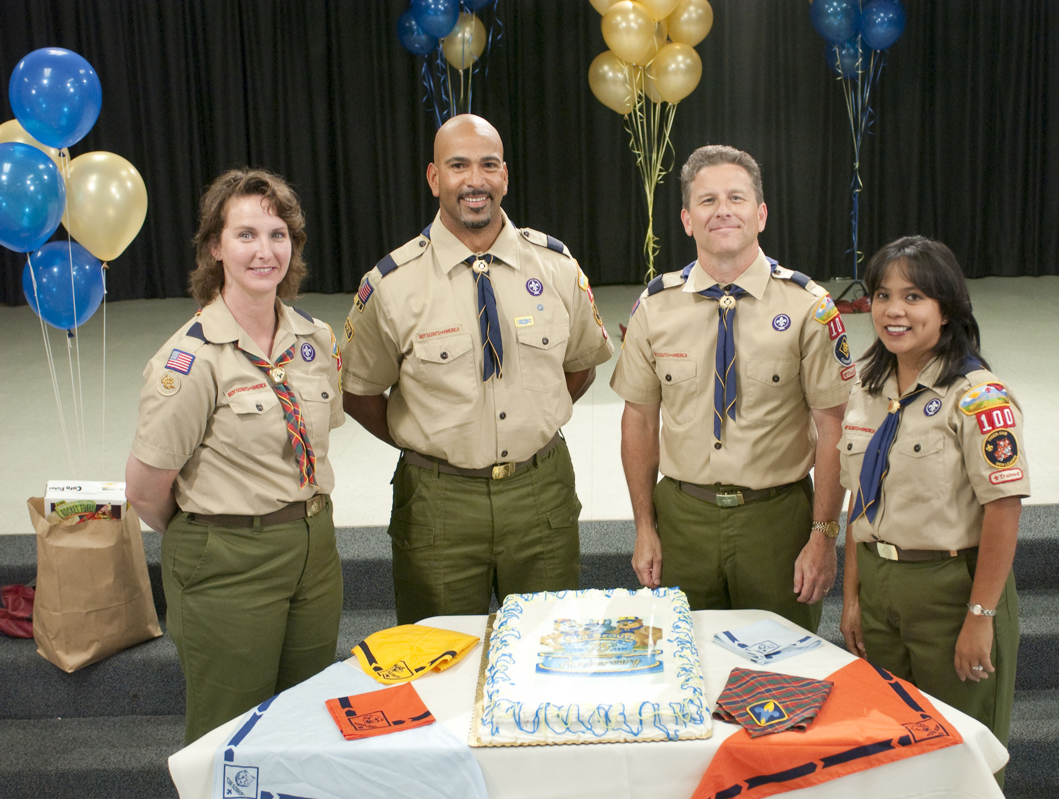
University of Scouting
Some councils hold this event.
Combines Cub Scouting, Boy Scouting, Venturing, and commissioner service.
Day-long event
Broad range
of subjects
Notes:
Say (in your own words):
All types of leaders in one location, learning together: That’s the University
of Scouting.
Do:
Discuss that some councils will also offer a larger training event called a
University of Scouting that includes not only Cub Scout leaders but leaders in all
other programs as well.
Other supplemental training may be offered at local option with locally
determined content.
Resource: Cub Scout Leader Book

Slide 14
BALOO
Basic Adult Leader Outdoor Orientation
  Required for pack to camp at council-
  approved locations
  At least one person per unit
  How to prepare and conduct an overnight activity
Notes:
Say (in your own words):
Boys love to camp, and this training course prepares pack leaders for conducting
a pack overnight camping experience at a council-approved facility.
Do:
Discuss the purpose of training. BALOO is required training for one
member of a pack who organizes and conducts an authorized pack
camping activity.
Resource: Basic Adult Leader Outdoor Orientation (BALOO)

Slide 15
Outdoor Leader Skills for Webelos Leaders
Planning and activities
Basic skills
  Camping essentials
  Knots and ropes
  Tents and packs
  Outdoor activity badges
  Cooking and sanitation
  How to have fun
Notes:
Say (in your own words):
Outdoor Leader Skills for Webelos Leaders is a day-long event that helps
the leaders be able to prepare and conduct Webelos overnight campouts.
Do:
List the skills taught in the course.
Discuss the requirement for and purpose of Outdoor Leader Skills for Webelos Leaders.
Note that this training must be completed to earn the Webelos Den Leader
Recognition Award (knot).
Resource: Outdoor Leader Skills for Webelos Leader

Slide 16
Den Chief Training
For Boy Scouts and Venturers who are filling a den chief leadership position.
Fast Start (online) provides immediate help
when Scout or Venturer is appointed.
Den chief conference provides:
  Structure of den meeting
  Games and activities
  How den chiefs can help the den leader
Notes:
Say (in your own words):
The den chief is a Boy Scout or Venturer who helps the den leader.
Do:
Provide information about the upcoming den chief training sessions in your
council or district.
Resources: Cub Scout Leader Book, Den Chief Training

Slide 17
Safety Training
Youth Protection (online)
Health and safety
Safe Swim Defense (online)
Safety Afloat (online)
First aid
CPR
Notes:
Say (in your own words):
Safety of all boys and adults is an important part of any Scouting activity. Safety
training is available for these areas.
Do:
Discuss that training is available online for Youth Protection, Safe Swim
Defense, and Safety Afloat. Health and Safety training are available through
the local council or district. First Aid and CPR training is available from local
resources such as the Red Cross or the American Heart Association.
Provide local resources to the participants for non-BSA courses.
Resources: Cub Scout Leader Book, www.olc.scouting.org

Slide 18
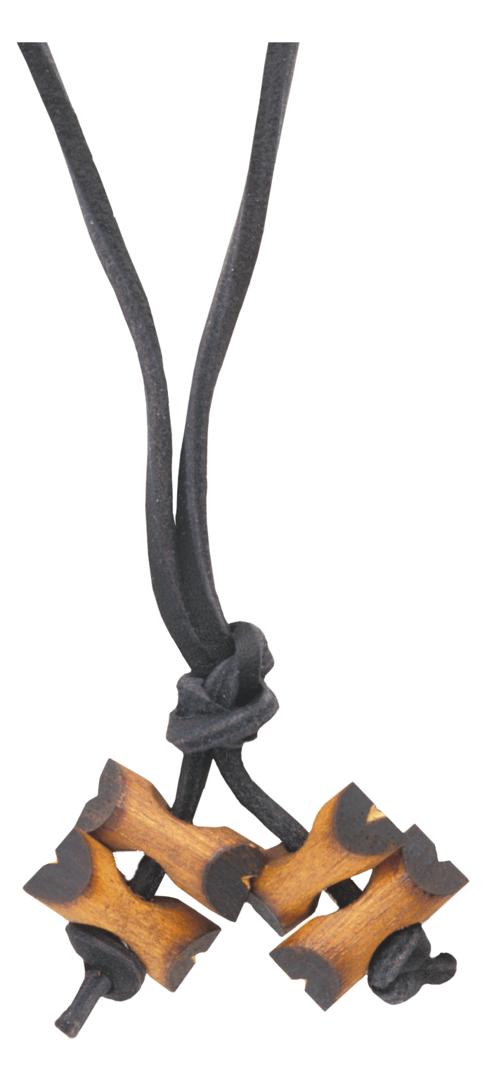
Wood Badge
Advanced leadership training
Weeklong or two extended
weekends
Focuses on five leadership areas.
Skills that apply to home,
work, and Scouting.
Notes:
Say (in your own words):
Earning your beads and learning leadership skills at the same time: This is Wood Badge.
Do:
Explain the Wood Badge program. Highlight the points on the slide. Remind the
participants that all trained leaders are eligible to attend Wood Badge.
Resource: Cub Scout Leader Book

Slide 19
Philmont Training Center
Open to all Scouting leaders
Family-oriented activities
Cub Scout courses
Notes:
Say (in your own words):
The Philmont Training Center at Philmont Scout Ranch provides
additional training opportunities.
Do:
Explain that Philmont Scout Ranch in northern New Mexico is a Scouting paradise.
Most people know of Philmont because of the backpacking adventures
for the boys. Philmont also provides adult leader training opportunities and family
programs for Scouting leaders who want just a little bit more in a training experience.
Note: Review the upcoming Philmont training schedule before this session so
that you can provide current information to the participants.
Resource: www.scouting.org/philmont

Slide 20
Pack Training Records
Unit Inventory of Training – work in conjunction of charter
Training Attendance Report
Training Status Change
There will be issues, stay vigilant, help get corrections to Council
Notes:
Say (in your own words):
Successful pack training depends on accurate records. Three training records
are available to help keep track of who was trained, what they were trained in,
and when the training occurred.
Another reason to keep track of training records is to assure that the leaders
receive the recognition they deserve.
Do:
Refer the attendees to the Leadership Training Committee Guide.
Distribute a copy of the Unit Inventory of Training form. Explain the different
areas of the form and how it can be used to keep track of training activity.
Distribute a copy of the Training Attendance Report. Explain that this form is used
to send to the district or council registrar to update the training completion for each
individual attending the course. This form should be submitted as soon as practical
after the completion of the course.
An additional form, the Training Status Change, may be used by the district
or council.
Show the different “score cards” for the leadership recognition awards in the Leadership
Training Committee Guide. Tell the participants that changes to the requirements
are found in this book as it is revised.
Resource: Leadership Training Committee Guide

Slide 21
Resources
Cub Scout Leader Book
Cub Scout Leader How-To Book
Webelos Leader Guide
Scouting magazine
Boys’ Life
Council and district calendar
Council and district training teams
Trainer development conference
Notes:
Say (in your own words):
Pack and den leaders need to know where to find answers to their questions.
These resources provide the answers.
Do:
Discuss how these resources can help the leaders succeed.
Ask the participants to tell about additional resources that could be useful.
These might include the following:
Den & Pack Meeting Resource Guide
Webelos Den Leader Guide
Scouting magazine
Local council newsletter and Web site
Cub Scout roundtable
www.scouting.org
The Internet

Slide 22
Resources
Leadership Training Committee Guide
Guide to Safe Scouting
National, council, district, and unit Web sites
Youth handbooks
Notes:
Say (in your own words):
How can these items help the pack trainer?
Do:
Explain that the more the pack trainer knows, the more help the trainer can
provide to other leaders.
Ask how the youth handbooks can be helpful to the pack trainer. One answer
might be that they help the pack trainer remember what the den leaders are hoping
to accomplish with the boys.

Slide 23
Pack Trainer Award
Tenure
  Complete two years as a registered pack trainer.
Training
  Complete Fast Start training for the
  pack committee.
  Complete Youth Protection training.
  Be familiar with and able to explain the key elements of position-specific training for all volunteer positions in the pack.
  Complete This is Scouting.
  Participate in a trainer development conference.
  Complete Leader Position-Specific Training
  for Pack Trainer
Notes:
Say (in your own words):
Remember to get recognition for the important job that you do.
Do:
Review the requirements for the Pack Trainer Award.
Resource: Leadership Training Committee Guide, the Cub Scout Leader Book

Slide 24
Review and Questions
Notes:
Say (in your own words):
Any question or comments?
Do:
Answer any questions asked.

Slide 25


Congratulations!
Notes:
Say (in your own words):
Thanks for attending Training for the Pack Trainer.
Do:
Use an inspirational phrase or presentation to give the participants a boost in
moving forward. Here is one possibility:
Someone once said, “Everyone needs a child to teach. It’s the way adults learn.”
By teaching adults, you reach down to every boy and learn more yourself.

